Slide 1
From Evidence to Action: Lessons from Ethiopia on scaling Multiple Micronutrient Supplementation (MMS)
Masresha Tessema (PhD) , July 9, 2026

Slide 2

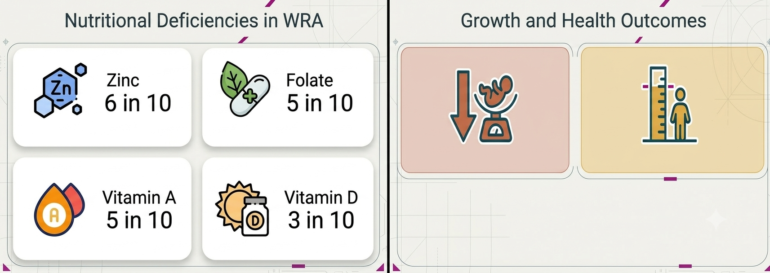

Motivation
Ethiopia is high burden of LBW
Stunting is major public health problem, limit child long-term ability

Slide 3
Global Evidence
Evidence
Dimension | IFA Baseline | MMS
Formulation | 2 nutrients | 15 nutrients
Global | Standard | WHO Recommended: “in the context of rigorous research”
Historical Efficacy | Available | 2019 Cochrane Review: 13% reduction in LBW,9% reduction in Small for Gestational Age
To operationalize WHO recommendation, Ethiopia required localized, rigorous evidence

Slide 4
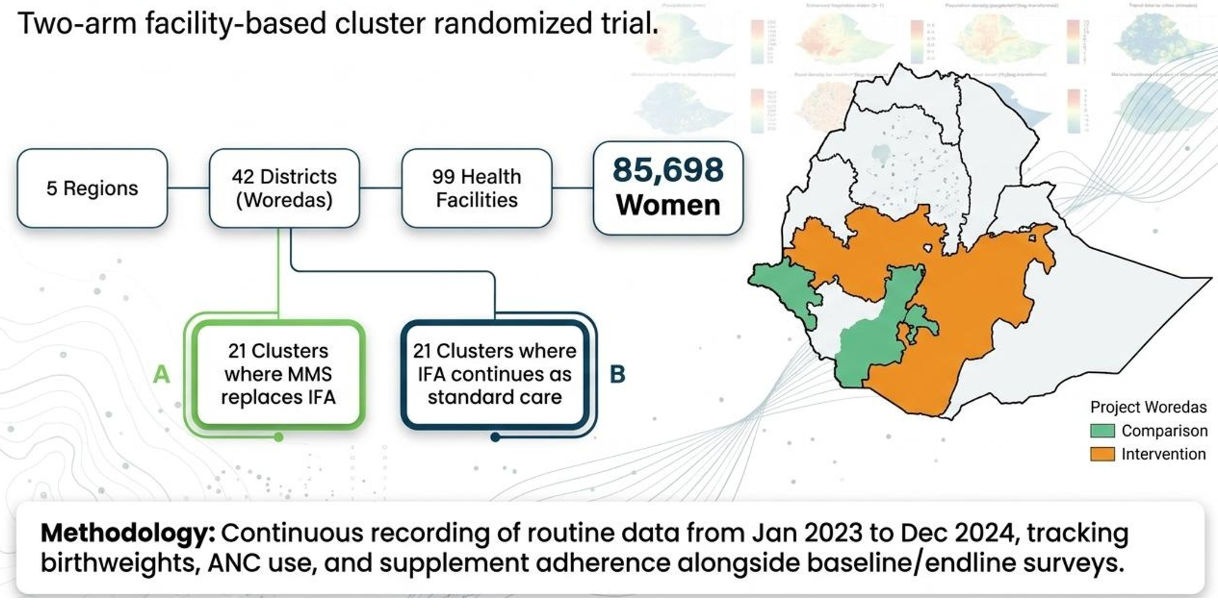
The evaluation design
5 regions, account about 60% total population

Slide 5
The evaluation design
•
Objectives:
• • •
Effectivenessof MMS on mean birth weight, including cost and cost-effectiveness.
Effective coverage of the program.
Qualitative evidence on the mechanisms of change
•
Tools and methods of data collection
Continuous recording of routine data period Jan 2023 – Dec 2024:
o o
Birth weight for all live newborns whose mothers give consent, and
Recording of mother’s use of ANC and use of nutritional supplements
•
Baseline, midline and endline facility, health worker and womens survey on processes and costs

Slide 6

How the evaluation was implemented in practice?
Notes:
Early engagement and consensus on the evaluation results.
Ownership of government and lower level of engagement.
Effective coordination and planning: close collaboration and partnership:
implementers, evaluators and CIFF.
Regular feedback.
Capacity building: enhanced training to improve knowledge and manage stock, built data literacy at district level.
Able to use routine data.
Routine monitoring and follow up

Slide 7
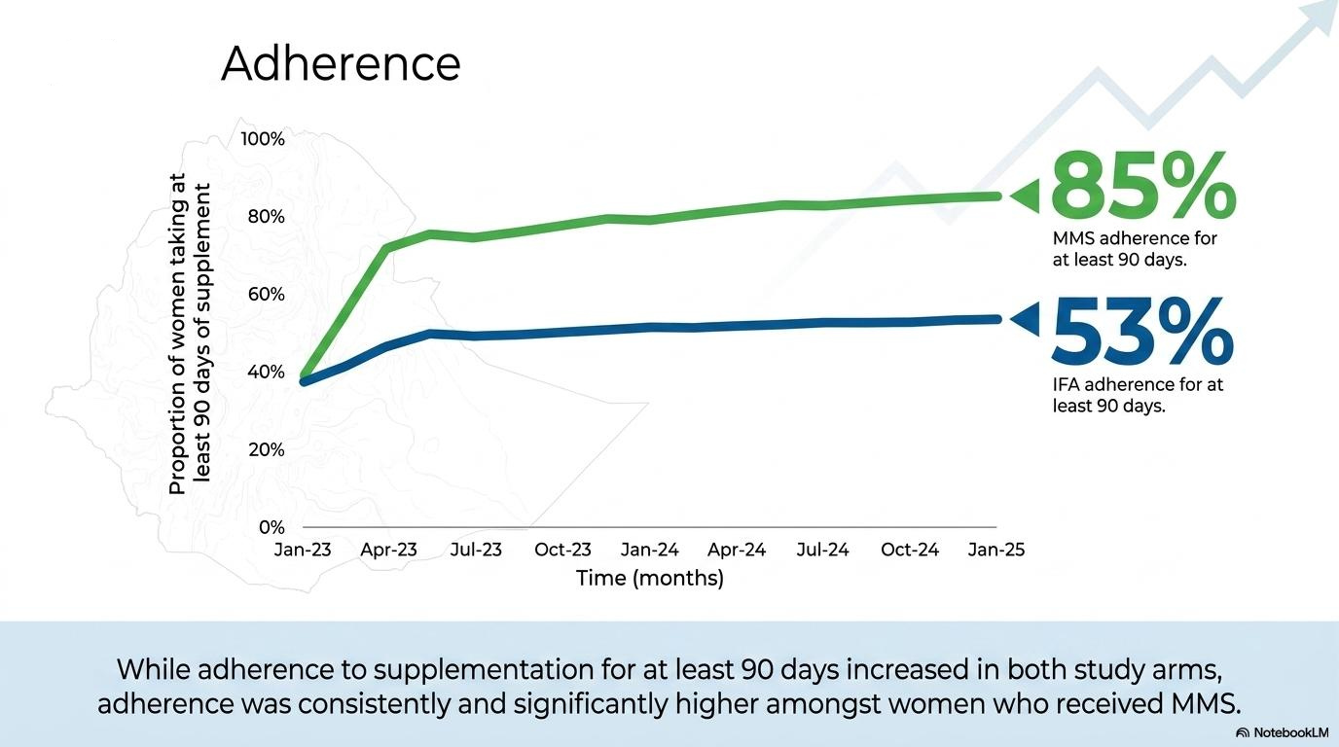
Results

Slide 8
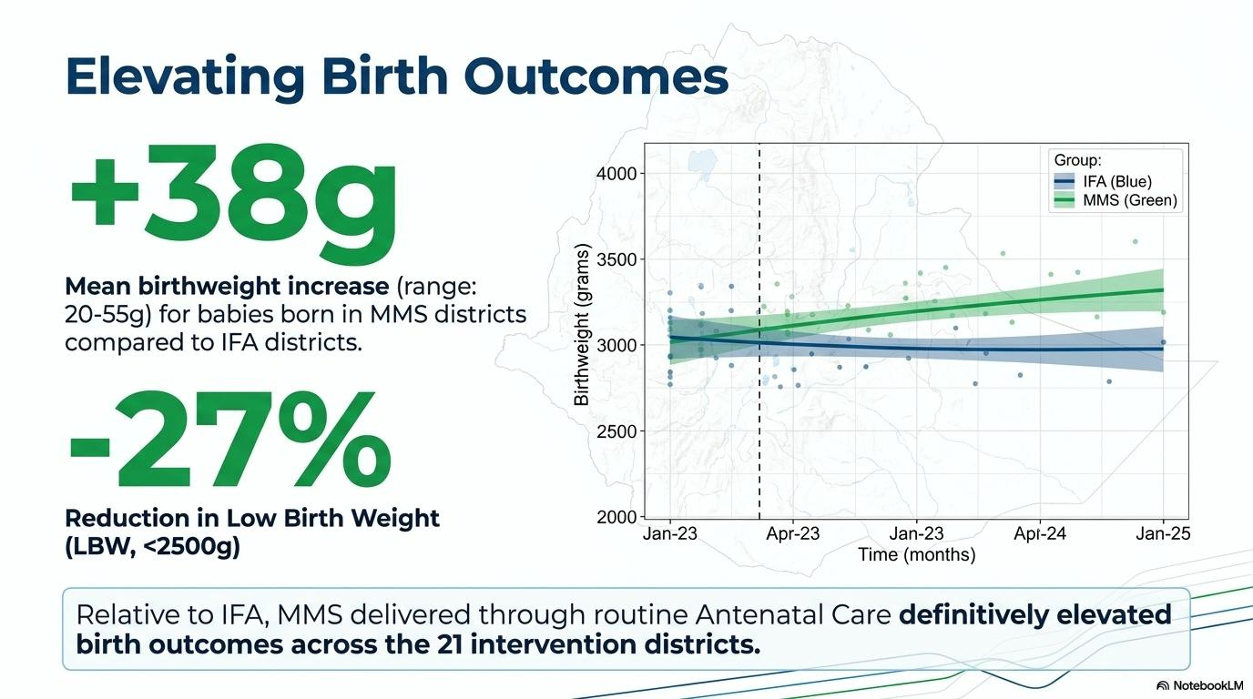
Results
Despite not powered to detect the difference in LBW
Notes:
Adherence to for at least 90 days increased in both study arms.
Adherence was consistently higher in the MMS arm, at 85% amongst those who received MMS, relative to 53% IFA adherence in the IFA arm.
Mean birth weight of babies born to women living in the 21 districts where MMS was available was 38 grammes higher (20-55) than the mean birth weight of babies born to women in IFA districts.
~ 27% reduction of LBW (<2500g) with adjusted odds ratio of 0.73 (0.52-1.01)

Slide 9
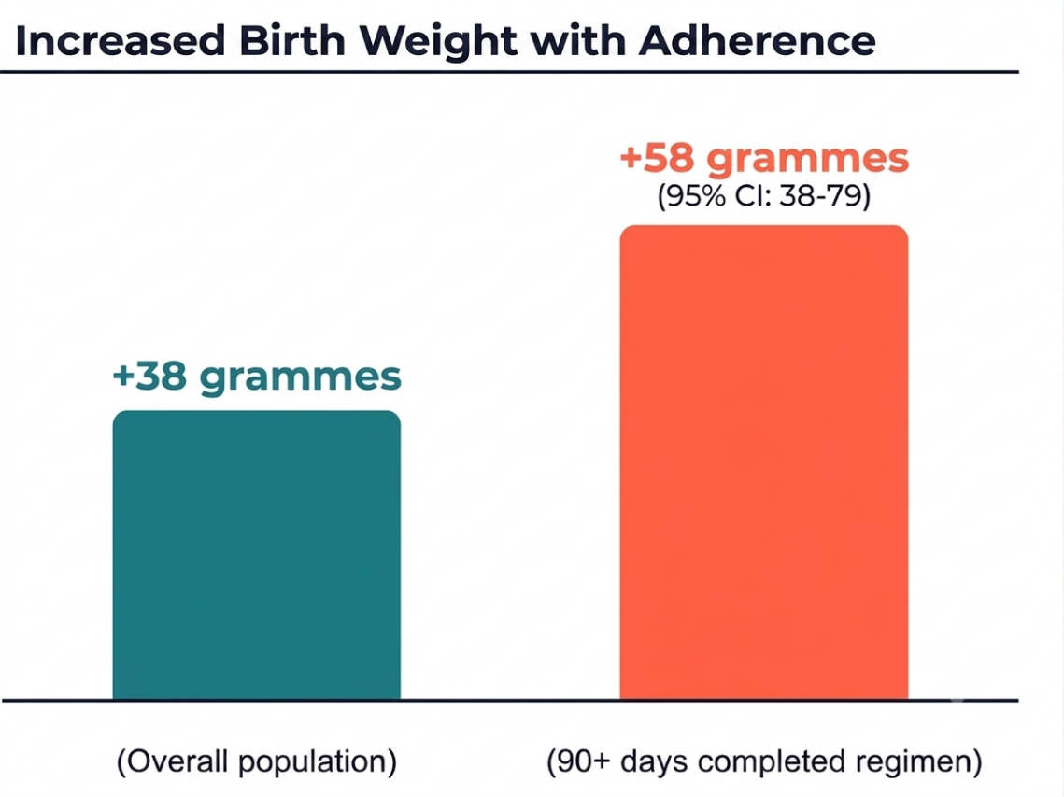
Results
The effect on birthweight was strongest for women who took supplements for at least 90 days
Notes:
Remove multiplier on top and base impact on the bottom of figure

Slide 10

Learnings from evaluation

Slide 11
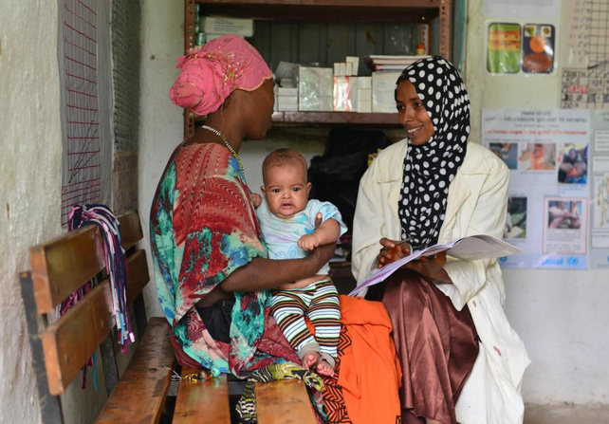

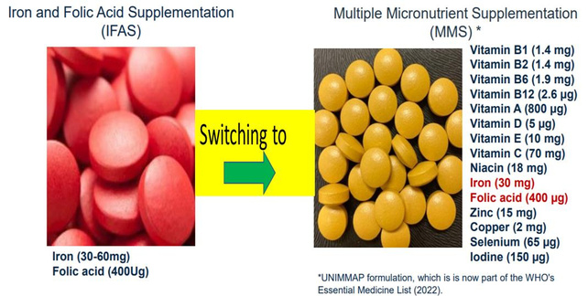
Looking ahead
❖ ❖
Other health benefits.
Full scale-up: need to have local production.

Slide 12

Looking ahead

Slide 13
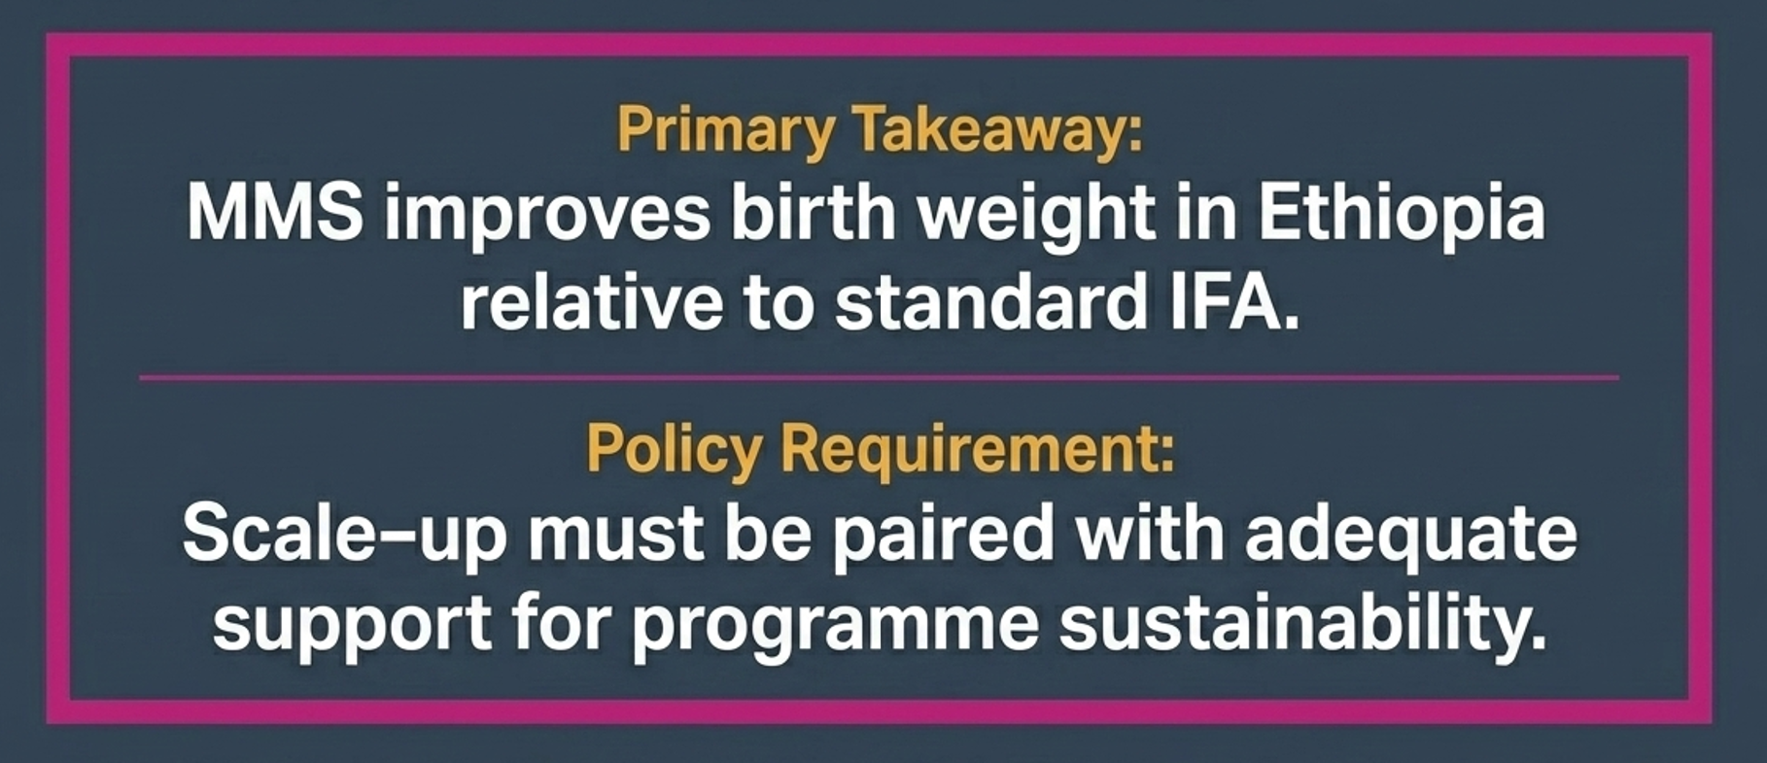
Conclusion

Slide 14
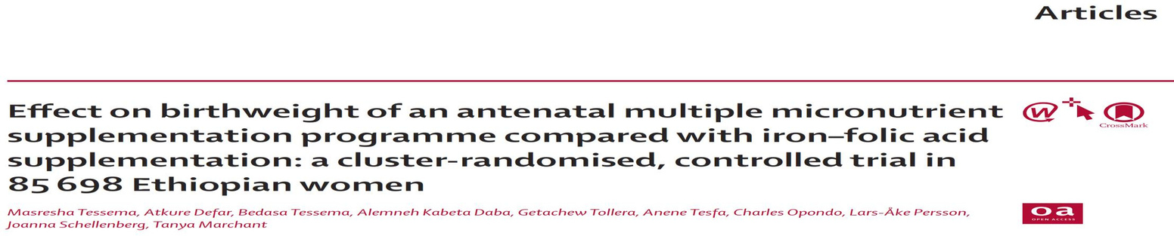
Acknowledgements
• •
This study received funding from the Children's Investment Fund Foundation [grant no. 2002-04486].
The team gratefully acknowledge the dedication and contributions of the entire study team, including
research assistants and data clerks, regional health officials, birth attendants, and administrators across the
We are indebted to the 85,698 women who consented to contribute
• •
The team are also grateful to the Ethiopian MoH for their commitment and to UNICEF support.
Contact: dr.masresha.tessema@gmail.com

