Slide 1
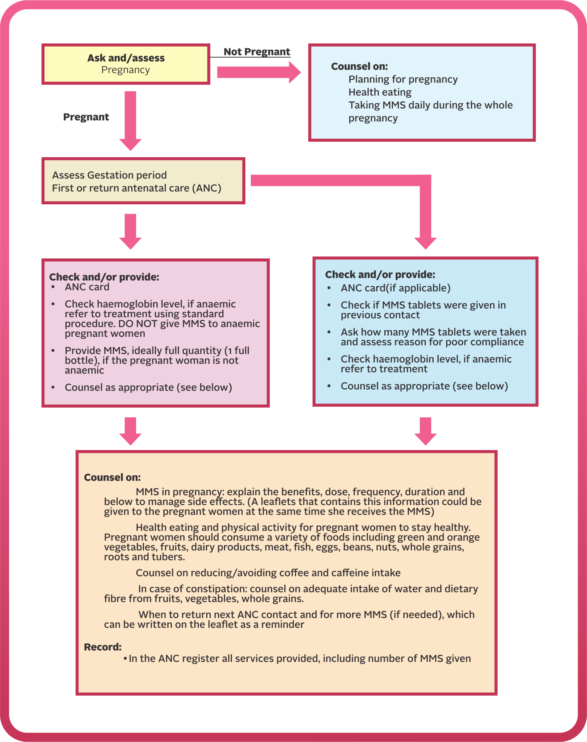
MODULE 7:
Monitoring and Record Keeping of Multiple Micronutrient Supplements (MMS)
DURATION: 45 Minutes

Slide 2

MODULE 7: MONITORING AND RECORD KEEPING OF MULTIPLE MICRONUTRIENT SUPPLEMENTS (MMS)
NATIONAL TRAINING MANUAL ON MULTIPLE MICRONUTRIENT SUPPLEMENTS (MMS) FOR FRONTLINE HEALTHCARE PROVIDERS IN NIGERIA
Learning Objectives
At the end of this module, participants should be able to:
Describe the purpose of monitoring and record keeping of MMS
Record the distribution of MMS and appropriate counselling using the national routine monitoring system

Slide 3
MODULE 7: MONITORING AND RECORD KEEPING OF MULTIPLE MICRONUTRIENT SUPPLEMENTS (MMS)
NATIONAL TRAINING MANUAL ON MULTIPLE MICRONUTRIENT SUPPLEMENTS (MMS) FOR FRONTLINE HEALTHCARE PROVIDERS IN NIGERIA
Monitoring and
Reporting of MMS
Record-keeping is crucial for monitoring MMS program implementation
Monitoring at health facilities helps gather, review, and validate data regularly
It assesses intervention effectiveness, progress towards targets, and areas for improvement in real-time
Monitoring system includes details on what data (indicators) are collected, when, how, and by whom
Relevant data collection tools are used for systematic monitoring

Slide 4
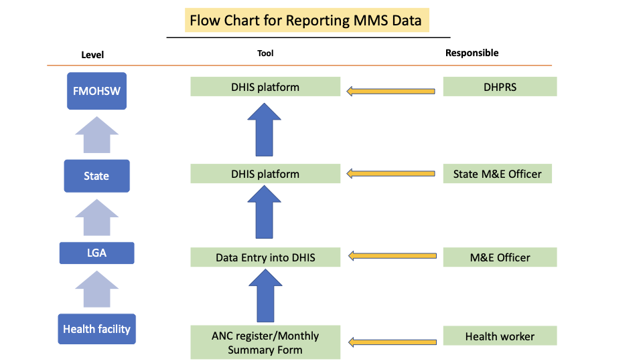
MODULE 7: MONITORING AND RECORD KEEPING OF MULTIPLE MICRONUTRIENT SUPPLEMENTS (MMS)
NATIONAL TRAINING MANUAL ON MULTIPLE MICRONUTRIENT SUPPLEMENTS (MMS) FOR FRONTLINE HEALTHCARE PROVIDERS IN NIGERIA
Reporting MMS
MMS data reporting should follow the NHMIS pathway
Data is collected and collated at the health facility
It is then transmitted to the national DHIS platform
Reporting ensures accurate tracking and integration into the national health system
Reporting pathway from the health facility to the NHMIS, DHIS platform

Slide 5
MODULE 7: MONITORING AND RECORD KEEPING OF MULTIPLE MICRONUTRIENT SUPPLEMENTS (MMS)
NATIONAL TRAINING MANUAL ON MULTIPLE MICRONUTRIENT SUPPLEMENTS (MMS) FOR FRONTLINE HEALTHCARE PROVIDERS IN NIGERIA
Reporting MMS (Cont’d)
What are the expected data to report?
Number of pregnant women who received MMS
Number of tablets of MMS received
Number of pregnant women who received Nutrition counselling service
Number of pregnant women who were tested for anaemia
Number of pregnant women who utilized more than one form of multiple micronutrient supplements

Slide 6
MODULE 7: MONITORING AND RECORD KEEPING OF MULTIPLE MICRONUTRIENT SUPPLEMENTS (MMS)
NATIONAL TRAINING MANUAL ON MULTIPLE MICRONUTRIENT SUPPLEMENTS (MMS) FOR FRONTLINE HEALTHCARE PROVIDERS IN NIGERIA
Reporting MMS (Cont’d)
Additional Data Elements to Capture
Opening balance at the beginning of the month
Quantity received from the 1st to the end of the month
Quantity given to pregnant women from the 1st to the end of the month
Balance of commodities at month-end
Expiration date of the commodities
All items (a-e) are recorded on the Inventory Control Card (ICC)

Slide 7
MODULE 7: MONITORING AND RECORD KEEPING OF MULTIPLE MICRONUTRIENT SUPPLEMENTS (MMS)
NATIONAL TRAINING MANUAL ON MULTIPLE MICRONUTRIENT SUPPLEMENTS (MMS) FOR FRONTLINE HEALTHCARE PROVIDERS IN NIGERIA
Reporting MMS (Cont’d)
Data Reporting Tools
ANC Register
GMP Register
Monthly Summary Form
Inventory Control Card (ICC)
General attendance Register

Slide 8
MODULE 7: MONITORING AND RECORD KEEPING OF MULTIPLE MICRONUTRIENT SUPPLEMENTS (MMS)
NATIONAL TRAINING MANUAL ON MULTIPLE MICRONUTRIENT SUPPLEMENTS (MMS) FOR FRONTLINE HEALTHCARE PROVIDERS IN NIGERIA
Reporting MMS (Cont’d)
Data Collection Responsibilities
The Record, M&E or logistics officers handle nutrition commodity data
Responsibilities include data entry, reporting, and documentation at the facility level
Reports are submitted to the LGA M&E, then to the State and Federal levels at the end of the month

Slide 9
MODULE 7: MONITORING AND RECORD KEEPING OF MULTIPLE MICRONUTRIENT SUPPLEMENTS (MMS)
NATIONAL TRAINING MANUAL ON MULTIPLE MICRONUTRIENT SUPPLEMENTS (MMS) FOR FRONTLINE HEALTHCARE PROVIDERS IN NIGERIA
Monitoring MMS
Monitoring MMS Overview
Integral to Antenatal Care (ANC) and conducted at various levels
Utilizes established data collection tools (ANC Register, GMP and Monthly Summary Forms)

Slide 10
MODULE 7: MONITORING AND RECORD KEEPING OF MULTIPLE MICRONUTRIENT SUPPLEMENTS (MMS)
NATIONAL TRAINING MANUAL ON MULTIPLE MICRONUTRIENT SUPPLEMENTS (MMS) FOR FRONTLINE HEALTHCARE PROVIDERS IN NIGERIA
Monitoring of MMS
at the Facility 1/3
Monitoring MMS requires collecting data at various levels
based on the protocol for delivering MMS
Individual Level
Track the number of pregnant women receiving and being counselled on MMS.
Compare received MMS tablets to target population figures during ANC visits.
For health facility and LGA Levels, document monthly/quarterly data on pregnant women reached and supply chain bottlenecks .
Identify and address bottlenecks to prevent stockouts.

Slide 11
MODULE 7: MONITORING AND RECORD KEEPING OF MULTIPLE MICRONUTRIENT SUPPLEMENTS (MMS)
NATIONAL TRAINING MANUAL ON MULTIPLE MICRONUTRIENT SUPPLEMENTS (MMS) FOR FRONTLINE HEALTHCARE PROVIDERS IN NIGERIA
Monitoring of MMS
at the Facility 2/3
2. National Level:
Use NHMIS to capture data on number of pregnant women who have received MMS and the number of pregnant women counselled on MMS.
Refer to the monitoring checklist in the annex for program implementation.

Slide 12
MODULE 7: MONITORING AND RECORD KEEPING OF MULTIPLE MICRONUTRIENT SUPPLEMENTS (MMS)
NATIONAL TRAINING MANUAL ON MULTIPLE MICRONUTRIENT SUPPLEMENTS (MMS) FOR FRONTLINE HEALTHCARE PROVIDERS IN NIGERIA
Monitoring of MMS
at the Facility 3/3
NOTE:
On provision of counselling cards in relation to maternal nutrition (Refer to MIYCN Training Manual).
Practical Session:
Use the HMIS tool to demonstrate how to enter MMS data into the HMIS tool.

