Slide 1
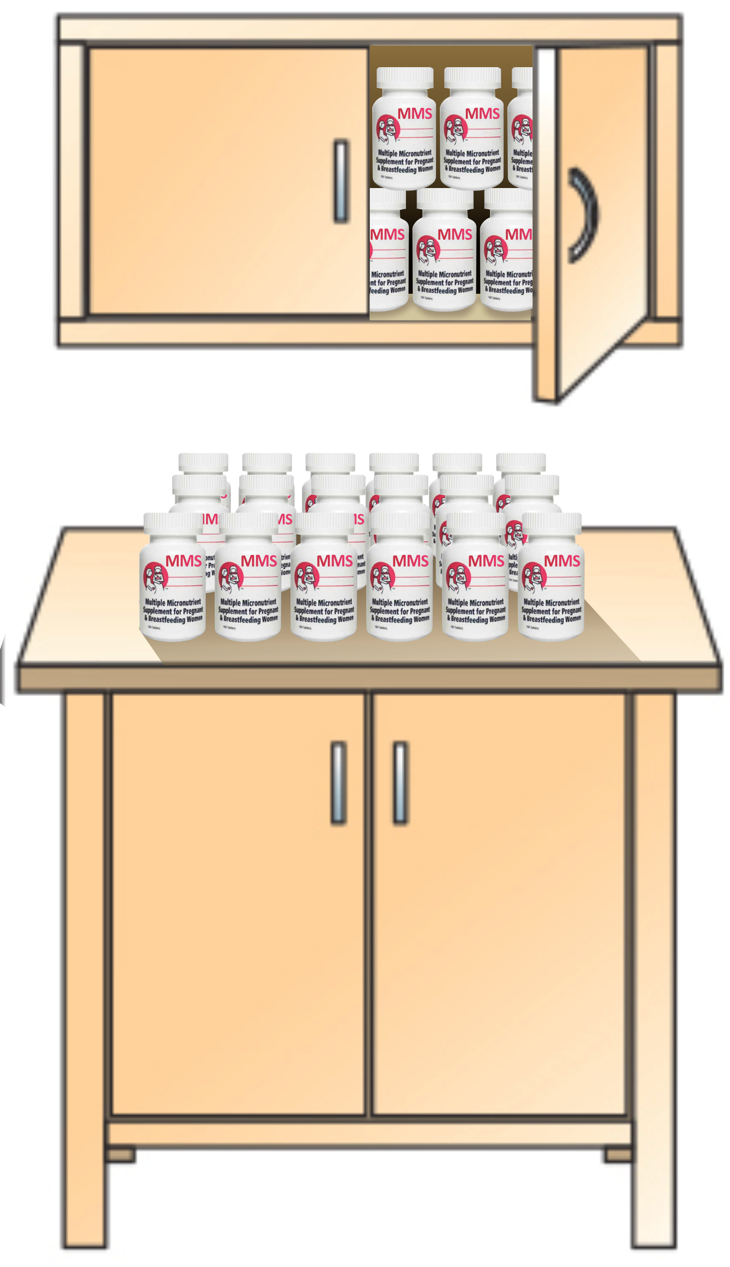
MODULE 6:
Estimating Supply Needs for MMS
DURATION: 45 Minutes

Slide 2

NATIONAL TRAINING MANUAL ON MULTIPLE MICRONUTRIENT SUPPLEMENTS (MMS) FOR FRONTLINE HEALTHCARE PROVIDERS IN NIGERIA
MODULE 6: ESTIMATING SUPPLY NEEDS FOR MMS
Learning Objectives
At the end of this module, you should be able to:
Estimate the MMS supply need in the health facility
Estimate MMS supply need for an LGA or a State

Slide 3
NATIONAL TRAINING MANUAL ON MULTIPLE MICRONUTRIENT SUPPLEMENTS (MMS) FOR FRONTLINE HEALTHCARE PROVIDERS IN NIGERIA
MODULE 6: ESTIMATING SUPPLY NEEDS FOR MMS
Materials Needed
Flip chart and marker

Slide 4
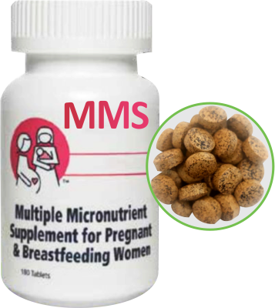
NATIONAL TRAINING MANUAL ON MULTIPLE MICRONUTRIENT SUPPLEMENTS (MMS) FOR FRONTLINE HEALTHCARE PROVIDERS IN NIGERIA
MODULE 6: ESTIMATING SUPPLY NEEDS FOR MMS
Steps for Estimating MMS Supplies for a Typical Health Facility
Example (Option #1): A pregnant woman collects one bottle of MMS containing 180 tablets
Each pregnant woman receives one bottle of MMS (180 tablets)
Estimate 200 new pregnant women attend ANC monthly
Add 10% to account for unexpected increase in clients: 200 + 20 = 220 pregnant women
Monthly MMS requirement: 220 bottles
Quarterly MMS requirement: 220 bottles × 3 months = 660 bottles
Annual MMS requirement: 220 bottles × 12 months = 2,640 bottles, round up to 2,700 bottles
Note to Facilitator: This is an hypothetical example just to get a grasp off how to do the calculation, in the real setting the number would change and that has to be adjusted for. Also, this calculation is done with the assumption that 200 new pregnant women attend the ANC monthly

Slide 5
NATIONAL TRAINING MANUAL ON MULTIPLE MICRONUTRIENT SUPPLEMENTS (MMS) FOR FRONTLINE HEALTHCARE PROVIDERS IN NIGERIA
MODULE 6: ESTIMATING SUPPLY NEEDS FOR MMS
Steps for Estimating MMS Supplies for a Typical Health Facility (Cont’d)
NOTE
The calculated number of bottles for a typical health facility should be adjusted to account for buffer stocks
Lag time for supplies may vary due to transportation, formalities, and seasonal delays, especially for hard-to-reach health facilities
Population changes and expected pregnancies should guide the initial estimation of MMS supply needs
Medical storekeepers and pharmacists should be trained on supplementation protocols and supply management, adapting these steps to current medical supply practices.

Slide 6
NATIONAL TRAINING MANUAL ON MULTIPLE MICRONUTRIENT SUPPLEMENTS (MMS) FOR FRONTLINE HEALTHCARE PROVIDERS IN NIGERIA
MODULE 6: ESTIMATING SUPPLY NEEDS FOR MMS
Steps for Estimating MMS Supplies for a Typical Health Facility (Cont’d)
Option #2: State and LGA estimation if population figures are available
Determine the total or catchment population
Calculate the target population of pregnant women by multiplying the total population by 5%
Multiply the target population by the anticipated coverage (typically 80-90%)
Add a 10% contingency/buffer factor
Net annual requirement: Multiply the target population by 80% (coverage), add 10% buffer, and multiply by 1 (bottle per pregnant woman)

Slide 7
NATIONAL TRAINING MANUAL ON MULTIPLE MICRONUTRIENT SUPPLEMENTS (MMS) FOR FRONTLINE HEALTHCARE PROVIDERS IN NIGERIA
MODULE 6: ESTIMATING SUPPLY NEEDS FOR MMS
Steps for Estimating MMS Supplies for a Typical Health Facility (Cont’d)
Example for Option #2
Estimate an annual requirement of MMS for a LGA with a total population of 200,000 people?
Total population = 200,000
Target population of pregnant women = 200,000 multiplied by 5% = 10,000 pregnant women
Pregnant women expected to cover = 10,000 multiplied by 80% = 8,000
Pregnant women expected to cover buffer = 8,000 multiplied by 10% + 8,000 = 800 + 8,000 = 8,800
ANNUAL NET REQUIREMENT = 8,800 * 1 bottle of MMS = 8,800 bottles of MMS (approximately 9,000 bottles)

Slide 8
NATIONAL TRAINING MANUAL ON MULTIPLE MICRONUTRIENT SUPPLEMENTS (MMS) FOR FRONTLINE HEALTHCARE PROVIDERS IN NIGERIA
MODULE 6: ESTIMATING SUPPLY NEEDS FOR MMS
Steps for Estimating MMS Supplies for a Typical Health Facility (Cont’d)
Participants Exercise 1:
Calculate the Quantity of MMS Supply for a facility with 150 new pregnant women attending monthly ANC for the following:
(i) Quantity of MMS supply for the facility for a month,
(ii) Quantity of MMS supply for the facility quarterly,
(iii) Quantity of MMS supply for the facility for a year.
Participants Exercise 2:
An LGA with a total population of 100,000, had an anticipated coverage of 90% and buffer contingency of 10%. Calculate the net annual quantity of MMS bottles for the target pregnant women in the L.G.A.

