Slide 1
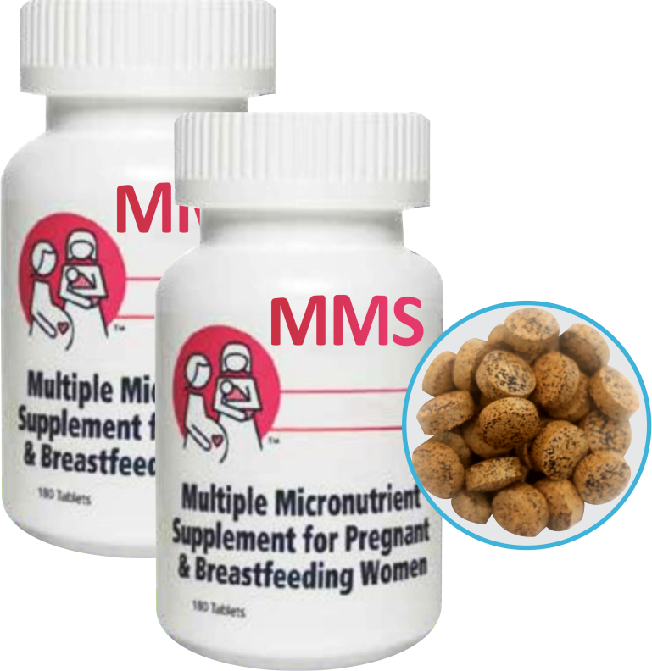

MODULE 5:
Steps for Provision of MMS During ANC in Health Facilities
DURATION: 90 Minutes

Slide 2

MODULE 5: STEPS FOR PROVISION OF MMS
DURING ANC IN HEALTH FACILITIES
NATIONAL TRAINING MANUAL ON MULTIPLE MICRONUTRIENT SUPPLEMENTS (MMS) FOR FRONTLINE HEALTHCARE PROVIDERS IN NIGERIA
Learning Objectives
At the end of this module, you should be able to:
Describe the steps for providing MMS to pregnant women during the ANC contacts
Use accompanying job aid and fact sheet

Slide 3
MODULE 5: STEPS FOR PROVISION OF MMS
DURING ANC IN HEALTH FACILITIES
NATIONAL TRAINING MANUAL ON MULTIPLE MICRONUTRIENT SUPPLEMENTS (MMS) FOR FRONTLINE HEALTHCARE PROVIDERS IN NIGERIA
Materials Needed
Flow chart
Flip chart and markers

Slide 4

MODULE 5: STEPS FOR PROVISION OF MMS
DURING ANC IN HEALTH FACILITIES
NATIONAL TRAINING MANUAL ON MULTIPLE MICRONUTRIENT SUPPLEMENTS (MMS) FOR FRONTLINE HEALTHCARE PROVIDERS IN NIGERIA
Steps in Providing MMS to Pregnant Women
Step 1 : Confirm Pregnancy: Through history taking, clinical examination and laboratory investigations, including ultrasound scan (Part of ANC services).
Step 2: Registration for ANC and Provision of Recommended ANC Services: Pregnant women should be provided with a set of recommended ANC services based on the national ANC Guidelines which includes screening for anaemia, nutritional counseling etc.
Step 3 : Screening for Anaemia: Screen the pregnant woman for anaemia, if diagnosed with mild or moderate anaemia, counsel and treat accordingly. For severe anaemia, refer for treatment according to clinical protocols.

Slide 5
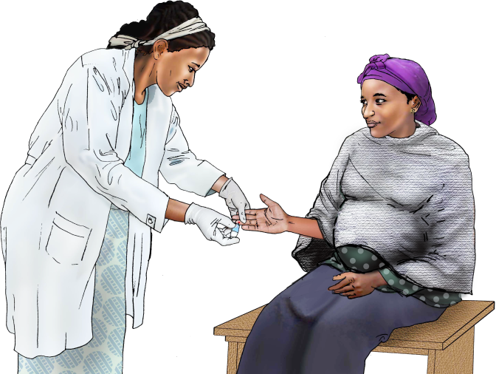
MODULE 5: STEPS FOR PROVISION OF MMS
DURING ANC IN HEALTH FACILITIES
NATIONAL TRAINING MANUAL ON MULTIPLE MICRONUTRIENT SUPPLEMENTS (MMS) FOR FRONTLINE HEALTHCARE PROVIDERS IN NIGERIA
Steps in Providing MMS to Pregnant Women (Cont’d)
Step 4 :Assessment of Supplements Intake: Ask if the woman is already taking any pregnancy supplements (E.g. IFA or any branded supplements). If yes, counsel the woman on maternal nutrition and appropriate supplementation (not to combine two types of supplements e.g. IFAS and MMS or with any supplement brands).
Step 5 :Appropriate Nutrition Counselling: All the pregnant women should be counsel appropriately.

Slide 6

MODULE 5: STEPS FOR PROVISION OF MMS
DURING ANC IN HEALTH FACILITIES
NATIONAL TRAINING MANUAL ON MULTIPLE MICRONUTRIENT SUPPLEMENTS (MMS) FOR FRONTLINE HEALTHCARE PROVIDERS IN NIGERIA
Steps in Providing MMS to Pregnant Women (Cont’d)
Step 6 : Administration of MMS: To receive maximum benefit from MMS, a pregnant woman should take one (1) MMS tablet daily for at least 180 days. Each pregnant woman should receive an unopened bottle of MMS and be encouraged to take it throughout her pregnancy.
Step 7: Record and follow up plan: Document the number of pregnant women counselled and given MMS. Provide a follow up plan and re-emphasize the importance of nutrition counselling on consumption of healthy, diverse and nutritious diet during pregnancy

Slide 7

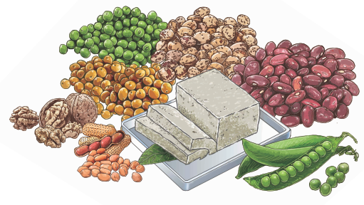

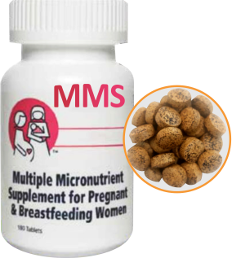

MODULE 5: STEPS FOR PROVISION OF MMS
DURING ANC IN HEALTH FACILITIES
NATIONAL TRAINING MANUAL ON MULTIPLE MICRONUTRIENT SUPPLEMENTS (MMS) FOR FRONTLINE HEALTHCARE PROVIDERS IN NIGERIA
Steps in Providing MMS to Pregnant Women (Cont’d)
At each ANC contact, health care providers should address any adherence issues during counselling.
Pregnant women should be reminded to take their MMS daily during each ANC contact.
They should also be reminded to come back for their follow-up ANC contact

Slide 8
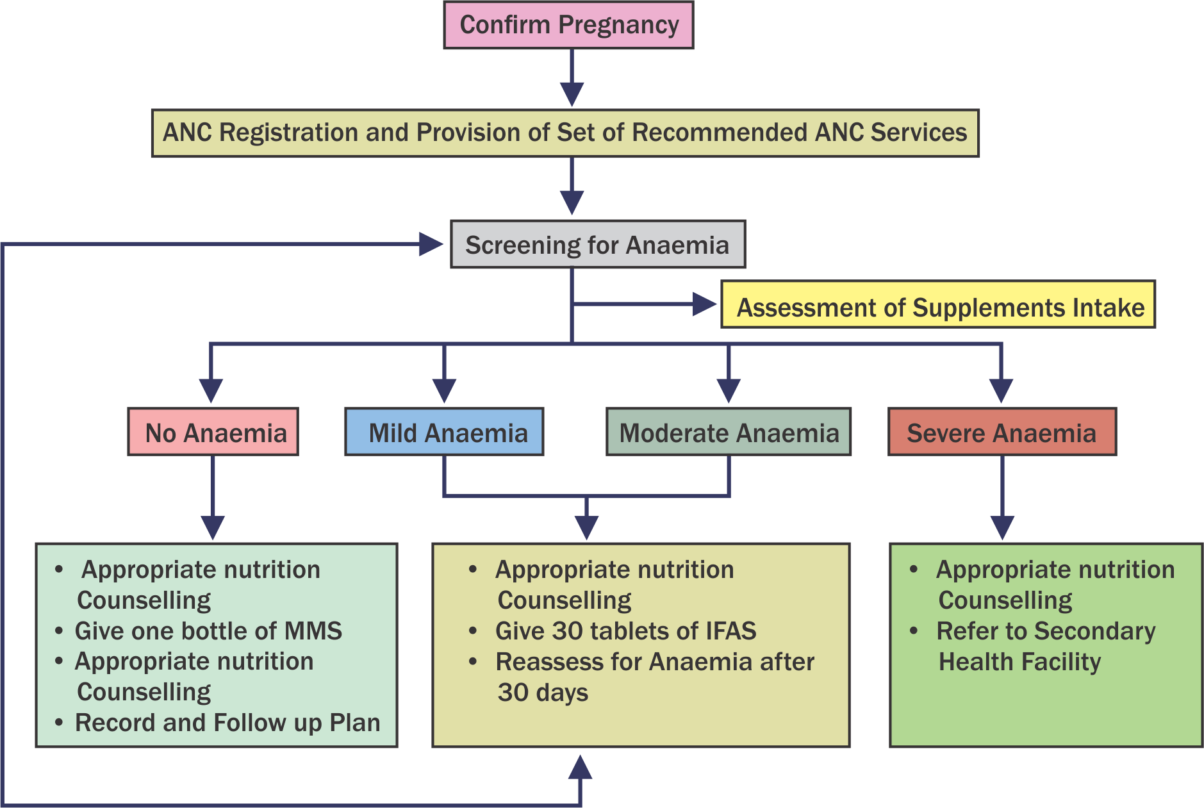
MODULE 5: STEPS FOR PROVISION OF MMS
DURING ANC IN HEALTH FACILITIES
NATIONAL TRAINING MANUAL ON MULTIPLE MICRONUTRIENT SUPPLEMENTS (MMS) FOR FRONTLINE HEALTHCARE PROVIDERS IN NIGERIA
Figure: Multiple Micronutrient
Supplementation (MMS)
Flowchart in ANC

Slide 9
MODULE 5: STEPS FOR PROVISION OF MMS
DURING ANC IN HEALTH FACILITIES
NATIONAL TRAINING MANUAL ON MULTIPLE MICRONUTRIENT SUPPLEMENTS (MMS) FOR FRONTLINE HEALTHCARE PROVIDERS IN NIGERIA
How to use MMS Flowchart
The following scenarios apply for providing MMS and IFAS to pregnant women during ANC.
The following scenarios apply for providing MMS and IFAS to pregnant women during ANC.
Scenario 1: No anaemia; start or continue MMS management.
Scenario 2: No anaemia; start or continue MMS management. Thereafter, she should resume the standard daily antenatal MMS dose. Mild to moderate anaemia; start or continue MMS and follow with anaemia treatment as in Table 4.3
Scenario 3: Severe anaemia: Refer appropriately for further clinical management. Thereafter, she should resume the standard daily antenatal MMS dose

