Slide 1

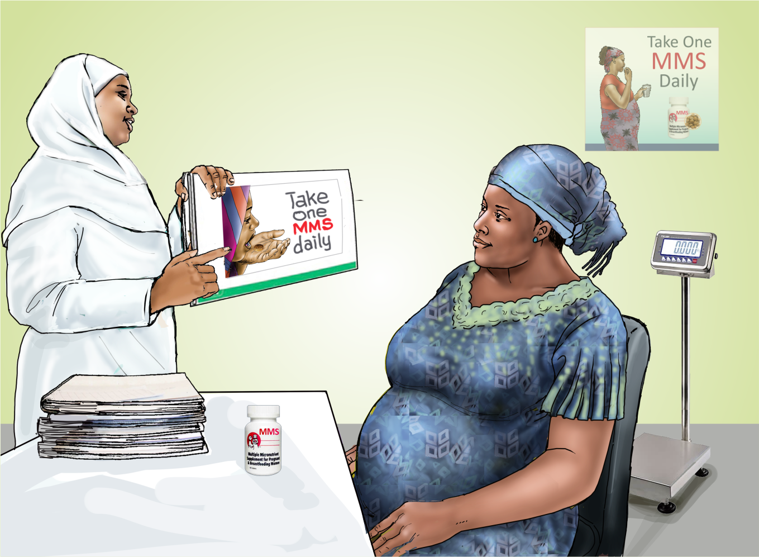
MODULE 4:
Key Messages on the Provision of
MMS and Counse-
lling Techniques
DURATION: 90 Minutes

Slide 2

MODULE 4: KEY MESSAGES ON THE PROVISION OF MMS AND COUNSELLING TECHNIQUES
NATIONAL TRAINING MANUAL ON MULTIPLE MICRONUTRIENT SUPPLEMENTS (MMS) FOR FRONTLINE HEALTHCARE PROVIDERS IN NIGERIA
Learning Objectives
At the end of this module, you should be able to explain:
Delivery Platform and Target Beneficiaries for MMS
MMS use and dosage
MMS compliance
Possible side effects of MMS and how to manage the side effects
Treatment of anaemia in pregnancy
The best effective counselling practices

Slide 3
MODULE 4: KEY MESSAGES ON THE PROVISION OF MMS AND COUNSELLING TECHNIQUES
NATIONAL TRAINING MANUAL ON MULTIPLE MICRONUTRIENT SUPPLEMENTS (MMS) FOR FRONTLINE HEALTHCARE PROVIDERS IN NIGERIA
Materials Needed
Flip charts and markers
Set of puzzle pieces representing different delivery platforms (antenatal care clinics, campaigns/outreaches
Set of puzzle pieces representing the target beneficiaries of MMS (pregnant women).
Annex Checklist for Effective Counselling

Slide 4
MODULE 4: KEY MESSAGES ON THE PROVISION OF MMS AND COUNSELLING TECHNIQUES
NATIONAL TRAINING MANUAL ON MULTIPLE MICRONUTRIENT SUPPLEMENTS (MMS) FOR FRONTLINE HEALTHCARE PROVIDERS IN NIGERIA
Some Key Points to be Noted in the Delivery of MMS
MMS is for preventive care and is provided to all non-anaemic pregnant women accessing ANC services
Anaemic pregnant women should follow the recommended anaemia management protocol (to be discussed in module 5)
Non-anaemic pregnant women should take one MMS tablet daily throughout pregnancy for optimal outcomes
MMS is specifically designed to meet the nutritional needs of pregnancy based on RDAs and is intended only for pregnant women

Slide 5
MODULE 4: KEY MESSAGES ON THE PROVISION OF MMS AND COUNSELLING TECHNIQUES
NATIONAL TRAINING MANUAL ON MULTIPLE MICRONUTRIENT SUPPLEMENTS (MMS) FOR FRONTLINE HEALTHCARE PROVIDERS IN NIGERIA
MMS Use and Dosage
Pregnant women should seek ANC services as soon as they know they are pregnant
MMS is provided to non-anaemic women as part of standard ANC care
Take one MMS tablet daily starting early in pregnancy, continuing through delivery; continue after delivery if any tablets remain
If non-anaemic, do not take MMS with iron folic acid supplements (IFAS)
MMS should be taken with clean water and not chewed or crushed

Slide 6
MODULE 4: KEY MESSAGES ON THE PROVISION OF MMS AND COUNSELLING TECHNIQUES
NATIONAL TRAINING MANUAL ON MULTIPLE MICRONUTRIENT SUPPLEMENTS (MMS) FOR FRONTLINE HEALTHCARE PROVIDERS IN NIGERIA
MMS Use and Dosage (Cont’d)
Do not use tea, coffee, or calcium-rich foods like milk when taking MMS, as they can decrease absorption of Iron
Use reminders to take MMS daily; do not exceed one tablet per day if a dose is missed
MMS should be stored in its original sealed bottle, out of reach of children, and kept in a dry, cool place
MMS is not a substitute for a healthy diet; pregnant women still need to consume protein, essential fatty acids, calcium, and other nutrients from food

Slide 7
MODULE 4: KEY MESSAGES ON THE PROVISION OF MMS AND COUNSELLING TECHNIQUES
NATIONAL TRAINING MANUAL ON MULTIPLE MICRONUTRIENT SUPPLEMENTS (MMS) FOR FRONTLINE HEALTHCARE PROVIDERS IN NIGERIA
Learning Activity 1
Note to Facilitator
Lead a group discussion using true/false questions on MMS initiation, dosage, and consumption
Avoid asking leading, close-ended, or judgmental questions during the discussion

Slide 8
MODULE 4: KEY MESSAGES ON THE PROVISION OF MMS AND COUNSELLING TECHNIQUES
NATIONAL TRAINING MANUAL ON MULTIPLE MICRONUTRIENT SUPPLEMENTS (MMS) FOR FRONTLINE HEALTHCARE PROVIDERS IN NIGERIA
MMS Compliance
Pregnant women should take MMS daily for optimal health benefits, ensuring consistent intake (compliance)
Assess and encourage compliance at every ANC visit, using a non-judgmental approach

Slide 9
MODULE 4: KEY MESSAGES ON THE PROVISION OF MMS AND COUNSELLING TECHNIQUES
NATIONAL TRAINING MANUAL ON MULTIPLE MICRONUTRIENT SUPPLEMENTS (MMS) FOR FRONTLINE HEALTHCARE PROVIDERS IN NIGERIA
MMS Compliance (Cont’d)
Questions to ascertain compliance
Have you had the opportunity to start taking MMS during this
pregnancy?
Around what time did you begin taking MMS?
How has your experience been with taking MMS daily?
What might be some of the challenges or factors affecting
your ability to take MMS every day?
Would you like to explore ways I can help support you in
addressing these challenges?

Slide 10
MODULE 4: KEY MESSAGES ON THE PROVISION OF MMS AND COUNSELLING TECHNIQUES
NATIONAL TRAINING MANUAL ON MULTIPLE MICRONUTRIENT SUPPLEMENTS (MMS) FOR FRONTLINE HEALTHCARE PROVIDERS IN NIGERIA
Learning Activity 2
Group discussion
Participants should be divided into groups to discuss barriers/challenges to MMS adherence among pregnant women in their communities

Slide 11
MODULE 4: KEY MESSAGES ON THE PROVISION OF MMS AND COUNSELLING TECHNIQUES
NATIONAL TRAINING MANUAL ON MULTIPLE MICRONUTRIENT SUPPLEMENTS (MMS) FOR FRONTLINE HEALTHCARE PROVIDERS IN NIGERIA
Common Reasons Why a Pregnant
Woman May Not Take MMS & Possible Solutions
Reason for Not Taking MMS | Possible Solutions
Lack of knowledge | Provide clear written and verbal information about the importance of MMS during pregnancy and how to take it
Misconceptions (e.g., fear of a big baby) | Reassure that MMS will not cause excessive weight gain or an overly large baby
Forgetfulness | Suggest taking MMS at the same time daily, keeping the bottle visible, setting alarms, or asking family for reminders
Side effects (nausea, vomiting) | Advise taking MMS before bed or with food (not on an empty stomach) and avoid taking MMS with tea, coffee, or calcium-rich foods like milk as they decrease absorption of Iron; assure that side effects are often temporary

Slide 12
MODULE 4: KEY MESSAGES ON THE PROVISION OF MMS AND COUNSELLING TECHNIQUES
NATIONAL TRAINING MANUAL ON MULTIPLE MICRONUTRIENT SUPPLEMENTS (MMS) FOR FRONTLINE HEALTHCARE PROVIDERS IN NIGERIA
Safety and Possible Side effects of MMS and their Management
MMS is safe with no major side effects, though minor discomfort may occur as the body adjusts to the iron
Common minor side effects: constipation, stomach upset, mild headaches, and nausea
Management tips: Drink extra water, eat fruits and vegetables to prevent constipation, and take the tablet at night after the evening meal to reduce nausea
If side effects persist, consult a doctor
MMS is safe for women with diabetes, high blood pressure, heart disease, or a history of miscarriage

Slide 13
MODULE 4: KEY MESSAGES ON THE PROVISION OF MMS AND COUNSELLING TECHNIQUES
NATIONAL TRAINING MANUAL ON MULTIPLE MICRONUTRIENT SUPPLEMENTS (MMS) FOR FRONTLINE HEALTHCARE PROVIDERS IN NIGERIA
Anaemia Cut-offs in Pregnancy
Haemoglobin concentration (g/dl)
Stages of Pregnancy
 | No Anaemia | Mild Anaemia | Moderate Anaemia | Severe Anaemia | No Anaemia | Mild Anaemia | Moderate Anaemia | Severe Anaemia
First trimester | ≥33.0 | 30.0-32.9 | 21.0-29.9 | <21.0 | >11.0 | 10.0-10.9 | 7.0 -9.9 | <.7.0
Second trimester | ≥31.5 | 28.5-31.4 | 21.0-28.4 | <21.0 | >10.5 | 9.5-10.4 | 7.0 -9.4 | <7.0
Third trimester | ≥33.0 | 30.0-32.9 | 21.0-29.9 | <21.0 | >11.0 | 10.0-10.9 | 7.0 -9.9 | <7.0
PCV level (%)
*WHO (2024). Guideline on haemoglobin cutoffs to define anaemia in individuals and populations. Geneva: World Health Organization; 2024. Licence: CC BY-NC-SA 3.0 IGO

Slide 14
MODULE 4: KEY MESSAGES ON THE PROVISION OF MMS AND COUNSELLING TECHNIQUES
NATIONAL TRAINING MANUAL ON MULTIPLE MICRONUTRIENT SUPPLEMENTS (MMS) FOR FRONTLINE HEALTHCARE PROVIDERS IN NIGERIA
Treatment of Anaemia
in Pregnancy
MMS is for preventive use and should not be given to anaemic pregnant women
MMS is not suitable for pregnant women with sickle cell disease
Severe anaemia cases should be referred to a secondary or tertiary health facility
Intolerance or non-compliance with MMS should lead to referral for intravenous iron if haemoglobin levels are below 7 g/dL
When Mild to moderate anaemia is due to Iron deficiency, the patient should be treated with target iron dose of 120mg daily for 30 days (for protocol, see Table 4:2 in next slide)
After 30 days, the pregnant woman should return to the health facility to be rescreened for anaemia and continue treatment or given MMS based on anaemia status

Slide 15
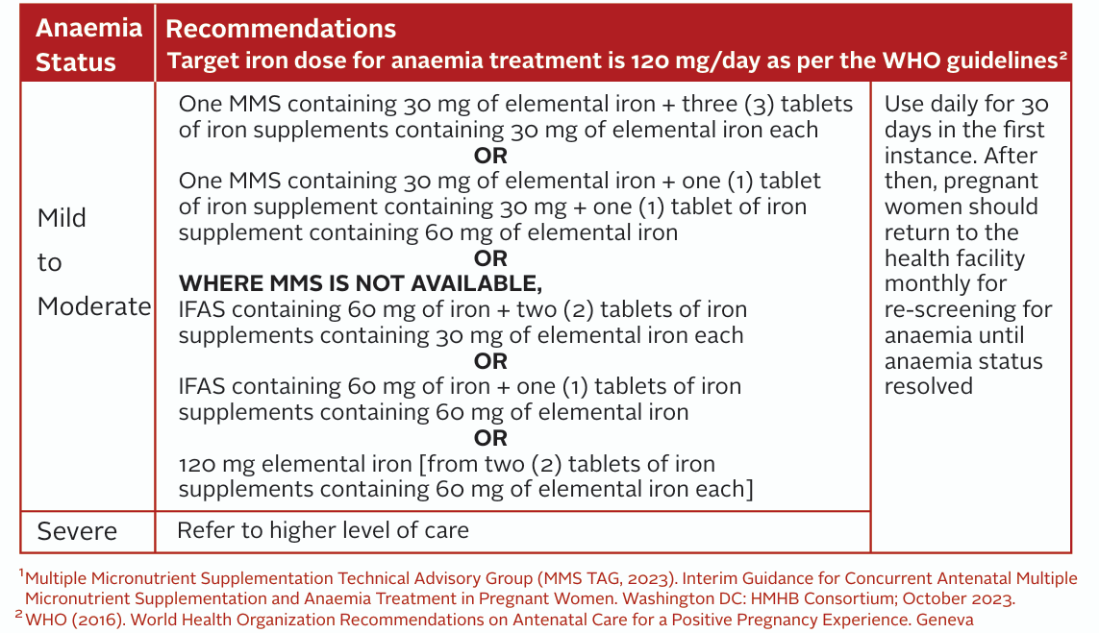
Table 4:2 Treatment of Mild to Moderate Anaemia during Pregnancy (Based on MMS TAG, 2023)

Slide 16
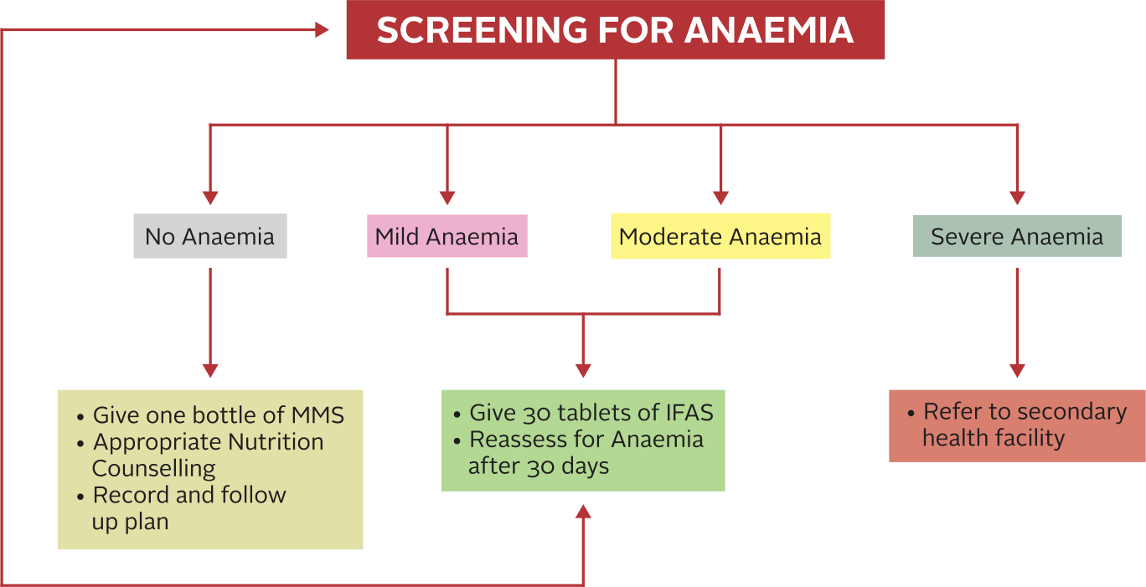
MODULE 4: KEY MESSAGES ON THE PROVISION OF MMS AND COUNSELLING TECHNIQUES
NATIONAL TRAINING MANUAL ON MULTIPLE MICRONUTRIENT SUPPLEMENTS (MMS) FOR FRONTLINE HEALTHCARE PROVIDERS IN NIGERIA
Screening for Anaemia to Determine Treatment Options
Figure: Showing Screening for Anaemia to Determine Anaemia Treatment Option

Slide 17
MODULE 4: KEY MESSAGES ON THE PROVISION OF MMS AND COUNSELLING TECHNIQUES
NATIONAL TRAINING MANUAL ON MULTIPLE MICRONUTRIENT SUPPLEMENTS (MMS) FOR FRONTLINE HEALTHCARE PROVIDERS IN NIGERIA
The GATHER Approach
to Counselling
GATHER: Greet, Ask, Tell, Help, Explain, Return
Originally used and effective in family planning programs
Can also be used to counsel on maternal nutrition and the importance of Multiple Micronutrient Supplementation (MMS)

Slide 18
MODULE 4: KEY MESSAGES ON THE PROVISION OF MMS AND COUNSELLING TECHNIQUES
NATIONAL TRAINING MANUAL ON MULTIPLE MICRONUTRIENT SUPPLEMENTS (MMS) FOR FRONTLINE HEALTHCARE PROVIDERS IN NIGERIA
The GATHER Approach
to Counselling
G
GREET
GREET the pregnant woman and invite her to sit down
Exchange pleasantries to create a friendly atmosphere
Discuss her status and well-being since the last visit
Inquire about her pregnancy progress

Slide 19
MODULE 4: KEY MESSAGES ON THE PROVISION OF MMS AND COUNSELLING TECHNIQUES
NATIONAL TRAINING MANUAL ON MULTIPLE MICRONUTRIENT SUPPLEMENTS (MMS) FOR FRONTLINE HEALTHCARE PROVIDERS IN NIGERIA
The GATHER Approach
to Counselling
A
ASK
ASK about her feelings regarding her nutrition and health status
Inquire about symptoms, nutrition problems, and concerns
Conduct or review a nutrition assessment (weight, biochemical, dietary, clinical)
Identify her nutritional needs (e.g., weight gain, MMS adherence, healthy diet)
Discuss actions she has taken to address identified problems

Slide 20
MODULE 4: KEY MESSAGES ON THE PROVISION OF MMS AND COUNSELLING TECHNIQUES
NATIONAL TRAINING MANUAL ON MULTIPLE MICRONUTRIENT SUPPLEMENTS (MMS) FOR FRONTLINE HEALTHCARE PROVIDERS IN NIGERIA
The GATHER Approach
to Counselling
T
TELL
TELL the pregnant woman about alternative ways to address her nutrition problems
Use the key messages in this module to guide the session
Help the pregnant woman set specific, measurable, achievable, realistic, and time-bound (SMART) goals to address the problems

Slide 21
MODULE 4: KEY MESSAGES ON THE PROVISION OF MMS AND COUNSELLING TECHNIQUES
NATIONAL TRAINING MANUAL ON MULTIPLE MICRONUTRIENT SUPPLEMENTS (MMS) FOR FRONTLINE HEALTHCARE PROVIDERS IN NIGERIA
The GATHER Approach
to Counselling
H
HELP
HELP the pregnant woman make informed choices
Work with the pregnant woman (accompanied by spouse
or other family members) to find approaches and actions to
reach the goal the pregnant woman has set
As much as possible, let the pregnant woman come up with
choices that are practical and relevant to her context

Slide 22
MODULE 4: KEY MESSAGES ON THE PROVISION OF MMS AND COUNSELLING TECHNIQUES
NATIONAL TRAINING MANUAL ON MULTIPLE MICRONUTRIENT SUPPLEMENTS (MMS) FOR FRONTLINE HEALTHCARE PROVIDERS IN NIGERIA
The GATHER Approach
to Counselling
E
EXPLAIN
EXPLAIN fully the choices the pregnant woman has made
Discuss barriers to implementing the choices
Ask the pregnant woman to explain the actions, doing demonstrations if necessary
Summarize (or ask the pregnant woman to summarize) what has been agreed and how it will be done

Slide 23
MODULE 4: KEY MESSAGES ON THE PROVISION OF MMS AND COUNSELLING TECHNIQUES
NATIONAL TRAINING MANUAL ON MULTIPLE MICRONUTRIENT SUPPLEMENTS (MMS) FOR FRONTLINE HEALTHCARE PROVIDERS IN NIGERIA
The GATHER Approach
to Counselling
R
REASSURE, RETURN
REASSURE the pregnant woman and give a RETURN date for the next visit
Ask the pregnant woman to repeat the date

Slide 24
MODULE 4: KEY MESSAGES ON THE PROVISION OF MMS AND COUNSELLING TECHNIQUES
NATIONAL TRAINING MANUAL ON MULTIPLE MICRONUTRIENT SUPPLEMENTS (MMS) FOR FRONTLINE HEALTHCARE PROVIDERS IN NIGERIA
Skills for Effective Counselling
Demonstrate good listening and learning skills
Show that you understand how the pregnant woman feels.
Use helpful non-verbal communication.
Ask open-ended questions.
Don’t use judgmental words
Praise and emphasize what a pregnant woman is doing right.
Provide the pregnant woman with practical help/demonstration.

Slide 25
MODULE 4: KEY MESSAGES ON THE PROVISION OF MMS AND COUNSELLING TECHNIQUES
NATIONAL TRAINING MANUAL ON MULTIPLE MICRONUTRIENT SUPPLEMENTS (MMS) FOR FRONTLINE HEALTHCARE PROVIDERS IN NIGERIA
Learning Activity 3
Activity Structure: Rotating Learning Stations
Five learning stations focused on different learning objectives
Participants will rotate through stations for interactive activities and discussions
Each station will be facilitated by a designated leader to guide learning

Slide 26
MODULE 4: KEY MESSAGES ON THE PROVISION OF MMS AND COUNSELLING TECHNIQUES
NATIONAL TRAINING MANUAL ON MULTIPLE MICRONUTRIENT SUPPLEMENTS (MMS) FOR FRONTLINE HEALTHCARE PROVIDERS IN NIGERIA
Learning Activity 3 (Cont’d)
Station 1: Delivery Platforms and Target Beneficiaries Puzzle
Goal: Participants should be able to identify the different platforms for delivering MMS and the specific groups who should receive it
Activity:
Provide participants with a set of puzzle pieces representing different delivery platforms (antenatal care clinics, campaigns/outreaches). Another set of puzzle pieces will represent the target beneficiaries of MMS (pregnant women)
Participants must match the delivery platform with its target beneficiaries, discussing how the platform can be optimized to ensure MMS reaches the appropriate population

Slide 27
MODULE 4: KEY MESSAGES ON THE PROVISION OF MMS AND COUNSELLING TECHNIQUES
NATIONAL TRAINING MANUAL ON MULTIPLE MICRONUTRIENT SUPPLEMENTS (MMS) FOR FRONTLINE HEALTHCARE PROVIDERS IN NIGERIA
Learning Activity 3 (Cont’d)
Station 2: MMS Prescription Scenario
Goal: By the end of this station, participants will be familiar with MMS initiation protocols, dosage recommendations, and consumption guidelines
Activity:
Present participants with several patient profiles (e.g., a pregnant woman in her first trimester, and a woman who missed two doses of MMS)
Ask participants to determine when MMS should be initiated, the correct dosage, and specific consumption guidelines for each profile. Additionally, participants should recommend strategies to ensure adherence

Slide 28
MODULE 4: KEY MESSAGES ON THE PROVISION OF MMS AND COUNSELLING TECHNIQUES
NATIONAL TRAINING MANUAL ON MULTIPLE MICRONUTRIENT SUPPLEMENTS (MMS) FOR FRONTLINE HEALTHCARE PROVIDERS IN NIGERIA
Learning Activity 3 (Cont’d)
Station 3: Barriers to MMS Adherence Brainstorm
Goal: Participants will identify common adherence gaps and develop practical strategies to improve MMS adherence among pregnant women
Activity:
The facilitator will present common barriers to MMS adherence (e.g., forgetfulness, side effects, lack of access to clean water, myths or misconceptions etc)
Participants will brainstorm potential solutions to overcome these barriers in their specific contexts (e.g., reminders, community health worker follow-ups, education campaigns etc)

Slide 29
MODULE 4: KEY MESSAGES ON THE PROVISION OF MMS AND COUNSELLING TECHNIQUES
NATIONAL TRAINING MANUAL ON MULTIPLE MICRONUTRIENT SUPPLEMENTS (MMS) FOR FRONTLINE HEALTHCARE PROVIDERS IN NIGERIA
Learning Activity 3 (Cont’d)
Station 4: Side Effects and Management Role Play
Goal: Participants will practice identifying potential side effects of MMS and providing solutions to manage these side effects effectively
Activity:
In pairs, participants will role-play a healthcare worker and a pregnant woman. The “pregnant woman” will describe experiencing side effects from MMS (e.g., nausea, constipation, or metallic taste)
The “healthcare worker” will counsel the woman on how to manage these side effects (e.g., taking MMS with food, increasing fluid intake, or switching the time of day for consumption)

Slide 30
MODULE 4: KEY MESSAGES ON THE PROVISION OF MMS AND COUNSELLING TECHNIQUES
NATIONAL TRAINING MANUAL ON MULTIPLE MICRONUTRIENT SUPPLEMENTS (MMS) FOR FRONTLINE HEALTHCARE PROVIDERS IN NIGERIA
Learning Activity 3 (Cont’d)
Station 5: Contraindications Case Study
Goal: Participants should learn how to assess who should and should not be given MMS based on individual health conditions
Activity:
Present participants with different case studies of pregnant women, including women with certain medical conditions (e.g., sickle cell disease, those anaemic, and those already taking other supplements)
Participants will discuss whether these women should be given MMS, considering potential contraindications and the need for personalized care in certain cases

Slide 31
MODULE 4: KEY MESSAGES ON THE PROVISION OF MMS AND COUNSELLING TECHNIQUES
NATIONAL TRAINING MANUAL ON MULTIPLE MICRONUTRIENT SUPPLEMENTS (MMS) FOR FRONTLINE HEALTHCARE PROVIDERS IN NIGERIA
Learning Activity 3 (Cont’d)
Debrief and Discussion
After completing all stations, participants will return to a
group setting where the facilitator will lead a debrief
This discussion will focus on reinforcing the key
takeaways from each station and providing participants an
opportunity to ask questions and clarify doubts
Note to Facilitator: This learning activity should engage participants in interactive, problem-solving exercises that reinforce key messages related to MMS provision

Slide 32
MODULE 4: KEY MESSAGES ON THE PROVISION OF MMS AND COUNSELLING TECHNIQUES
NATIONAL TRAINING MANUAL ON MULTIPLE MICRONUTRIENT SUPPLEMENTS (MMS) FOR FRONTLINE HEALTHCARE PROVIDERS IN NIGERIA
Learning Activity 3 (Cont’d)
Debrief Questions
What challenges do you foresee in delivering MMS through different platforms in your community?
How can healthcare workers effectively counsel pregnant women on MMS adherence?
What are the most effective ways to manage side effects while ensuring continued MMS use?

