Slide 1
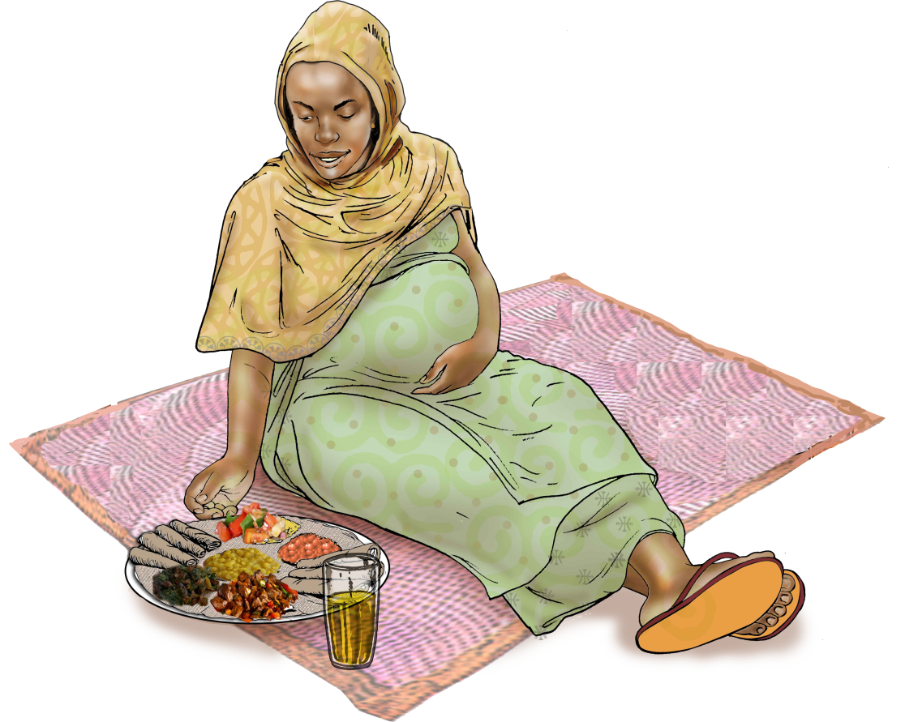
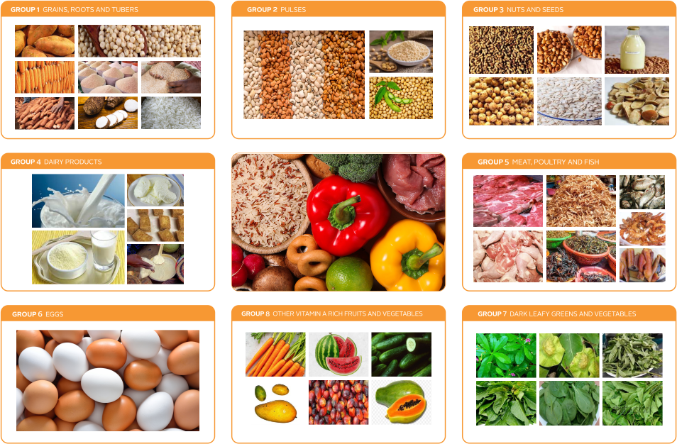
Strategy for Enhancing Micronutrient Sufficiency in Pregnant Women
MODULE 2:
DURATION: 90 Minutes

Slide 2

MODULE 2: INTERVENTIONS TO IMPROVE MICRONUTRIENT NUTRITION IN PREGNANT WOMEN
NATIONAL TRAINING MANUAL ON MULTIPLE MICRONUTRIENT SUPPLEMENTS (MMS) FOR FRONTLINE HEALTHCARE PROVIDERS IN NIGERIA
Learning Objectives
At the end of this module, you should be able to:
Identify the key interventions to improve micronutrient adequacy in pregnant women
Explain the importance of micronutrient supplementation and healthy diet in preventing micronutrient deficiencies in pregnancy
Demonstrate how to deliver micronutrient supplements effectively during antenatal care (ANC)

Slide 3
MODULE 2: INTERVENTIONS TO IMPROVE MICRONUTRIENT NUTRITION IN PREGNANT WOMEN
NATIONAL TRAINING MANUAL ON MULTIPLE MICRONUTRIENT SUPPLEMENTS (MMS) FOR FRONTLINE HEALTHCARE PROVIDERS IN NIGERIA
Materials Needed
Bottle of MMS ( UNIMMAP Formulation)
Bottle of IFA
Flipcharts
Markers
Portable water

Slide 4
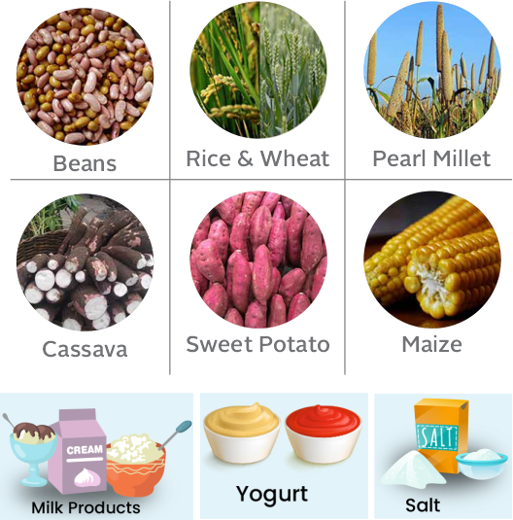
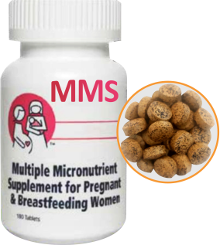
Interventions to Improve Nutrition in Pregnant Women
MODULE 2: INTERVENTIONS TO IMPROVE MICRONUTRIENT NUTRITION IN PREGNANT WOMEN
NATIONAL TRAINING MANUAL ON MULTIPLE MICRONUTRIENT SUPPLEMENTS (MMS) FOR FRONTLINE HEALTHCARE PROVIDERS IN NIGERIA
Dietary Diversification
Biofortification and Food Fortification
Supplementation

Slide 5
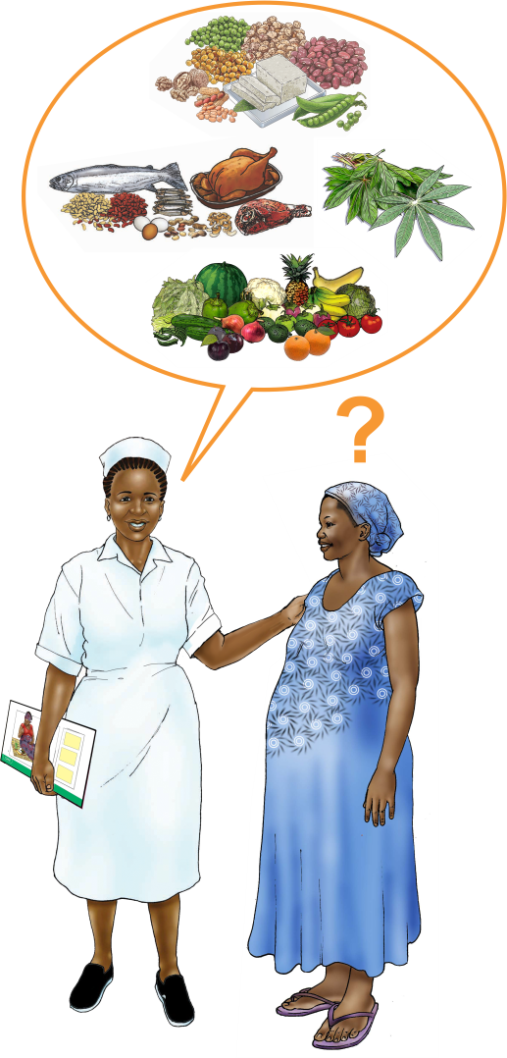
MODULE 2: INTERVENTIONS TO IMPROVE MICRONUTRIENT NUTRITION IN PREGNANT WOMEN
NATIONAL TRAINING MANUAL ON MULTIPLE MICRONUTRIENT SUPPLEMENTS (MMS) FOR FRONTLINE HEALTHCARE PROVIDERS IN NIGERIA
Dietary Diversification....1
A food-based solution that emphasizes the consumption of different variety of food from various food groups
Practical Tips for Health Workers:
Ask: “What types of foods do you eat daily?”
Counsel: Encourage pregnant women to eat from at least five food groups from the ten food groups daily

Slide 6
MODULE 2: INTERVENTIONS TO IMPROVE MICRONUTRIENT NUTRITION IN PREGNANT WOMEN
NATIONAL TRAINING MANUAL ON MULTIPLE MICRONUTRIENT SUPPLEMENTS (MMS) FOR FRONTLINE HEALTHCARE PROVIDERS IN NIGERIA
Dietary Diversification....2
10 Food Groups
Grains, white roots and tubers, and plantains
Pulses (beans, peas and lentils)
Nuts and seeds
Dairy
Meat, poultry and fish
Eggs
Dark green leafy vegetables
Vitamin A-rich fruits and vegetables
Other vegetables
Other fruits
Counseling Tip:
Explain that eating a variety of foods helps provide essential vitamins and minerals for both mother and foetus

Slide 7
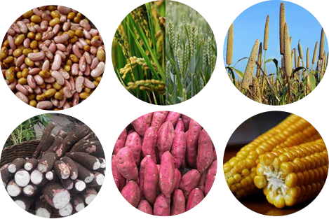
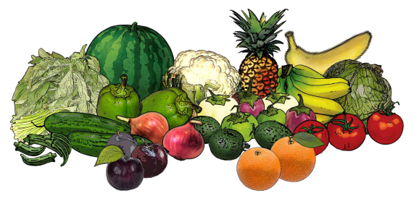
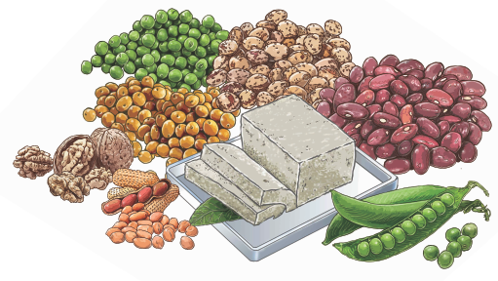
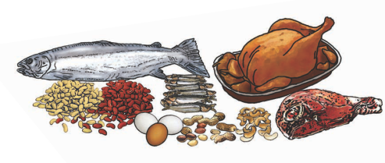

MODULE 2: INTERVENTIONS TO IMPROVE MICRONUTRIENT NUTRITION IN PREGNANT WOMEN
NATIONAL TRAINING MANUAL ON MULTIPLE MICRONUTRIENT SUPPLEMENTS (MMS) FOR FRONTLINE HEALTHCARE PROVIDERS IN NIGERIA
Biofortification and Food Fortification
  Biofortification:
Food Fortification:
  Increasing the micronutrient content in staple crops (e.g., orange-fleshed sweet potato or biofortified maize)
Adding vitamins and minerals to commonly eaten foods (e.g., iodine in salt, Vitamin A in flour and oil)
Counselling Tip:
Suggest pregnant women to consume fortified foods where available, such as fortified flour, oil, and salt.

Slide 8
MODULE 2: INTERVENTIONS TO IMPROVE MICRONUTRIENT NUTRITION IN PREGNANT WOMEN
NATIONAL TRAINING MANUAL ON MULTIPLE MICRONUTRIENT SUPPLEMENTS (MMS) FOR FRONTLINE HEALTHCARE PROVIDERS IN NIGERIA
Supplementation
Multiple Micronutrient Supplements (MMS)
A supplement containing 15 essential vitamins and minerals, including iron and folic acid, to meet the increased nutritional needs in pregnancy
1 MMS tablet per day throughout pregnancy for non-anaemic women
Iron and Folic Acid Supplements (IFAS)
Iron and folic acid supplement is given to pregnant women to prevent anaemia and birth defects

Slide 9
MODULE 2: INTERVENTIONS TO IMPROVE MICRONUTRIENT NUTRITION IN PREGNANT WOMEN
NATIONAL TRAINING MANUAL ON MULTIPLE MICRONUTRIENT SUPPLEMENTS (MMS) FOR FRONTLINE HEALTHCARE PROVIDERS IN NIGERIA
Supplementation
Counsel
Ensure she unders-
tands the importan-
ce of taking MMS or IFAS daily to prevent anaemia, birth def-
ects, and other complications.
Assist
Help her overcome common barriers, like nausea (suggest to her to take supplements with food)
Assess
Ask if the woman is already taking MMS or IFAS. If not, explain the benefits
Screen
Screen for anaemia

Slide 10
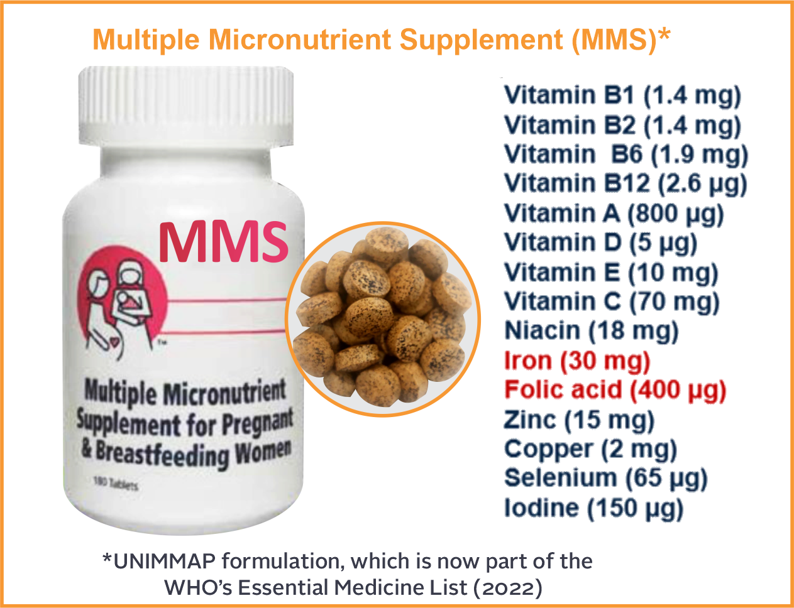
MODULE 2: INTERVENTIONS TO IMPROVE MICRONUTRIENT NUTRITION IN PREGNANT WOMEN
NATIONAL TRAINING MANUAL ON MULTIPLE MICRONUTRIENT SUPPLEMENTS (MMS) FOR FRONTLINE HEALTHCARE PROVIDERS IN NIGERIA
Why MMS is Critical
During Pregnancy
Provides a broad range of essential nutrients beyond just iron and folic acid
Prevents micronutrient deficiencies, especially in pregnancy .
Fills nutritional gaps in a pregnant woman’s diet

Slide 11
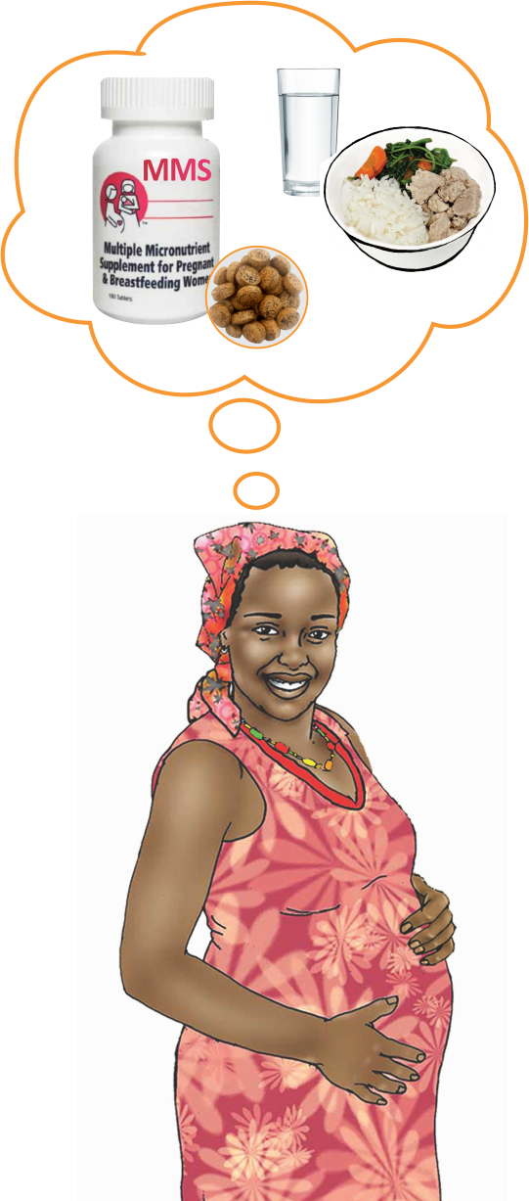
MODULE 2: INTERVENTIONS TO IMPROVE MICRONUTRIENT NUTRITION IN PREGNANT WOMEN
NATIONAL TRAINING MANUAL ON MULTIPLE MICRONUTRIENT SUPPLEMENTS (MMS) FOR FRONTLINE HEALTHCARE PROVIDERS IN NIGERIA
Additional Benefits of MMS
Reduces maternal anaemia
Improves foetal growth, reducing the risk of low birth weight and preterm birth
Provides all essential nutrients, including iron, folic acid, vitamins A, C, and zinc, which are often lacking in the diets of pregnant women

Slide 12
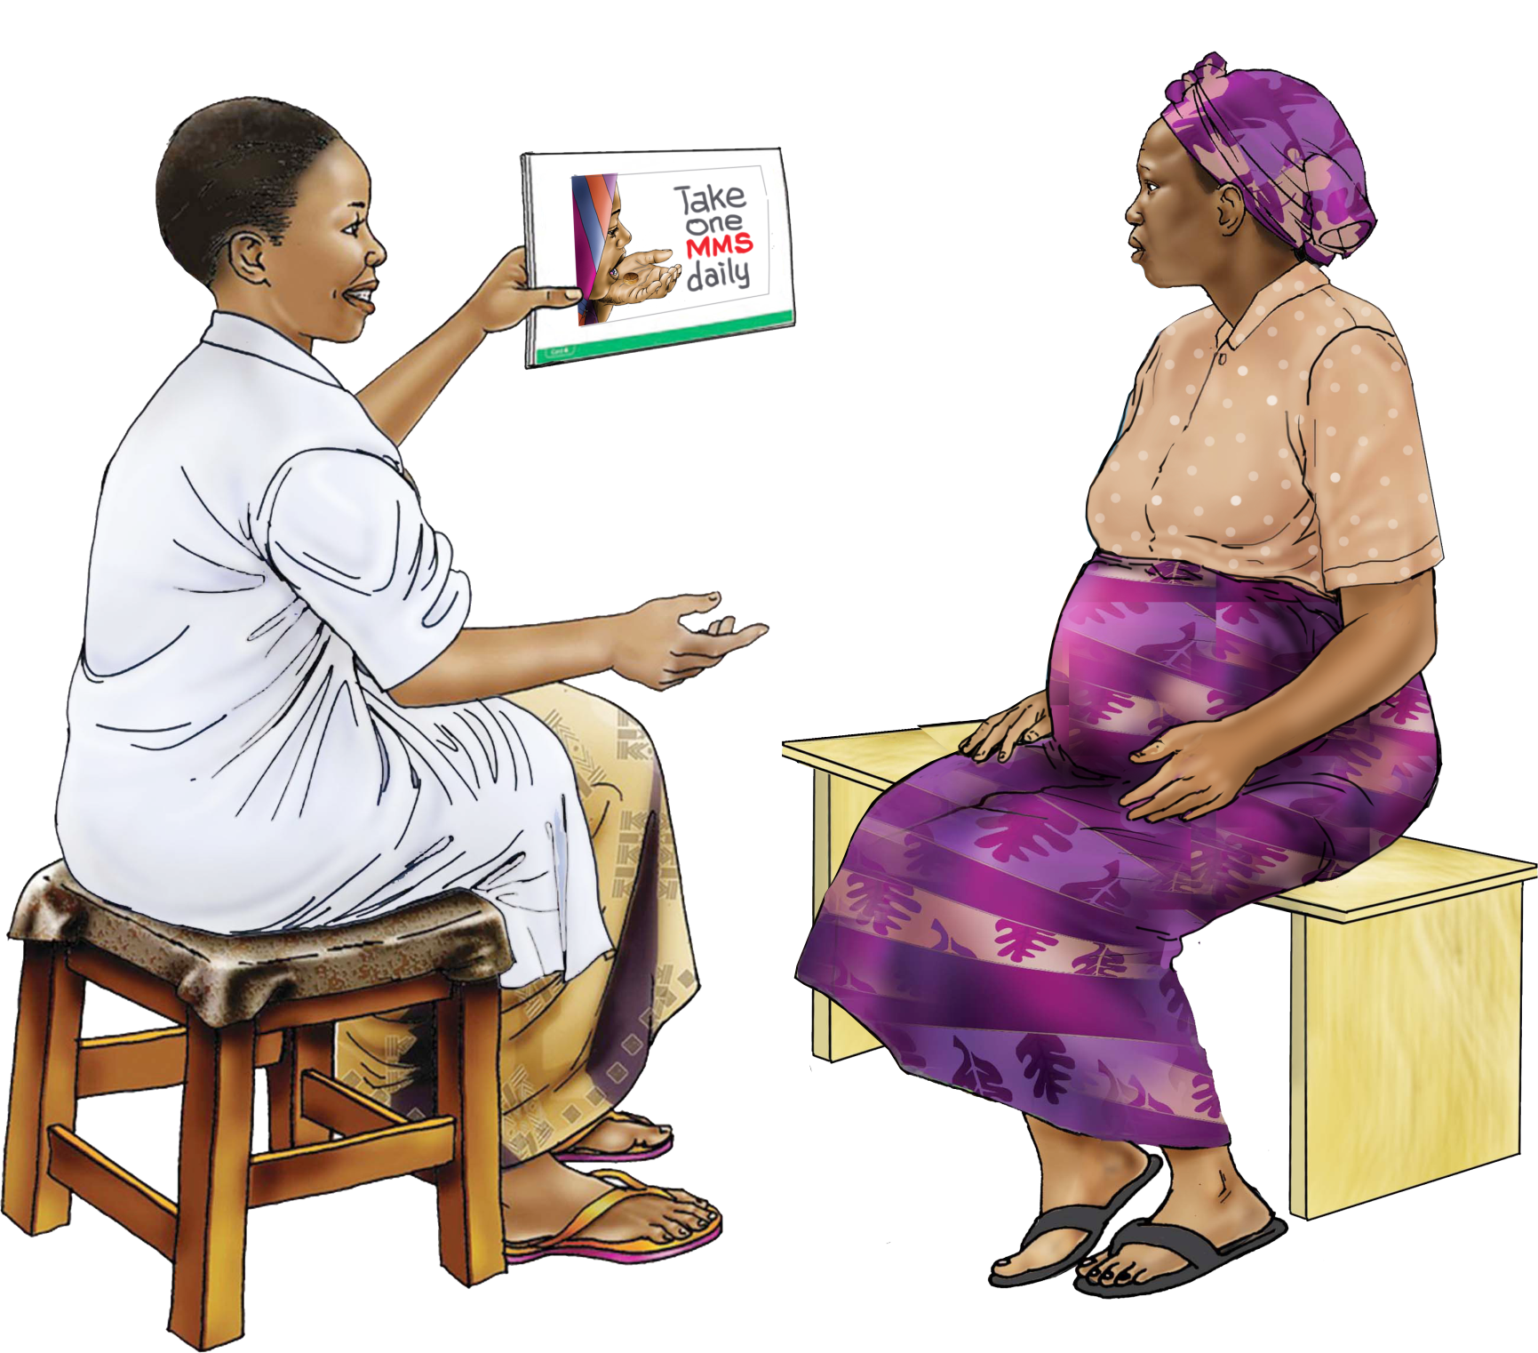
MODULE 2: INTERVENTIONS TO IMPROVE MICRONUTRIENT NUTRITION IN PREGNANT WOMEN
NATIONAL TRAINING MANUAL ON MULTIPLE MICRONUTRIENT SUPPLEMENTS (MMS) FOR FRONTLINE HEALTHCARE PROVIDERS IN NIGERIA
Counselling on MMS
Importance: Explain that MMS or IFAS supports the health of both mother and baby by providing essential vitamins and minerals
Dosage: Take one MMS tablet daily, even if feeling healthy
Side Effects: Address common side effects (e.g., nausea) by suggesting to take the supplement with food or at night
Food and Supplement Interaction: MMS should only be taken with water to avoid reducing iron absorption

Slide 13
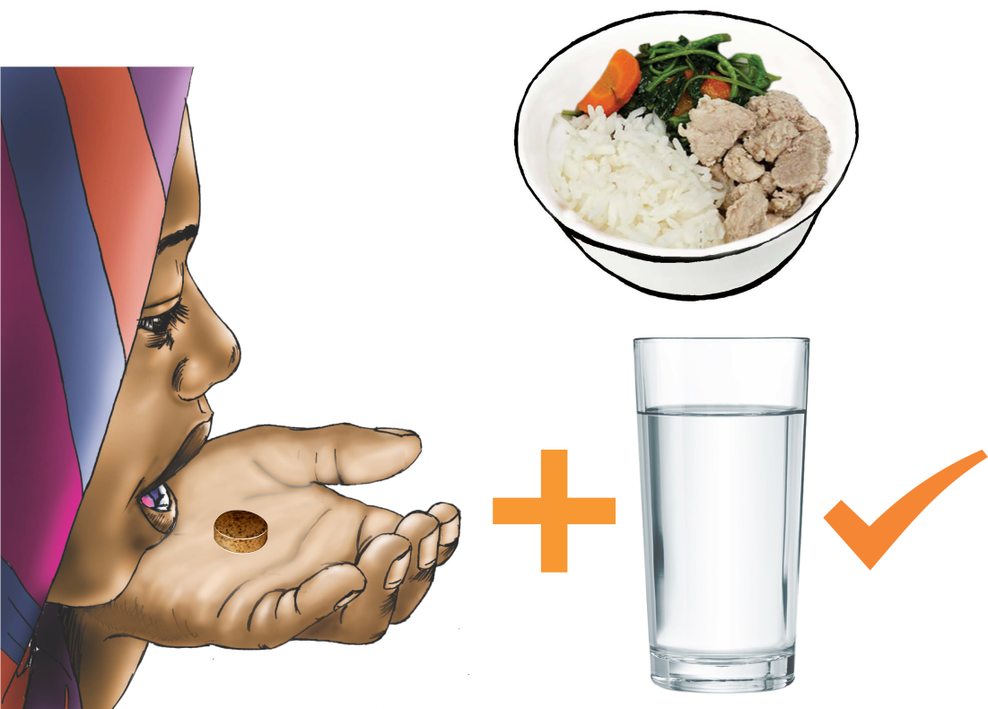
MODULE 2: INTERVENTIONS TO IMPROVE MICRONUTRIENT NUTRITION IN PREGNANT WOMEN
NATIONAL TRAINING MANUAL ON MULTIPLE MICRONUTRIENT SUPPLEMENTS (MMS) FOR FRONTLINE HEALTHCARE PROVIDERS IN NIGERIA
Role Play
A pregnant woman says she feels nauseous after taking supplements
Health Worker’s Response: Suggest that she take the supplement after her evening meal and assure her that mild side effects usually go away

Slide 14
MODULE 2: INTERVENTIONS TO IMPROVE MICRONUTRIENT NUTRITION IN PREGNANT WOMEN
NATIONAL TRAINING MANUAL ON MULTIPLE MICRONUTRIENT SUPPLEMENTS (MMS) FOR FRONTLINE HEALTHCARE PROVIDERS IN NIGERIA
Promoting a Healthy, Diverse Diet
Practical Steps for Health Workers
Assess: During ANC visits, ask pregnant women what they typically eat in a day
Assist : Help her identify gaps in her diet, such as lack of leafy greens (for folate and iron) or fruits (for Vitamin C)
Counsel : Provide simple suggestions to improve her diet using local foods:
  Green vegetables for iron
  Citrus fruits for Vitamin C
  Fortified maize or rice for extra vitamins and minerals

Slide 15
MODULE 2: INTERVENTIONS TO IMPROVE MICRONUTRIENT NUTRITION IN PREGNANT WOMEN
NATIONAL TRAINING MANUAL ON MULTIPLE MICRONUTRIENT SUPPLEMENTS (MMS) FOR FRONTLINE HEALTHCARE PROVIDERS IN NIGERIA
Interactive Activity
Diet Assessment and Counselling
Exercise: In pairs, one person acts as the health worker, and the other as the pregnant woman. The health worker assesses the woman’s diet based on simple questions and gives advice on how to improve it with local foods.
Discussion: Groups discuss the barriers to healthy eating in their communities and how to address them, such as access to nutritious foods or cultural preferences

Slide 16
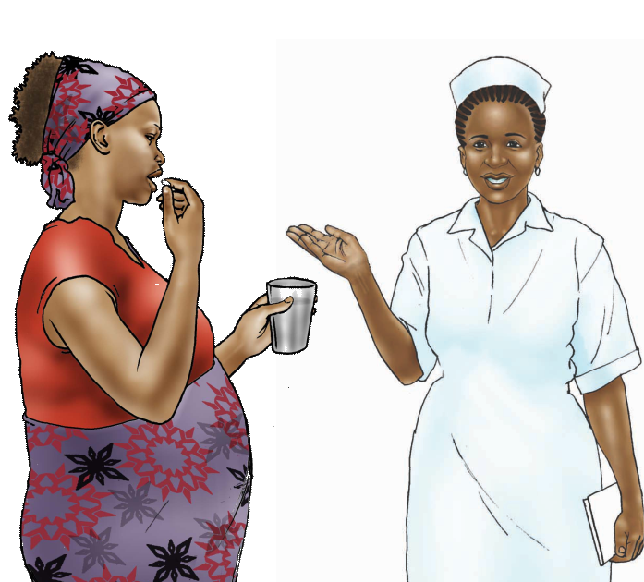
MODULE 2: INTERVENTIONS TO IMPROVE MICRONUTRIENT NUTRITION IN PREGNANT WOMEN
NATIONAL TRAINING MANUAL ON MULTIPLE MICRONUTRIENT SUPPLEMENTS (MMS) FOR FRONTLINE HEALTHCARE PROVIDERS IN NIGERIA
Monitoring and Ensuring Adherence to Supplementation
Ask open-ended questions to assess whether the pregnant woman is regularly taking her supplements:
  "How often do you take your supplements?"
  "Have you missed any doses? If yes, ask Why?"
Provide support if adherence is low:
  If forgetfulness is an issue, suggest setting reminders or enlisting family support
  If side effects are the problem, suggest ways to reduce discomfort (e.g., taking the supplement with food, especially with evening meals)

Slide 17
MODULE 2: INTERVENTIONS TO IMPROVE MICRONUTRIENT NUTRITION IN PREGNANT WOMEN
NATIONAL TRAINING MANUAL ON MULTIPLE MICRONUTRIENT SUPPLEMENTS (MMS) FOR FRONTLINE HEALTHCARE PROVIDERS IN NIGERIA
Activity: Identifying Barriers to Adherence
Scenario
  A pregnant woman says she forgets to take her MMS
Health Worker’s Response
  Help her find a way to remember, such as taking the supplement at the same time each day, keeping the bottle in a visible place, or asking a family member to remind her

Slide 18
MODULE 2: INTERVENTIONS TO IMPROVE MICRONUTRIENT NUTRITION IN PREGNANT WOMEN
NATIONAL TRAINING MANUAL ON MULTIPLE MICRONUTRIENT SUPPLEMENTS (MMS) FOR FRONTLINE HEALTHCARE PROVIDERS IN NIGERIA
Key Takeaways for Health Workers
Promote diverse diets that include local,
nutrient-rich foods
Ensure all pregnant women receive and understand the importance of MMS or IFAS
Regularly monitor and encourage adherence to supplementation
Use practical, culturally relevant counselling techniques to help women improve their nutrition during pregnancy

