Slide 1
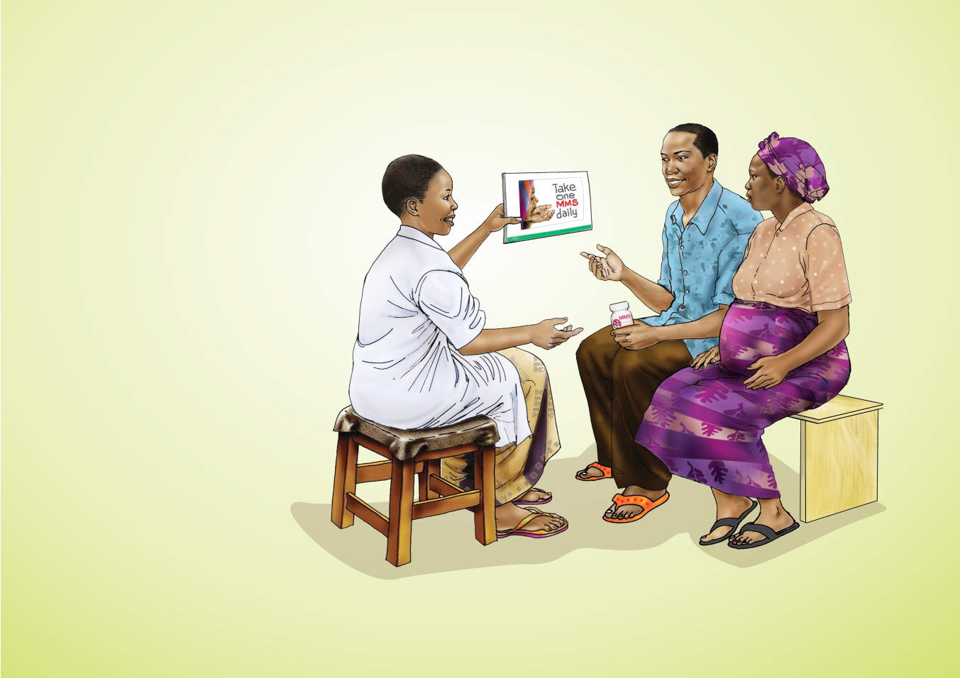


NATIONAL TRAINING MANUAL ON
MULTIPLE MICRONUTRIENT
SUPPLEMENTS (MMS)
FOR FRONTLINE HEALTHCARE PROVIDERS IN NIGERIA

Slide 2
Overview of Training
NATIONAL TRAINING MANUAL ON MULTIPLE MICRONUTRIENT SUPPLEMENTS (MMS) FOR FRONTLINE HEALTHCARE PROVIDERS IN NIGERIA
MODULE 1: Nutrition During Pregnancy
MODULE 2: Interventions to Improve Micronutrient Nutrition in Pregnant Women
MODULE 3: Integrating MMS into ANC Service Delivery
MODULE 4: Key Messages on the Provision of MMS and Counselling Techniques
MODULE 5: Steps for Provision of MMS During ANC in Health Facilities
MODULE 6: Estimating Supply Needs for MMS
MODULE 7: Monitoring and Record Keeping of Multiple Micronutrient Supplements (MMS)

Slide 3
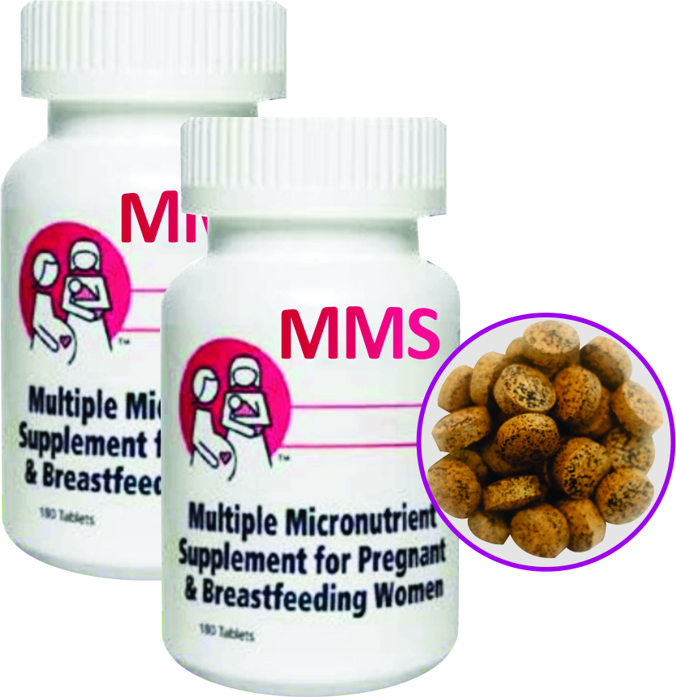

MODULE 1:
Nutrition During
Pregnancy
DURATION: 90 Minutes

Slide 4
MODULE 1: NUTRITION DURING PREGNANCY
NATIONAL TRAINING MANUAL ON MULTIPLE MICRONUTRIENT SUPPLEMENTS (MMS) FOR FRONTLINE HEALTHCARE PROVIDERS IN NIGERIA
Learning Objectives
At the end of this module, you should be able to:
Describe the trimesters of pregnancy
Explain the role of key macronutrients and micronutrients in pregnancy, focusing on how they support maternal and foetal health
Identify signs of micronutrient deficiencies and their impact on pregnancy outcomes
Provide dietary and supplementation advice to address adverse pregnancy and birth outcomes associated with nutrient deficiencies.

Slide 5
Materials Needed
NATIONAL TRAINING MANUAL ON MULTIPLE MICRONUTRIENT SUPPLEMENTS (MMS) FOR FRONTLINE HEALTHCARE PROVIDERS IN NIGERIA
MODULE 1: NUTRITION DURING PREGNANCY
Poster summarizing key micronutrients, their roles, and food sources
Counselling Cards
Flip chart

Slide 6
NATIONAL TRAINING MANUAL ON MULTIPLE MICRONUTRIENT SUPPLEMENTS (MMS) FOR FRONTLINE HEALTHCARE PROVIDERS IN NIGERIA
MODULE 1: NUTRITION DURING PREGNANCY
The Trimesters in Pregnancy
Pregnancy is divided into three trimesters, each with specific changes in the mother’s body and baby’s development
1st Trimester (Weeks
1–13)
Key Developments: Formation of major organs (heart, brain, spine)
2nd Trimester (Weeks
14–26)
Key Developments: Rapid foetal growth and bone development
3rd Trimester (Weeks
27–40)
Key Developments: Foetal fat storage and brain development

Slide 7
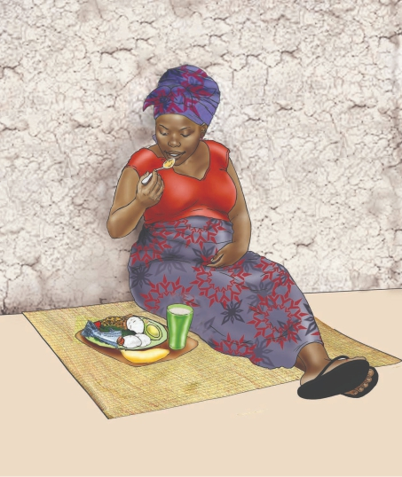
NATIONAL TRAINING MANUAL ON MULTIPLE MICRONUTRIENT SUPPLEMENTS (MMS) FOR FRONTLINE HEALTHCARE PROVIDERS IN NIGERIA
MODULE 1: NUTRITION DURING PREGNANCY
Nutritional Needs
Nutritional needs increase during pregnancy to ensure healthy outcomes for both mother and baby
Key nutrients needed:
  Macronutrients - carbohydrates, proteins, fats,
  Micronutrients- vitamins, minerals (e.g., iron, folate, Vitamin A, zinc)
  Adequate diet helps in optimal health and well-being

Slide 8
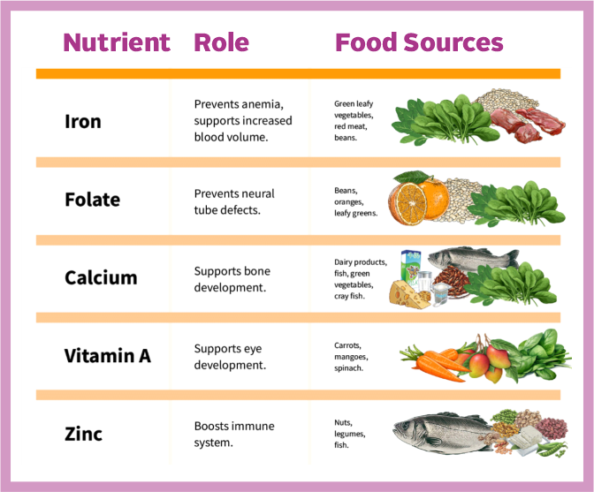
NATIONAL TRAINING MANUAL ON MULTIPLE MICRONUTRIENT SUPPLEMENTS (MMS) FOR FRONTLINE HEALTHCARE PROVIDERS IN NIGERIA
MODULE 1: NUTRITION DURING PREGNANCY
Nutrients, Roles and Food Sources
Note to Facilitator:
Use counselling cards to counsel women that in addition to taking MMS they should consume food items from all food groups
Counselling Tips:
When discussing with health workers, facilitators should emphasis the following;
Use simple language: "Iron keeps your blood strong so you can avoid feeling tired and dizzy.“
Provide culturally appropriate advice: Recommend local foods rich in essential nutrients like leafy greens, beans, and fish.

Slide 9
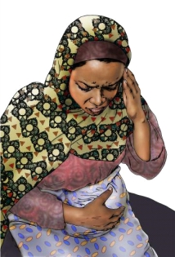
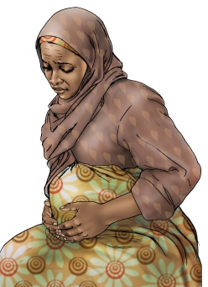
NATIONAL TRAINING MANUAL ON MULTIPLE MICRONUTRIENT SUPPLEMENTS (MMS) FOR FRONTLINE HEALTHCARE PROVIDERS IN NIGERIA
MODULE 1: NUTRITION DURING PREGNANCY
Key Deficiencies and Signs
Nutrient Deficiency | Signs | Impact on Pregnancy
Iron Deficiency | Pale skin, fatigue, dizziness | Increases risk of anaemia, preterm birth.
Folate Deficiency | Fatigue, poor foetal development | Can cause neural tube defects
Calcium Deficiency | Muscle cramps, weak teeth | Poor foetal bone development
Zinc deficiency | Loss of appetite, unexplained weight loss, impaired sense of taste and smell | Low birthweight, premature birth, preeclampsia and stillbirth
Vitamin A Deficiency | Night blindness, dry skin | Can cause poor foetal growth

Slide 10
NATIONAL TRAINING MANUAL ON MULTIPLE MICRONUTRIENT SUPPLEMENTS (MMS) FOR FRONTLINE HEALTHCARE PROVIDERS IN NIGERIA
MODULE 1: NUTRITION DURING PREGNANCY
Providing Dietary Counselling
on Healthy, Diverse Diet
Practical Steps for Health Workers:
  Assess: During ANC visits, ask pregnant women what they
  typically eat in a day.
  Analyze: Help her identify gaps in her diet, such as lack of leafy greens (for folate and iron) or fruits (for Vitamin C).
  Act/Assist: Provide simple suggestions to improve her diet using local foods:
    Variety of food different food groups
    Green vegetables for iron.
    Citrus fruits for Vitamin C.
    Fortified maize or rice for extra vitamins and minerals

Slide 11
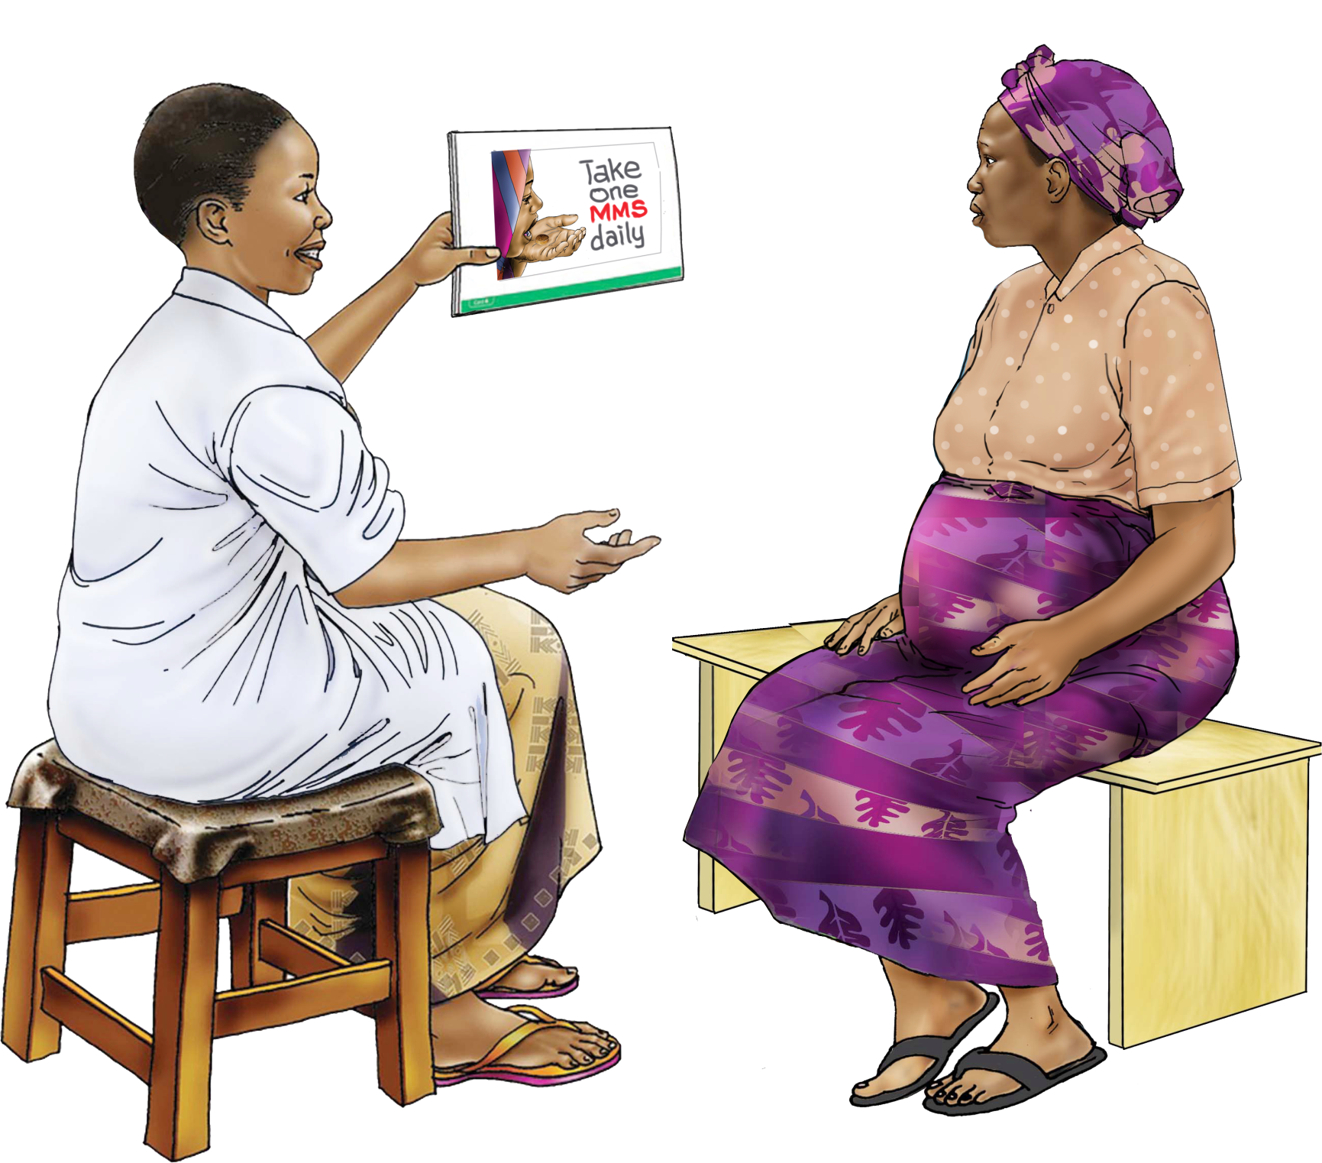
NATIONAL TRAINING MANUAL ON MULTIPLE MICRONUTRIENT SUPPLEMENTS (MMS) FOR FRONTLINE HEALTHCARE PROVIDERS IN NIGERIA
MODULE 1: NUTRITION DURING PREGNANCY
Steps to Assess Nutritional Needs
Follow the steps below to assess whether a pregnant
woman is meeting her nutritional needs:
  "What did you eat yesterday (in the morning, afternoon and night)?" – Helps assess dietary diversity
  "How many meals do you eat daily?" – To evaluate meal frequency and portion size
  "What do you eat?" – Check out for (beans, eggs, or green vegetables,) protein, Iron, and folate intake
  "Are you taking your supplements?" – Ensures adherence to taking MMS
  Pale skin or dizziness: May indicate anaemia (Iron deficiency)
  Muscle cramps: May indicate calcium or magnesium deficiency
  Fatigue or poor foetal growth: Could suggest inadequate protein or micronutrient intake
  Encourage extra portions: 1 in the first trimester, 2 in the second, and 1 additional meal in the third, with healthy snacks
  Suggest local foods like fish, beans, leafy vegetables, and fruit
  Counsel on MMS supplements, their importance, and managing side effects (nausea, constipation)
Ask Key Questions
?
Check for
Signs and
Symptoms
Counsel

Slide 12
NATIONAL TRAINING MANUAL ON MULTIPLE MICRONUTRIENT SUPPLEMENTS (MMS) FOR FRONTLINE HEALTHCARE PROVIDERS IN NIGERIA
MODULE 1: NUTRITION DURING PREGNANCY
Micronutrients Deficiency
in Pregnancy
Many women in Nigeria and developing countries consume poor, non-diverse diets, leading to unmet nutritional needs (NFCMS 2021)
Increased nutrient needs and inadequate diets during pregnancy increase the risk of micronutrient deficiencies and related health issues

Slide 13
NATIONAL TRAINING MANUAL ON MULTIPLE MICRONUTRIENT SUPPLEMENTS (MMS) FOR FRONTLINE HEALTHCARE PROVIDERS IN NIGERIA
MODULE 1: NUTRITION DURING PREGNANCY
Micronutrients Deficiency
in Pregnancy
According to the 2021 National Food Consumption and Micronutrient Survey (NFCMS)
28% of women of reproductive age (15-49) achieved minimum dietary diversity
34% of pregnant women received nutrition counselling
28.8% of pregnant women met minimum dietary diversity
Over 30% of women lacked adequate protein intake
More than 50% of women had insufficient calcium, vitamins C, B1, B2, folate, and B12
14.2% of reproductive-age women were underweight (BMI <18.5), 15% overweight, and 8.1% obese
32% of pregnant women had anaemia
28% were iron deficient, 22% lacked Vitamin A, 85% were folate deficient, and 12% lacked Vitamin B12

Slide 14
NATIONAL TRAINING MANUAL ON MULTIPLE MICRONUTRIENT SUPPLEMENTS (MMS) FOR FRONTLINE HEALTHCARE PROVIDERS IN NIGERIA
MODULE 1: NUTRITION DURING PREGNANCY
Counselling Skills for
Early Intervention
Analyze: Based on the information from the
pregnant woman
Act: If deficiencies are suspected, ensure women are taking their supplements. Offer tips to reduce side effects (e.g., nausea from MMS)
Ask: Simple, open-ended questions like “How are you feeling?” or “Do you have
any other complaints?”

Slide 15
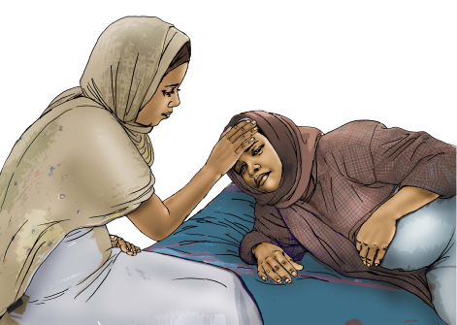
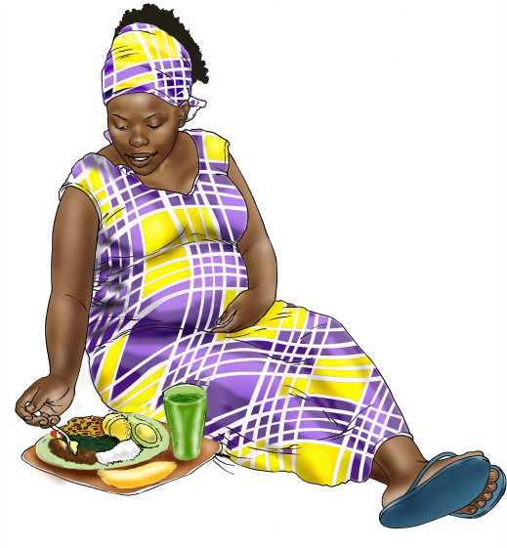
NATIONAL TRAINING MANUAL ON MULTIPLE MICRONUTRIENT SUPPLEMENTS (MMS) FOR FRONTLINE HEALTHCARE PROVIDERS IN NIGERIA
MODULE 1: NUTRITION DURING PREGNANCY
Case Study
Scenario
A pregnant woman in her second trimester complains of dizziness and pale skin
Health Worker Action
Ask if she’s taking MMS supplements and eating
Iron-rich foods
Advise her to eat more green vegetables and meat
Encourage her to continue taking supplements with
Vitamin C-rich foods for better absorption

Slide 16

NATIONAL TRAINING MANUAL ON MULTIPLE MICRONUTRIENT SUPPLEMENTS (MMS) FOR FRONTLINE HEALTHCARE PROVIDERS IN NIGERIA
MODULE 1: NUTRITION DURING PREGNANCY
Practical Activity
Flip Card Exercise: Health workers practice using flip cards to explain the importance of each micronutrient during pregnancy.
Role Play (refer case scenario above): One participant acts as the health worker, another as a pregnant woman with a nutrient deficiency. The health worker asks questions, identifies the deficiency, and provides dietary or supplementation advice.
Group Discussion: Participants discuss common barriers pregnant women face in meeting their nutritional needs (e.g., cultural beliefs, food access) and brainstorm solutions.
Spend 30 minutes on this activity

