Slide 1

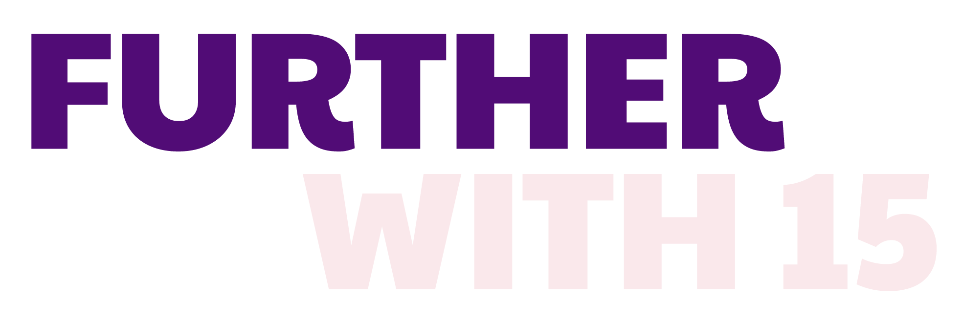

The global movement to improve maternal nutrition and newborn health has begun.
Together, we can all go #FurtherWith15

Slide 2



How to use this slide deck
Facilitate dialogue & create consensus
  View these slides as a resource for anyone wanting to communicate that MMS is an affordable and cost-effective investment that supports pregnant women, their babies, and entire communities. Our goal is to equip the presenter of these slides with key messages that can be delivered to decision-makers or to those considering piloting, scaling, and implementation of MMS.
Customize dialogue
  Speaker notes are provided with each slide, but they are not intended to be read word-for-word. Tailor and add your own speaking notes to make this relevant for your audience.
ADAPT to Your Audience
  Slides can be tailored with data and statistics from your country and made relevant for your audience. Slides or entire sections can be removed or re-ordered. Additional resources can be found at the end of the presentation.
We’d like to hear from you! Contact HMHBConsortium@micronutrientforum.org if you have questions or would like additional support.​
Notes:
Please review the instructions on this slide for how to use/customize this presentation. Then, remove this slide before presenting.

Slide 3



Audiences for this slide deck
This presentation provides an overview of the growing need for multiple micronutrient supplements (MMS) and why they are a best buy for global development, providing key messages and slides that can be tailored with country-specific data to support the introduction, piloting, and scaling of MMS. You may wish to include (or omit) specific sections of the presentation.
Government finance officials & Ministry of finance representatives
National health officials
Advocates & NGOS
Notes:
Please review the instructions on this slide for how to use/customize this presentation. Then, remove this slide before presenting.

Slide 4

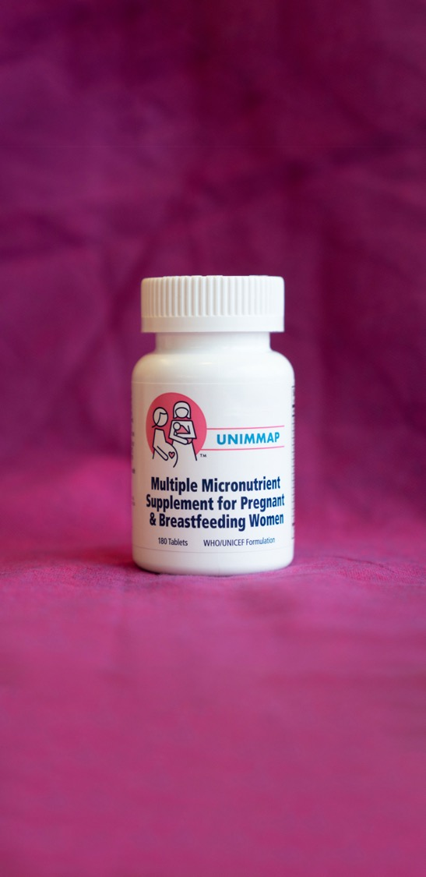

Affordable Investment In Stronger Economies and a Productive Workforce
With 15 essential vitamins and minerals, the WHO/UNICEF formulation of multiple micronutrient supplements (known as UNIMMAP MMS) are one of the best-value investments that countries can make in their development, driving healthier communities and stronger economies.
Topics covered:
The growing need for MMS
The clear evidence behind MMS
MMS is an affordable & cost-effective investment
Now is the time to take action on MMS
Notes:
UNIMMAP MMS is a strong investment for global development. This presentation covers the growing need for MMS, the evidence behind it, how and why it’s an affordable and cost-effective investment, and why now, more than ever before, is the time to act.

Slide 5


The Need for MMS is Growing
1
Over 1 billion women and adolescent girls
are malnourished worldwide.¹
2 out of every 3 women of reproductive age
suffer from micronutrient deficiencies.²
Nearly 50% of all child deaths are linked to child
and maternal malnutrition.³
Each year, 17 million children are born with low birthweight, 146 million children under five are stunted, and 245 million suffer from anemia.⁴
B
United Nations Children’s Fund (UNICEF). Undernourished and Overlooked: A Global Nutrition Crisis in Adolescent Girls and Women. UNICEF Child Nutrition Report Series, 2022. UNICEF, New York, 2023.
Stevens et al. Micronutrient deficiencies among preschool-aged children and women of reproductive age worldwide: a pooled analysis of individual level data from population-representative surveys. Lancet Glob. Heal. 2022, 10 (11). https://www.thelancet.com/journals/langlo/ article/PIIS2214109X(22)00367-9
Institute for Health Metrics and Evaluation (IHME). Global Burden of Disease 2021: Findings from the GBD 2021 Study. Seattle, WA: IHME, 2024.
Jain S, Ahsan S, Robb Z, Crowley B, Walters D. The cost of inaction: a global tool to inform nutrition policy and investment decisions on global nutrition targets. Health Policy and Planning, 2024. https://doi.org/10.1093/heapol/czae056
Notes:
Worldwide, over 1 billion women and adolescent girls are malnourished – and 2 out of every 3 women of reproductive age have micronutrient deficiencies.
45 million children experienced wasting—the most severe forms of chronic and acute malnutrition. Stunting, low birthweight, and anemia leads 1.3 million child deaths annually.
Nearly 50% of all child deaths are linked to child and maternal malnutrition.
Each year, 17 million children are born with low birthweight, 146 million children under five are stunted, and 245 million suffer from anemia.

Slide 6



The Evidence Behind MMS
Over 25 years of evidence have made the benefits clear: MMS doesn’t just improve lives — it saves them.
MMS is proven to reduce the risk of babies being born stillborn, or born too small, or too soon.⁵
When a woman takes MMS during pregnancy, she has a 27% lower risk of giving birth to a low birthweight baby born too small or too soon.⁶
The benefits are even greater for anemic women, who are at higher risk of dying due to postpartum hemorrhage and eclampsia, two leading causes of maternal death.⁷
Smith, E. R.et al. Modifiers of the Effect of Maternal Multiple Micronutrient Supplementation on Stillbirth, Birth Outcomes, and Infant Mortality: A Meta-Analysis of Individual Patient Data from 17 Randomized Trials in Low-Income and Middle-Income Countries. Lancet Glob. Heal. 2017, 5 (11). https://pubmed.ncbi.nlm.nih.gov/29025632/.
Wang, Dongqing Adu-Afarwuah, Seth et al. 2025. The effects of prenatal multiple micronutrient supplementation and small-quantity lipid-based nutrient supplementation on small vulnerable newborn types in low-income and middle-income countries: a meta-analysis of individual participant data. Lancet Glob. Heal. Volume 13, Issue 2, e298 - e308, https://doi.org/10.1016/S2214-109X(24)00449-2
Smith, E. R.et al. Modifiers of the Effect of Maternal Multiple Micronutrient Supplementation on Stillbirth, Birth Outcomes, and Infant Mortality: A Meta-Analysis of Individual Patient Data from 17 Randomized Trials in Low-Income and Middle-Income Countries. Lancet Glob. Heal. 2017, 5 (11). https://pubmed.ncbi.nlm.nih.gov/29025632/.
Notes:
Over 25 years of evidence have made the benefits clear: MMS doesn’t just improve lives – it saves them.
MMS improves birth outcomes by reducing the risk of babies being born stillborn, or born too small, or too soon. When a woman takes MMS during pregnancy, she has a 27% lower risk of giving birth to a low birthweight baby born too small or too soon. The benefits are even greater for anemic women, who are at higher risk of dying due to postpartum hemorrhage and eclampsia, two leading causes of maternal death.
MMS is a small but mighty intervention that can reduce the risk of life-threatening pregnancy complications and improve birth outcomes for millions of babies.
For just one dose a day, we can protect the health and wellbeing of entire generations.

Slide 7

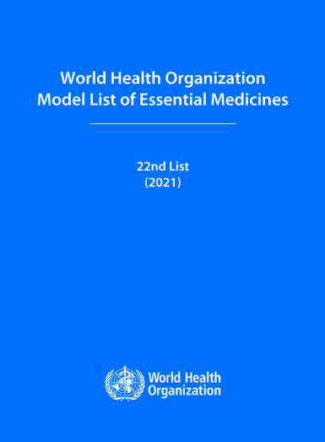
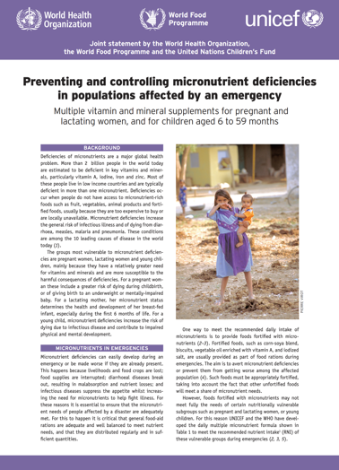
The Global Guidance Behind MMS
UNIMMAP MMS is included on the World Health Organization’s (WHO) List of Essential Medicines since 2021 and is WHO-approved for use with rigorous research and in emergency situations.
2020 updated WHO antenatal care recommendations: https://apps.who.int/iris/bitstream/handle/10665/333561/9789240007789-eng.pdf
WHO Model List of Essential Medicines: https://www.who.int/publications/i/item/WHO-MHP-HPS-EML-2023.02
Preventing and controlling micronutrient deficiencies in populations affected by an emergency https://www.who.int/docs/default-source/nutritionlibrary/preventing-and-controlling-micronutrient-deficiencies-in-populations-affected-by-an-emergency.pdf?sfvrsn=e17f6dff_2
Notes:
After decades of research, WHO released a context-specific recommendation for MMS, including in populations affected by an emergency and in other contexts support by rigorous research as part of antenatal care for pregnant women.
Preventing and controlling micronutrient deficiencies in populations affected by an emergency
https://www.who.int/docs/default-source/nutritionlibrary/preventing-and-controlling-micronutrient-deficiencies-in-populations-affected-by-an-emergency.pdf?sfvrsn=e17f6dff_2
2020 updated WHO antenatal care recommendations
https://apps.who.int/iris/bitstream/handle/10665/333561/9789240007789-eng.pdf
Since 2021, MMS has been included on the WHO’s Model List of Essential Medicines:
WHO Model List of Essential Medicines
https://www.who.int/publications/i/item/WHO-MHP-HPS-EML-2021.02
https://www.who.int/publications/i/item/WHO-MHP-HPS-EML-2023.02

Slide 8


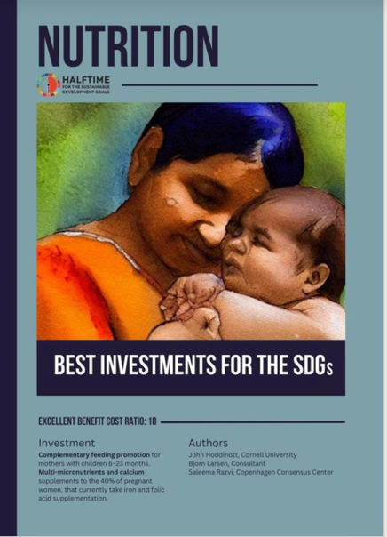
A Best Buy for Global Development
MMS was named one of the best investments for global development – with a $37 return for every $1 invested.¹¹
Well-nourished mothers give birth to well-nourished babies, who can go on to uplift entire communities.
MMS has the potential to improve a child’s cognitive and behavioral development, setting them up for a lifetime of better health.¹²
MMS builds resiliency and helps families withstand and recover from conflicts, epidemics, and climate change.¹³
Larsen B, Hoddinott J, Razvi S. Investing in nutrition – a global best investment case. Journal of Benefit Cost Analysis. 2023 (in press). Available at: https://copenhagenconsensus.com/sites/default/files/2023-03/Nutrition%20Best%20Investment%20Manuscript%20230211.pdf
Cusick SE, Georgieff MK. The Role of Nutrition in Brain Development: The Golden Opportunity of the “First 1000 Days”. J Pediatr. 2016;175:16-21. doi:10.1016/j.jpeds.2016.05.013
Bloem et al, 2007. Preventing and controlling micronutrient deficiencies in populations affected by an emergency. WHO, WFP, UNICEF.
Notes:
Multiple Micronutrient Supplements are one of the best-value investments that countries can make in their development, driving healthier communities and stronger economies.
MMS was named one of the best investments for global development – with a $37 return for every $1 invested.
Well-nourished mothers give birth to well-nourished babies, who can go on to uplift entire communities.
MMS has the potential to improve a child’s cognitive and behavioral development, setting them up for a lifetime of better health.
MMS builds resiliency and helps families withstand and recover from conflicts, epidemics, and climate change.

Slide 9



MMS is an Affordable &
Cost-effective Investment
Poor nutrition impacts entire nations.
MMS is affordable, cost-effective, and can be delivered at scale.
For as little as $2.50 per pregnancy — a similar price to iron-folic acid (IFA) — MMS boosts local and global economies.¹⁴
MMS one of the most cost-effective nutrition interventions available.
Kirk Humanitarian. UNIMMAP Multiple Micronutrient Supplements (MMS) for Pregnant Women: Packaging Options, Costs, and Environmental Impact. August 2024. Accessed at https://kirkhumanitarian.org/wp-content/uploads/2024/07/Kirk-HumanitarianInfographic-8.29.24.pdf
Notes:
Poor nutrition has generational consequences – impacting families, communities, and entire nations.
MMS is an affordable and cost-effective product that can be delivered at scale.
Access to MMS boosts local and global economies for as little as $2.50 per pregnancy—a similar price to iron-folic acid (IFA).¹³
This makes MMS one of the most cost-effective nutrition interventions available to governments and their partners, with the added benefit of being a more effectual product than IFA.

Slide 10



Intergenerational Impact
Reaching women with MMS during pregnancy sets their child up for a lifetime of improved opportunity, and an estimated benefit of over $3.1 billion per year.¹⁵
  $94 million from averted stillbirths
  $428 million from averted preterm births
  $2.6 billion from averted low birth weights
15. Affordable Investment in Stronger Economies and a Productive Workforce Fact sheet, 2025
Notes:
Poor nutrition during the early days of a child’s life can stunt their development and impact their ability to do well in school and earn a good living.
MMS can set a child up for a lifetime of improved opportunity. Reaching mothers with MMS in the earliest stages of pregnancy is crucial to improving development outcomes for babies; which sets the stage for a healthier, more productive life.
Well-nourished mothers give birth to healthy babies who can go on to become productive members of the workforce and help their families rise out of poverty.

Slide 11
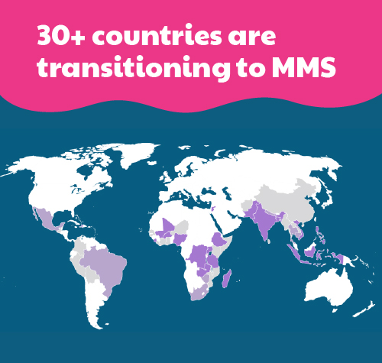
Now Is The Time To Take Action
Now is the time to ensure that pregnant women in all countries have access to MMS, the same standard of care that has long been available to women in high-income countries.
​​Support in many forms — from a proven implementation science framework to manufacturing capability support to initial product donations — are available.
Countries are encouraged to tap into existing mechanisms to accelerate MMS coordination and collaboration, including the CNF, Global MMS Donor Alliance, coordinating with the UNICEF Supply Forum, and collaborating with National MMS Scale-up Alliances.
Notes:
The demand for MMS has never been greater.
Through 2030, more than 130 million are estimated to need MMS each year. As more countries introduce and scale up MMS, that number will only grow.
Supporting the nutrition of women and girls is crucial for delivering on and inextricably linked to meeting several of the United Nations’ Sustainable Development Goals, a global movement for a better world for everyone.
Now is the time to ensure that pregnant women in all countries have access to the same standard of care that has long been available to women in high-income countries.

Slide 12

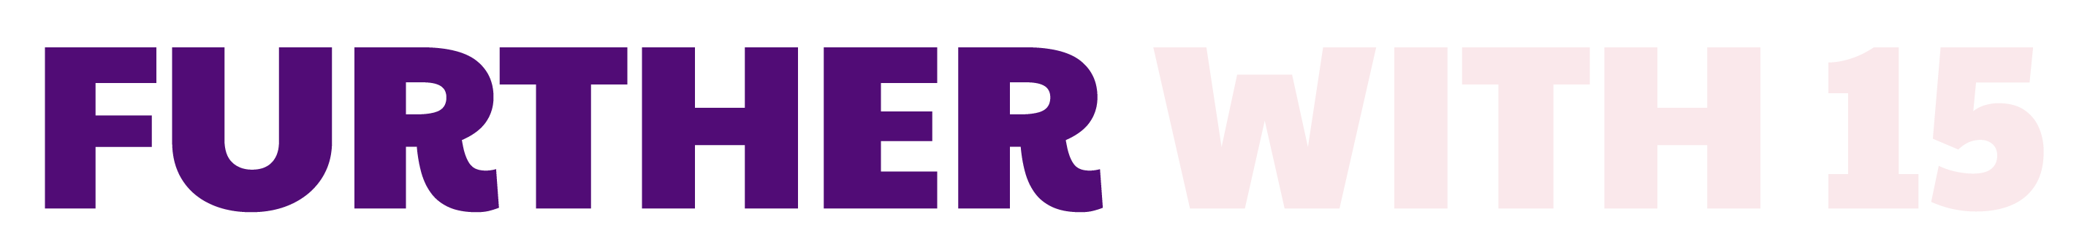






See also
Targeted resources for:
Understanding this High-impact Intervention for Healthier Women and Babies
Countries Acting Now: Scale-up, Financing, Supply & Manufacturing
Visit these pages at FurtherWith15.org for more information

Slide 13
Appendix

Slide 14
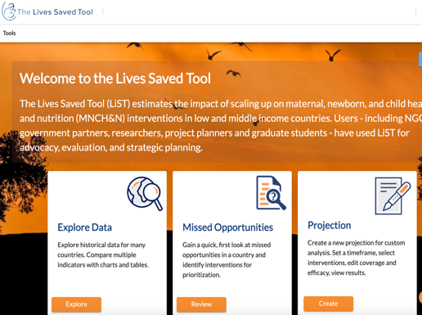
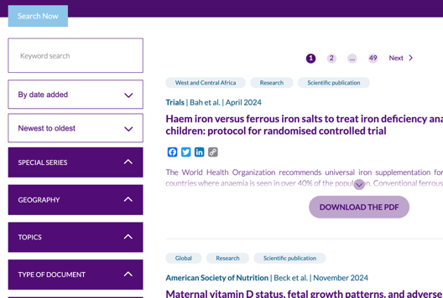

Advocacy Tools
Understand MMS’s impact on lives saved with the Lives Saved Tool (LiST) from Johns Hopkins Bloomberg School of Public Health, funded by the Gates Foundation.
Visit the HMHB Knowledge Hub to access tools and resources to guide MMS exploration and implementation.
Access tools to connect governments and development partners with resources to adopt and scale MMS in the HMHB Advocacy Resource Center.
Visit FurtherWith15.org for these resources and more

Slide 15


Advocacy Tools
Learn more about the lives of mothers during pregnancy by watching HMHB’s Women’s Voices Video Series.
Understand the consequences of lack of access to prenatal multivitamins by viewing Devex’s video, “Why access to prenatal vitamins is a health equity issue” sponsored by the Eleanor Crook Foundation.
Visit FurtherWith15.org for these resources and more

Slide 16

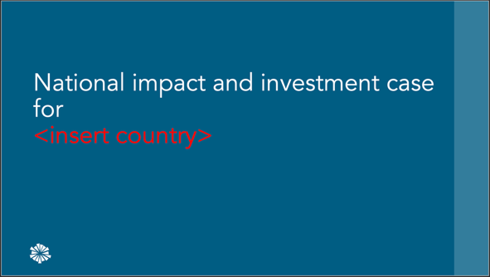
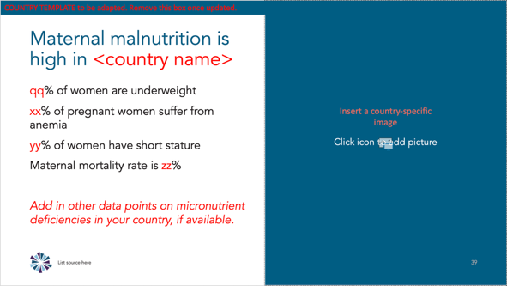
Advocacy Tools
Advancing MMS Advocacy Toolkit
These adaptable slides are a resource for anyone wanting to communicate the evidence and benefits of MMS for pregnant women and their babies.
They contain key messages and statistics that can be tailored to resonate with decision-makers in any country.

Slide 17
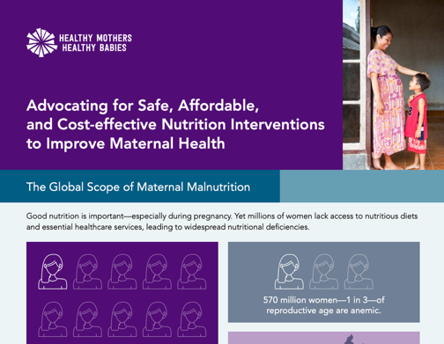
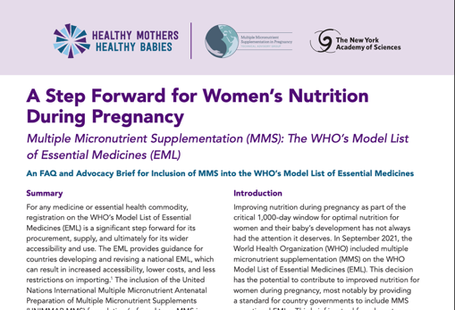
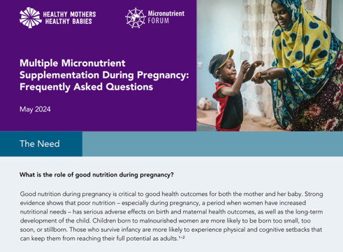
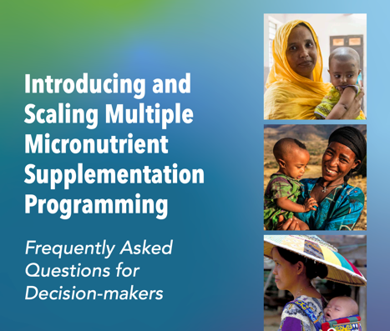
Advocacy Tools
The Advocacy Brief and FAQ on Inclusion of MMS in WHO’s EML provides best practices for getting MMS on the EML in your country.
The MMS Advocacy Brief addresses the wide scope of the need for MMS, and the Frequently Asked Questions (FAQ) Brief on MMS is tailored to decision-makers.
For support in scaling efforts, see Introducing and Scaling Multiple Micronutrient Supplementation Programming Frequently Asked Questions for Decision-makers.

Slide 18
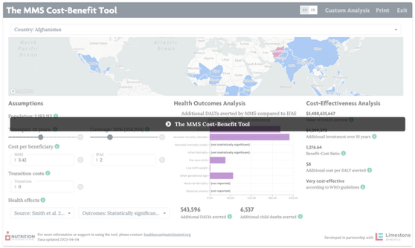
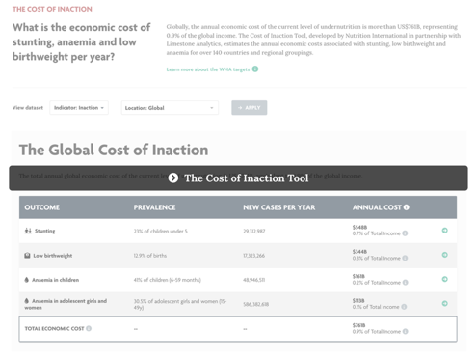
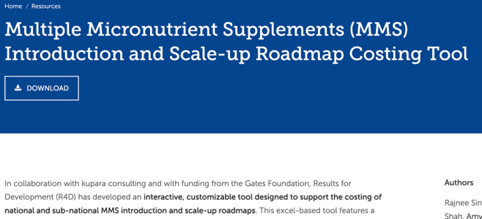
Costing Tools
MMS Cost-Benefit Tool + Cost of Inaction Tool were developed by Nutrition International to aid countries’ decision-making by calculating the incremental benefits and costs of transitioning from iron-folic acid supplementation (IFAS) to multiple micronutrient supplementation (MMS).
MMS Introduction and Scale-up Roadmap Costing Tool supports the development of costed national and sub-national MMS introduction and scale-up roadmaps. The tool was developed by R4D and funded by the Gates Foundation
Visit FurtherWith15.org for these resources and more

Slide 19

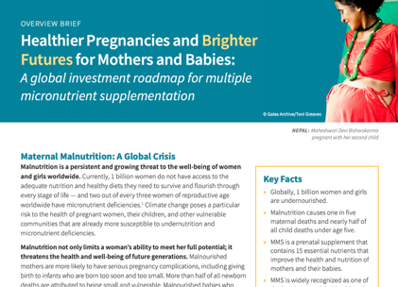
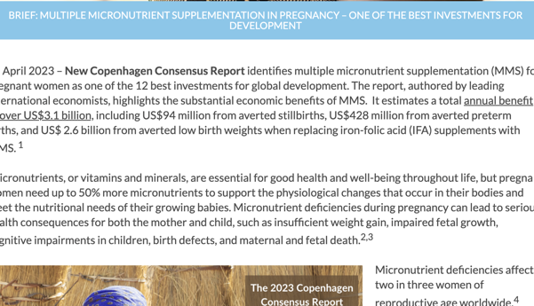

Resource Mobilization Tools
MMS Global Investment Roadmap and Overview Brief were developed by a collaborative of private philanthropies to catalyze and prioritize action and investment in multiple micronutrient supplements.
The HMHB Advocacy Brief: MMS in Pregnancy – One of the Best Investments for Development explains reasons why MMS is such a strong investment.
HMHB’s Knowledge Byte Webinar: “MMS – Invest in the Best” reviews key reasons to invest in MMS.

