Slide 1

ﺍﻟﻐﺬﺍﺋﻴﺔ ﺍﻟﻤﻜﻤﻼﺕ ﺗﻄﻮﻳﺮ
ﻭﺍﻟﻤﺘﻌﺪﺩﺓ ﺍﻟﺪﻗﻴﻘﺔ
1

Slide 2

ﺍﻟﺘﻌﺪﻳﻞ ﺑﻌﺪ ﺍﻟﺼﻨﺪﻭﻕ ﺍﺣﺬﻑ ﻟﻠﺘﻌﺪﻳﻞ ﻧﻤﻮﺫﺝ
ﺍﻟﻠﻘﺎﺀ ﺃﻬﺪﺍﻑ
ﺃﻬﺪﺍﻓﻪ ﺃﻮ/ ﻭ ﺍﻻﺟﺘﻤﺎﻉ ﺃﻌﻤﺎﻝ ﺟﺪﻭﻝ ﻹﺿﺎﻓﺔ ﺍﺧﺘﻴﺎﺭﻳﺔ ﺷﺮﻳﺤﺔ •
4

Slide 3

ﺍﻷﻘﺴﺎﻡ
6 - 18 ﺍﻟﺸﺮﺍﺋﺢ
19 -24 ﺍﻟﺸﺮﺍﺋﺢ
ﻭﺍﻟﺘﻐﺬﻳﺔ ﺍﻟﺤﻤﻞA.
7
ﺍﻟﺤﻤﻞ ﺃﺜﻨﺎﺀ ﺍﻟﺘﻐﺬﻳﺔ ﻟﺴﻮﺀ ﺍﻟﻌﺎﻟﻤﻲ ﺍﻟﻨﻄﺎﻕB.
25 -37 ﺍﻟﺸﺮﺍﺋﺢ
38 - 45 ﺍﻟﺸﺮﺍﺋﺢ
46 -61 ﺍﻟﺸﺮﺍﺋﺢ
ﻭﺍﻟﻤﺘﻌﺪﺩﺓ ﺍﻟﺪﻗﻴﻘﺔ ﺍﻟﻐﺬﺍﺋﻴﺔ ﺍﻟﻤﻜﻤﻼﺕ ﺣﻮﻝ ﺃﺪﻟﺔC.
ﺍﻟﻮﻃﻨﻴﺔ ﻭﺍﻻﺳﺘﺜﻤﺎﺭ ﺍﻟﺘﺄﺜﻴﺮ ﺣﺎﻟﺔD.
ﻧﻄﺎﻗﻬﺎ ﻭﺗﻮﺳﻴﻊ MMS ﻭﺍﻟﻤﺘﻌﺪﺩﺓ ﺍﻟﺪﻗﻴﻘﺔ ﺍﻟﻐﺬﺍﺋﻴﺔ ﺍﻟﻤﻜﻤﻼﺕ ﺗﻘﺪﻳﻢE.
5

Slide 4

ﺃﺜﻨﺎﺀ ﺍﻟﺘﻐﺬﻳﺔ ﻟﺴﻮﺀ ﺍﻟﻌﺎﻟﻤﻲ ﺍﻟﻨﻄﺎﻕ
ﺍﻟﺤﻤﻞ

Slide 5
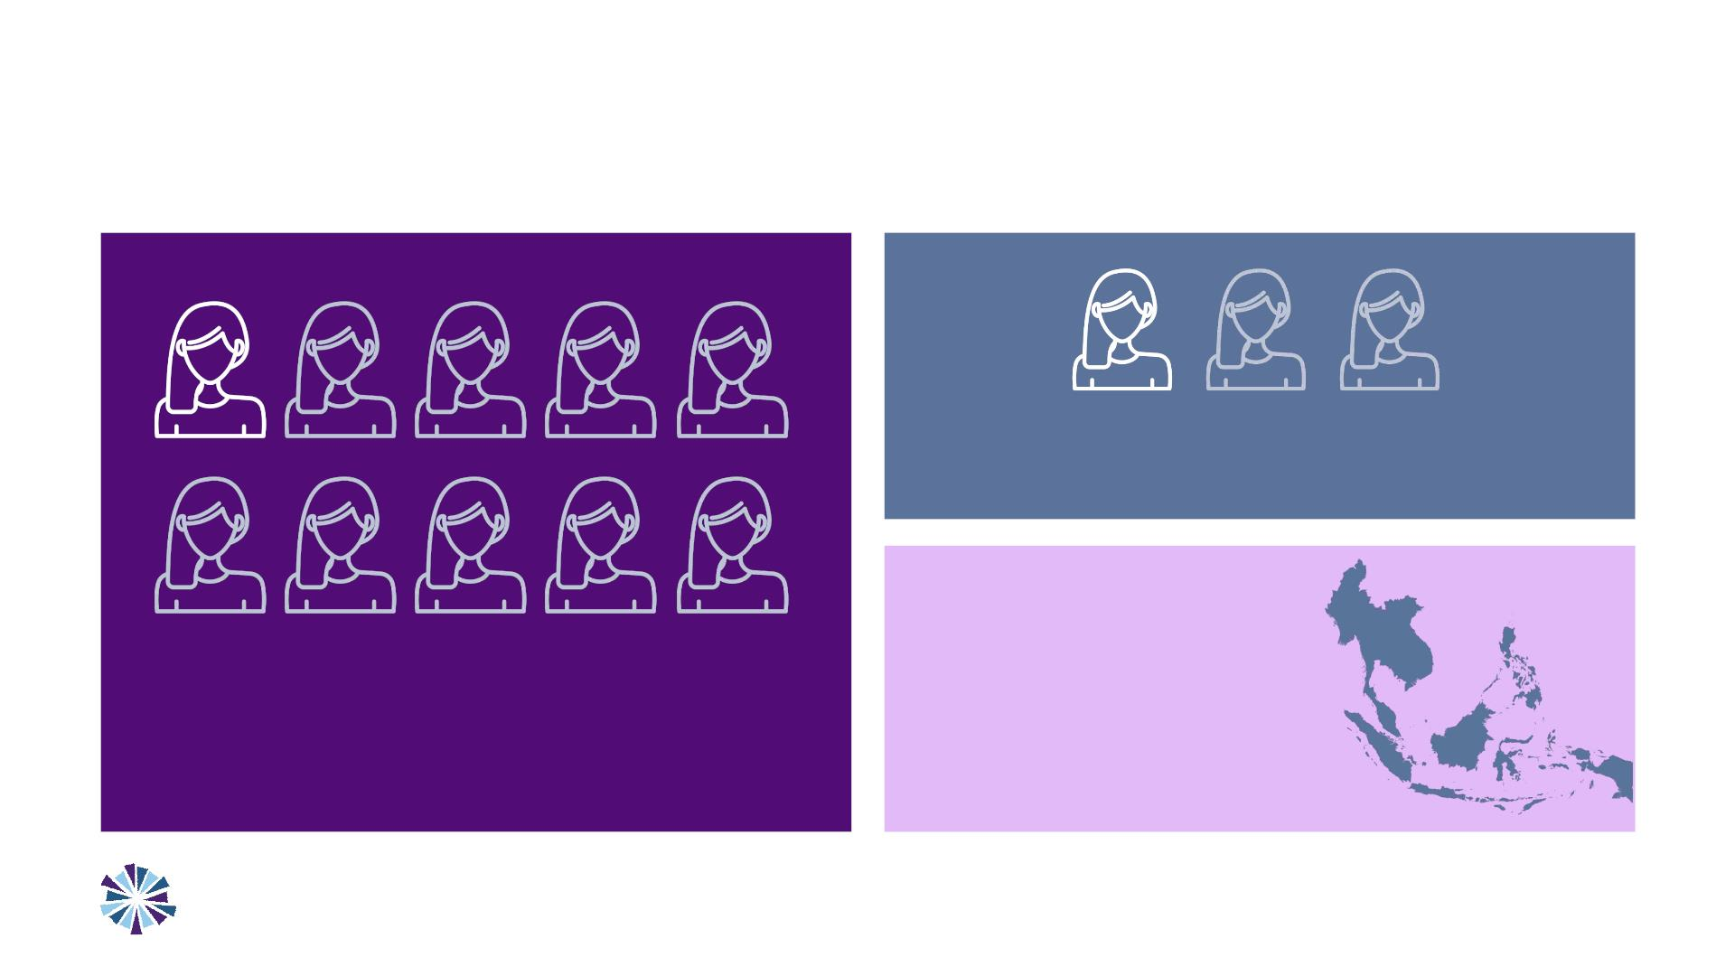
ﺇﻟﻰ ﺍﻟﻨﺴﺎﺀ ﻣﻦ ﺍﻟﻌﺪﻳﺪ ﺗﻔﺘﻘﺮ ،ﻋﺎﻟﻤﻴ
...ﻣﻐﺬﻳﺔ ﺣﻤﻴﺔ
ﻣﻦ3 - ﻣﻦ - 1ﺍﻣﺮﺃﺔ ﻣﻠﻴﻮﻥ570
. ﺍﻟﺪﻡ ﻓﻘﺮ ﻣﻦ ﻳﻌﺎﻧﻴﻦ ﺍﻹﻧﺠﺎﺏ ﻋﻤﺮ ﻓﻲ ﺍﻟﻨﺴﺎﺀ
ﻣﻦ10 - ﻣﻦ - 1ﺍﻣﺮﺃﺔ ﻣﻠﻴﻮﻥ17
. ﺍﻟﻤﻨﺨﻔﺾ ﺍﻟﻮﺯﻥ ﻣﻦ ﻳﻌﺎﻧﻴﻦ ﺍﻹﻧﺠﺎﺏ ﻋﻤﺮ ﻓﻲ ﺍﻟﻨﺴﺎﺀ
آﺴﻴﺎ ﺷﺮﻕ ﺟﻨﻮﺏ/ ﺟﻨﻮﺏ ﻓﻲ
(ﺍﻟﺘﻘﺰﻡ) ﺍﻟﻘﺎﻣﺔ ﻗﺼﺮ ﻳﺴﻢ
. ﺍﻟﻨﺴﺎﺀ ﻣﻦ35%
: WHO Global Health Observatory Indicators websiteﺍﻟﻤﺼﺪﺭ
Dalmiya et al, 2022. UNICEF Programming Guidance. Prevention of malnutrition in women before and during pregnancy and while breastfeeding. United Nations Children’s Fund.
2017. Nutrition recommendations in pregnancy and lactation. Med Clin North Am
7

Slide 6
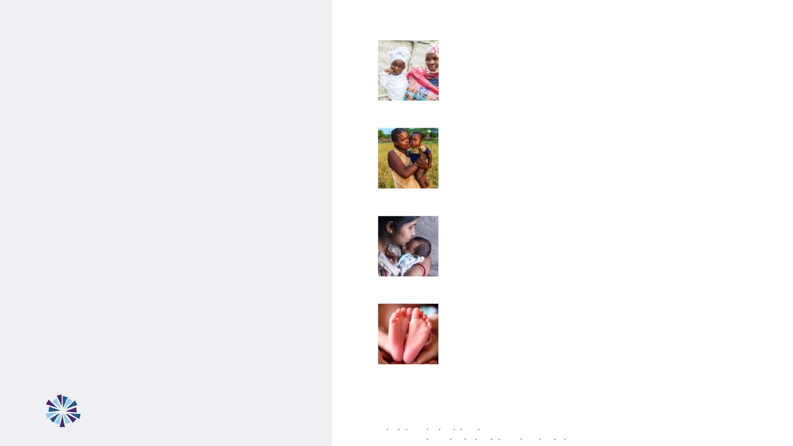
ﺍﻟﺤﺪﻳﺪ ﺣﺒﻮﺏ ﻋﻠﻰ ﺍﻟﺤﻮﺍﻣﻞ ﺍﻟﻨﺴﺎﺀ ﻣﻦ ﻓﻘﻂ35% ﻧﺴﺒﺔ ﺗﺤﺼﻞ
.ﺍﻟﺤﻤﻞ ﻓﺘﺮﺓ ﺃﺜﻨﺎﺀ90+ (IFA) ﺃﺴﻴﺪ ﻭﺍﻟﻔﻮﻟﻴﻚ
ﺍﻟﺰﻳﺎﺭﺍﺕ ﻣﻦ ﺃﺮﺑﻊ ﺍﻟﺤﻮﺍﻣﻞ ﺍﻟﻨﺴﺎﺀ ﻣﻦ ﻓﻘﻂ59% ﻧﺴﺒﺔ ﺗﺤﻀﺮ
ﺃﻮﺻﺖ ﻭﻗﺪ (ANC) ﺍﻟﻮﻻﺩﺓ ﻗﺒﻞ ﻣﺎ ﺍﻟﺮﻋﺎﻳﺔ ﻣﺮﺣﻠﺔ ﻓﻲ ﺍﻟﺼﺤﻴﺔ
ﻋﻠﻰ ﺍﻟﺤﺼﻮﻝ ﺑﻀﺮﻭﺭﺓ ،2016 ﻋﺎﻡ ﻣﻨﺬ ،ﺍﻟﻌﺎﻟﻤﻴﺔ ﺍﻟﺼﺤﺔ ﻣﻨﻈﻤﺔ
ﻓﻲ ﺳﺎﻫﻢ ﻣﻤﺎ ،ﺍﻟﻮﻻﺩﺓ ﻗﺒﻞ ﻣﺎ ﺍﻟﺼﺤﻴﺔ ﺑﺎﻟﺮﻋﺎﻳﺔ ﺧﺎﺻﺔ ﺯﻳﺎﺭﺍﺕ 8
. ﺍﻟﻔﺠﻮﺓ ﺍﺗﺴﺎﻉ
ﺍﻣﻜﺎﻧﻴﺔ ﻭﻋﺪﻡ...
ﺧﺪﻣﺎﺕ ﻋﻠﻰ ﺍﻟﺤﺼﻮﻝ
ﻭﻏﺬﺍﺋﻴﺔ ﺻﺤﻴﺔ
ﺍﻟﻮﻻﺩﺓ ﻋﻨﺪ ﺍﻟﻤﻨﺨﻔﺾ ﺍﻟﻮﺯﻥ ﻣﻦ ﺳﻨﻮﻳ ﻃﻔﻞ ﻣﻠﻴﻮﻥ 20 ﻳﻌﺎﻧﻲ
ﺍﻷﻢ ﻟﺪﻯ ﺍﻟﺘﻐﺬﻳﺔ ﻟﺴﻮﺀ ﻣﺒﻜﺮ ﻣﺆﺸﺮ ﺑﻤﺜﺎﺑﺔ ﻳﻌﺘﺒﺮ ﻣﺎ ،(LBW)
.ﻭﺍﻟﺮﺿﻴﻊ
ﺣﻤﻴﺔ ﻋﻠﻰ ﺍﻟﺤﺼﻮﻝ ﺇﻣﻜﺎﻧﻴﺔ ﻓﻲ ﺑﺘﺮﺍﺟﻊ ﺍﻟﻜﻮﺭﻭﻧﺎ ﺃﺰﻣﺔ ﺗﺘﺴﺒﺐ
. ﺍﻻﺣﺘﻤﺎﻻﺕ ﺃﺴﻮﺀ ﺃﻤﺎﻡ ﺑﺪﻭﺭﻩ ﻳﻀﻌﻨﺎ ﻣﻤﺎ ﺟﻴﺪﺓ
: 2017. Nutrition recommendations in pregnancy and lactation. Med Clin North Amduring pregnancy and while ﺍﻟﻤﺼﺪﺭ
breastfeeding. United Nations Children’s Fund.
8
ﺳﻮﺀ ﺗﻔﺎﻗﻢ ﻓﻲ ﺍﻟﻜﻮﺭﻭﻧﺎ ﺃﺰﻣﺔ ﺗﺴﺎﻫﻢ ﺃﻦ ﺍﻟﻤﺘﻮﻗﻊ ﻣﻦ2017. Nutrition recommendations in pregnancy and lactation. Med Clin North Am
. Nat Food.ﻭﺍﻟﻤﺘﻮﺳﻂ ﺍﻟﻤﻨﺨﻔﺾ ﺍﻟﺪﺧﻞ ﺫﺍﺕ ﺍﻟﺒﻠﺪﺍﻥ ﻓﻲ ﻭﺍﻷﻄﻔﺎﻝ ﻭﻭﻓﻴﺎﺕ ﺍﻟﻨﺴﺎﺀ ﻟﺪﻯ ﺍﻟﺘﻐﺬﻳﺔ

Slide 7

ﻋﻠﻰ ﺗﺆﺜﺮ ﺟﺴﻴﻤﺔ ﻋﻮﺍﻗﺐ ﺍﻷﻤﻬﺎﺕ ﻟﺪﻯ ﺍﻟﺘﻐﺬﻳﺔ ﺳﻮﺀ ﻋﻦ ﻳﻨﺘﺞ
ﺑﺄﺴﺮﻩ ﺍﻟﻌﺎﻟﻢ ﻭﻋﻠﻰ ﺍﻟﻤﺠﺘﻤﻌﺎﺕ
ﺍﻟﺼﻌﻴﺪ ﻋﻠﻰ ﺃﻤﺎ ،ﻋﺎﻣ 30 ﻳﺘﺠﺎﻭﺯ ﻣﺎ ﺇﻟﻰ ﺍﻟﻔﺮﺩﻱ ﺍﻟﺼﻌﻴﺪ ﻋﻠﻰ ﺍﻟﺘﻐﺬﻳﺔ ﺳﻮﺀ ﻋﻮﺍﻗﺐ ﺗﺄﺜﻴﺮ ﻳﻤﺘﺪ ﺃﻦ ﻳﻤﻜﻦ
.ﺃﺠﻴﺎﻝ ﻟﻌﺪﺓ ﺍﻟﺘﺄﺜﻴﺮ ﻫﺬﺍ ﻳﺴﺘﻤﺮ ﻓﻘﺪ ﺍﻟﻌﺎﺋﻠﻲ
ﺍﻗﺘﺼﺎﺩﻳﺔ ﻓﻮﺍﺋﺪ ﺇﻟﻰ ﻳﺆﺪﻱ ﻣﻤﺎ. ﺍﻹﻧﺘﺎﺟﻴﺔ ﻣﺴﺘﻮﻯ ﻭﺭﻓﻊ ﺍﻟﻤﺪﺭﺳﻲ ﺍﻷﺪﺍﺀ ﺑﺘﺤﺴﻴﻦ ﺍﻟﺠﻴﺪﺓ ﺍﻟﺘﻐﺬﻳﺔ ﺗﺮﺗﺒﻂ
.ﻭﺍﻟﻌﺎﻟﻤﻲ ﻭﺍﻟﻮﻃﻨﻲ ﺍﻟﻔﺮﺩﻱ ﺍﻟﻤﻘﻴﺎﺱ ﻋﻠﻰ ﺍﻟﻤﺪﻯ ﺑﻌﻴﺪﺓ
2030. ﻋﺎﻡ ﺑﺤﻠﻮﻝ ﺳﻨﻮﻳ ﺩﻭﻻ ﻣﻠﻴﺎﺭ 5.7ﺗﺒﻠﻎ ﻗﺪ ﻣﺠﺘﻤﻌﻴﺔ ﺑﺰﻳﺎﺩﺓ ﺍﻟﻐﺬﺍﺀ ﻣﺠﺎﻝ ﻓﻲ ﺍﻻﺳﺘﺜﻤﺎﺭ ﻳﺴﺎﻫﻢ
: Halim et al, 2015 The economic consequences of selected maternal and child nutrition interventions in low- and middle- income countries: A systematic review of recent literature, 2000–2013. BMC Women’s Health.ﺍﻟﻤﺼﺪﺭ
9

Slide 8
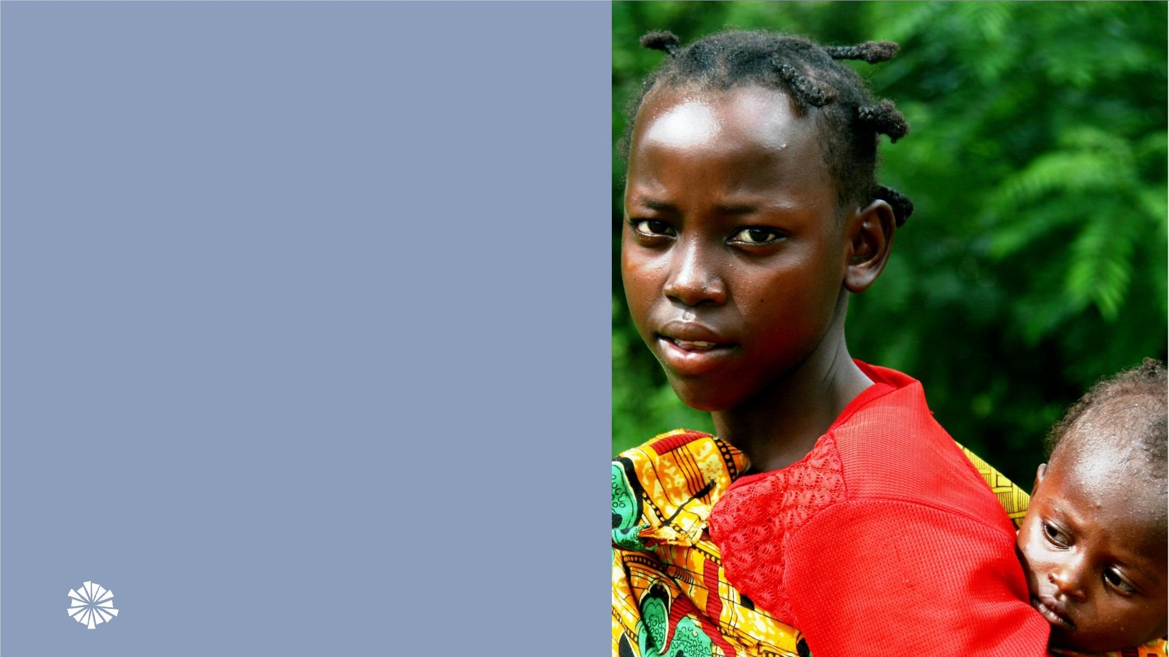
ﺑﺎﻟﻨﺴﺒﺔ ﺍﻟﻮﺿﻊ ﺗﺤﺴﻴﻦ ﺍﻟﻤﻤﻜﻦ ﻣﻦ
ﻭﺫﻟﻚ ،ﺍﻷﻤﻬﺎﺕ ﻟﺪﻯ ﺍﻟﺘﻐﺬﻳﺔ ﻟﺴﻮﺀ
ﺍﻟﺘﺪﺧﻼﺕ ﻣﻦ ﺣﺰﻣﺔ ﻧﻘﺪﻡ ﻋﻨﺪﻣﺎ
.ﺑﺎﻷﺪﻟﺔ ﺍﻟﻤﺜﺒﺘﺔ ﺍﻟﻐﺬﺍﺋﻴﺔ

Slide 9
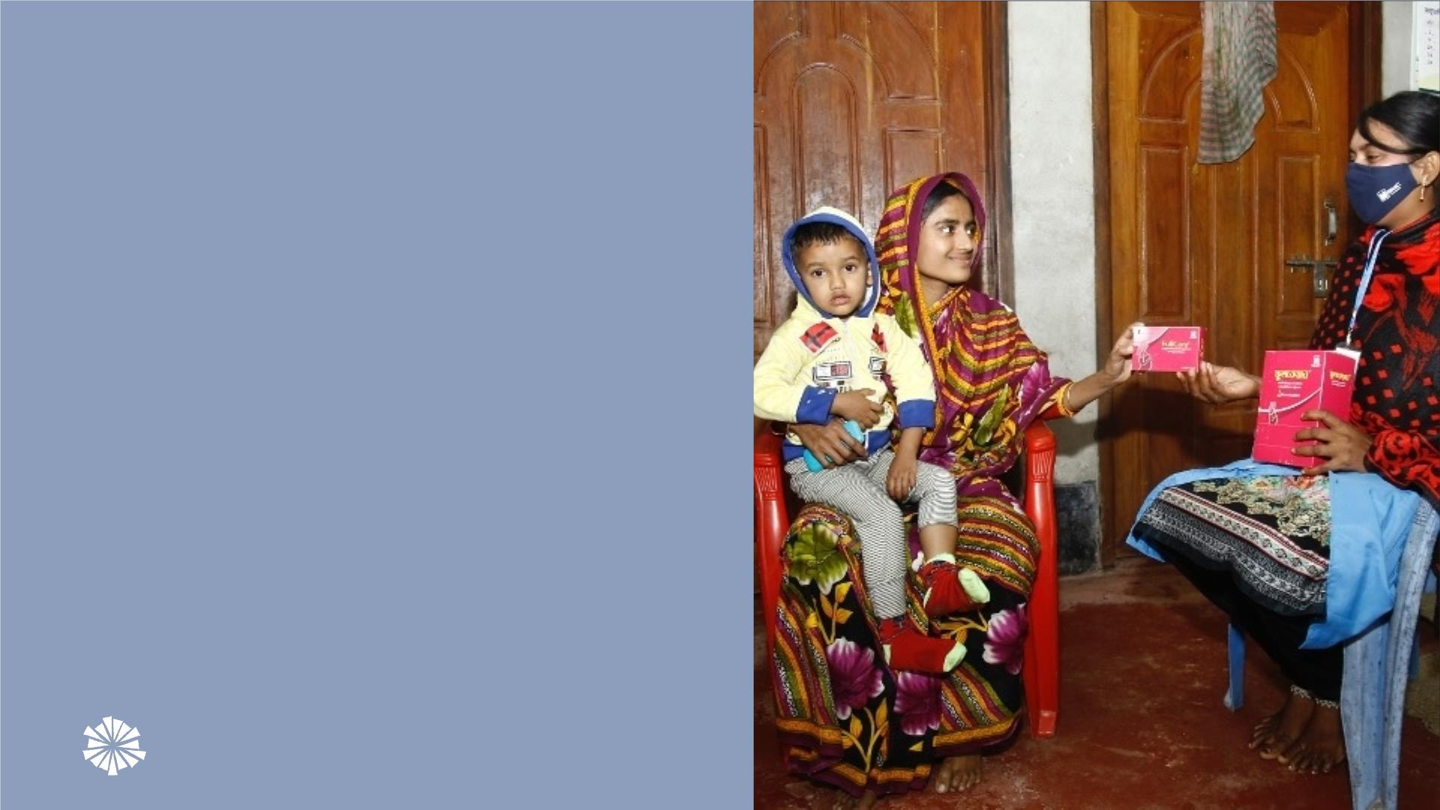
ﺍﻟﺪﻗﻴﻘﺔ ﺍﻟﻐﺬﺍﺋﻴﺔ ﺍﻟﻤﻜﻤﻼﺕ ﺗﻌﺘﺒﺮ
ﺇﻟﻴﻬﺎ ﻳﺸﺎﺭ ﻭﺍﻟﺘﻲ ، MMSﻭﺍﻟﻤﺘﻌﺪﺩﺓ
ﺃﻘﻮﻯ ﻣﻦ ،ﺍﻟﺤﻤﻞ ﺑﻔﻴﺘﺎﻣﻴﻨﺎﺕ ﻋﻤﻮﻣ
ﺗﺤﺴﻴﻦ ﻋﻠﻰ ﺗﺄﺜﻴﺮ ﺍﻟﻐﺬﺍﺋﻴﺔ ﺍﻟﻤﺪﺧﻼﺕ
ﻭ ﺍﻷﻤﻬﺎﺕ ﺻﺤﺔ
.ﺍﻟﻮﻻﺩﺓ ﻧﺘﺎﺋﺞ

Slide 10
ﺍﻟﺘﻌﺪﻳﻞ ﺑﻌﺪ ﺍﻟﺼﻨﺪﻭﻕ ﺍﺣﺬﻑ ﻟﻠﺘﻌﺪﻳﻞ ﻧﻤﻮﺫﺝ
:ﺍﻟﺘﺎﻟﻴﺔ ﺍﻟﺨﻄﻮﺓ
ﺟﺪﻳﺪﺓ ﻣﻌﻄﻴﺎﺕ ﺃﻮ ﺗﺎﻟﻴﺔ ﺍﻟﺨﻄﻮﺓ ﻹﺿﺎﻓﺔ ﺍﺧﺘﻴﺎﺭﻳﺔ ﺷﺮﻳﺤﺔ •
12

Slide 11
ﺍﻟﺘﻌﺪﻳﻞ ﺑﻌﺪ ﺍﻟﺼﻨﺪﻭﻕ ﺍﺣﺬﻑ ﻟﻠﺘﻌﺪﻳﻞ ﻧﻤﻮﺫﺝ
ﻣﻌﻨﺎ ﺗﻮﺍﺻﻞ
ﺍﻻﻟﻜﺘﺮﻭﻧﻲ ﺍﻟﺒﺮﻳﺪ ﺃﻮ/ ﻭ ،ﺍﻻﺟﺘﻤﺎﻋﻲ ﺍﻟﺘﻮﺍﺻﻞ ﻣﻌﻠﻮﻣﺎﺕ ،ﺍﻻﻟﻜﺘﺮﻭﻧﻲ ﺍﻟﻤﻮﻗﻊ ﺭﺍﺑﻂ ﻹﺿﺎﻓﺔ ﺍﺧﺘﻴﺎﺭﻳﺔ ﺷﺮﻳﺤﺔ •
13

Slide 12

ﺍﻟﺮﺋﻴﺴﻴﺔ ﺍﻟﻤﻨﺸﻮﺭﺍﺕ
• Bloem et al, 2007. Preventing and controlling micronutrient deficiencies in populations affected by an emergency . WHO, WFP, UNICEF.
• Smith et al, 2017. Modifiers of the effect of maternal multiple micronutrient supplementation on stillbirth, birth outcomes, and infant mortality: a meta-analysis
of individual patient data from 17 randomised trials in low-income and middle-income countries. Lancet Global Health.
• Prado et al, 2017. Maternal multiple micronutrient supplementation and other biomedical and socioenvironmental influences on children’s cognition at age 9-12
–12 years in Indonesia: follow-up of the SUMMIT randomised trial.
• Antenatal care recommendations for a positive pregnancy experience. ﻳﻮﻟﻴﻮ2020 Nutritional interventions update: multiple micronutrient supplements during
pregnancy. ﺍﻟﻌﺎﻟﻤﻴﺔ ﺍﻟﺼﺤﺔ ﻣﻨﻈﻤﺔ
2021 Impact of scaling up prenatal nutrition interventions on human capital outcomes in low- and middle-income countries: a modeling ﻳﻮﻟﻴﻮPerumal et al
analysis. ꢀꢀ American Journal of Clinical Nutrition
•
• May 2020. Use of MMS for maternal nutrition and birth outcomes during COVID-19 . MMS TAG.
• Dalmiya et al. January 2022. Maternal Nutrition: Prevention of malnutrition in women before and during pregnancy and while breastfeeding. UNICEF.
• Gomes et al, 2022. Multiple micronutrient supplements versus iron-folic acid supplements and maternal anemia outcomes: an iron dose analysis. Ann. N.Y. Acad.
Sci.
• Gomes et al, 2022. Effect of multiple micronutrient supplements vs iron and folic acid supplements on neonatal mortality: a reanalysis by iron dose. Public Health
Nutr.
14

Slide 13

Healthy Mothers Healthy Babies resources
HMHB Knowledge Hub •
HMHB Knowledge Bytes •
HMHB Commitment-making Guide for Nutrition for •
Growth
Watch the HMHB Powering Women, Promising Futures •
HMHB MMS Interactive World Map •
Nutrition for Growth side event
HMHB FAQ and Advocacy Brief on the Inclusion of •
Maternal Nutrition in Focus: HMHB at FIGO 2021 •
MMS on the Essential Medicine List
World Conference
HMHB Launch Video •
ﻟﺘﺴﺠﻴﻞ www.hmhbconsortium.org ﺯﻭﺭﻭﺍ ﺇﻟﻴﻨﺎ ﺍﻧﻀﻢ
ﺍﻟﻌﻀﻮﻳﺔ
15

Slide 14
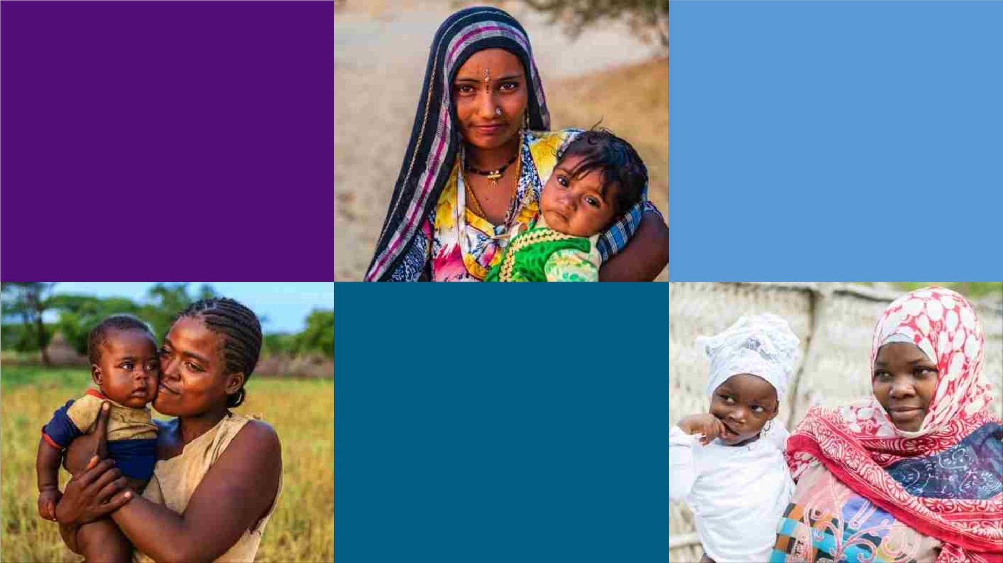
ﻋﻠﻰ ﻟﻼﺗﺤﺎﺩ ﺍﻻﻧﻀﻤﺎﻡ
HMHBconsortium.org
ﻣﻌﻨﺎ ﺗﻮﺍﺻﻞ
HMHB@micronutrientforum.org
ﺗﺎﺑﻌﻮﻧﺎ
@hmhbconsortium

