Slide 1

Advancing Multiple Micronutrient Supplementation
Module C : Evidence on multiple micronutrient supplements

Slide 2



How to use this slide deck
Facilitate dialogue & create consensus
  View these slides as a resource for anyone wanting to communicate the evidence and benefits of MMS for pregnant women and their babies. Our goal is to equip the presenter of these slides with key messages that can be delivered to decision makers or to those considering piloting, scaling, and implementation of MMS.
Customize dialogue
  Speaker notes are provided with each slide, but they are not intended to be read word-for-word. Tailor and add your own speaking notes to make this relevant for your audience.
ADAPT to Your Audience
  Content in red font should be tailored, then updated to black font. Slides labeled ‘National impact and investment case’ should be tailored with data and statistics from your country and made relevant for your audience. Slides or entire sections can be removed or re-ordered. Additional resources can be found at the end of the presentation.
We’d like to hear from you! Contact HMHBConsortium@micronutrientforum.org if you have questions or would like additional support.​
Notes:
Please review the instructions on this slide for how to use/customize this presentation. Then, remove this slide before presenting.

Slide 3




Audiences for this slide deck
Advocates & Public Health Professionals
  Suggested sections include A-E
This presentation provides an overview of maternal nutrition and the evidence on multiple micronutrient supplements (MMS), providing key messages and slides that can be tailored with country-specific data to support the introduction, piloting, and scaling of MMS.
You may wish to include (or omit) specific sections of the presentation. Suggested sections for each audience are included here. See the section descriptions on Slide 5.
National health officials & NGOS
  Suggested sections include A-E
Research & Academia
  Suggested sections include B-D
Local providers & Distributors
  Suggested sections include B
Notes:
Please review the instructions on this slide for how to use/customize this presentation. Then, remove this slide before presenting.

Slide 4
Meeting Objectives
TEMPLATE to be adapted. Remove this box once updated.
Optional slide to add meeting agenda and/or objectives
Notes:
This is a placeholder slide for the speaker’s welcome and introduction. Add in an overview of meeting objectives and/or agenda here.

Slide 5
Sections
A. Pregnancy and nutrition
Slides 6 - 18
B. Global scope of maternal malnutrition
Slides 19 - 24
C. Evidence on multiple micronutrient supplements
Slides 25 - 37
D. National impact and investment case
Slides 38 - 45
E. Introducing and scaling MMS
Slides 46 - 61
Notes:
Speaker may present each section or skip ahead to the relevant section(s) for the audience.

Slide 6
Evidence on multiple micronutrient supplements (MMS)
Notes:
Section C
Speaker Talking Points:
In this section, we will explain:
What Multiple Micronutrient Supplements are
The evidence, which shows that MMS significantly improves maternal health and birth outcomes compared to Iron-Folic Acid (IFA), the current standard of care in most places
The global impact of transitioning to MMS and how important it is for MMS to be included in a package of antenatal care services.

Slide 7



MMS has significant benefits compared to IFA
MMS contains 15 micronutrients, including iron and folic acid (IFA).
Research supports switching from IFA to MMS, especially for women with poor diets.
Before 2020, global policy guidance recommended use of IFA.
Source: HMHB Consortium website
Notes:
Speaker Talking Points:
MMS has significant benefits over IFA:
MMS contains 15 essential nutrients (including the 2 micronutrients in iron and folic acid.)
Research supports switching from IFA to MMS, especially for women with poor diets. This transition is based on 20 years of evidence that supports the transition from IFA to MMS for pregnant women.
However, global policy guidance before 2020 recommended IFA, so many women in LMICs are likely to have access to IFA only. But this is changing over recent years.
We will discuss each in detail over the next three slides.

Slide 8
What is
multiple
micronutrient supplementation?
  UNIMMAP MMS* contains 15 essential vitamins and minerals for pregnant and nursing women and meets micronutrient requirements that poor diets cannot meet.
UNIMMAP MMS composition*
Vitamin A | 800 µg
Vitamin D | 200 IU
Vitamin E | 10 mg
Vitamin C | 70 mg
Thiamin | 1.4 mg
Riboflavin | 1.4 mg
Niacin | 18 mg
Vitamin B6 | 1.9 mg
Folic Acid | 400 µg
Vitamin B12 | 2.6 µg
Copper | 2 mg
Iodine | 150 µg
Iron | 30 mg
Selenium | 65 µg
Zinc | 15 mg
*United Nations International Multiple Micronutrient Antenatal Preparation Multiple Micronutrient Supplementation (UNIMMAP MMS)
Note: for brevity, the term MMS will be used moving forward
Notes:
Speaker Talking Points:
The United Nations International Multiple Micronutrient Antenatal Preparation of Multiple Micronutrient Supplements (UNIMMAP MMS) is an antenatal supplement for pregnant women.
UNIMMAP MMS contains 15 essential vitamins and minerals for pregnant and nursing women and meets micronutrient requirements that poor diets cannot meet.
(Explain to audience that, for brevity, the term MMS will be used moving forward when referring to the UNIMMAP MMS formulation.)
The recommended dietary allowance, or RDA, is 1 as specified for women in USA/Canada.

Slide 9
How does MMS compare to IFA?
  Iron and Folic Acid contains just 2 essential vitamins and minerals.
Iron and Folic Acid
Folic Acid | 400 µg
Iron | 60 mg
Sources: Gomes et al, 2022. Multiple micronutrient supplements vs iron-folic acid supplements and maternal anemia outcomes: an iron dose analysis. Ann. N.Y. Acad. Sci.
Gomes et al, 2022. Effect of multiple micronutrient supplements vs iron and folic acid supplements on neonatal mortality: a reanalysis by iron dose. Public Health Nutr.
Notes:
Speaker Talking Points:
Compare that to iron and folic acid, which contains just 2 micronutrients.
You may notice that dose of iron is higher (60 mg) vs. 30 mg in MMS on the previous slide. That is because WHO currently recommends a range of 30 to 60 mg of iron for pregnancy women, with 60 mg recommended in settings where there is a high prevalence of anemia.
In 2020, WHO guidelines noted that more evidence was needed on the effects of switching from 60 mg to a 30 mg dose of iron. A recent study published in Annals of the New York Academy of Sciences in February 2022 confirms:
Providing MMS with 30 mg of iron during pregnancy is comparable to IFA with 60 mg of iron in terms of preventing maternal anemia.
MMS with 30 mg of iron does not increase the risk of adverse maternal iron-related outcomes (including anemia, iron deficiency anemia, or decreased hemoglobin concentration) when compared to IFA with equal or higher doses of iron.
Providing MMS with 30 mg of iron during pregnancy is comparable to IFA with 60 mg of iron in terms of preventing third trimester anemia. This effect may be explained by the additional micronutrients in MMS – including vitamin A, vitamin C, and riboflavin – that can improve the absorption of iron. Vitamins B₁₂ and vitamin A may also improve key deficiencies known to cause anemia in pregnant women.
And a recent study published in Public Health Nutrition in April 2022 confirms:
There were no statistically significant differences in neonatal mortality between MMS and IFA within any of the subgroups. When data from the 2020 WHO analysis was extracted and corrected, there was no increase in risk of neonatal mortality with MMS, regardless of iron dose in either supplement.
Providing MMS with 30 mg of iron during pregnancy likely results in little or no difference in neonatal mortality, when compared to IFA with 60 mg of iron. A transition from IFA containing 60 mg of iron to MMS containing 30 mg of iron would not adversely affect neonatal mortality.
References:
Gomes, F., Agustina, R., Black, R.E., Christian, P., Dewey, K.G., Kraemer, K., Shankar, A.H., Smith, E.R., Thorne-Lyman, A., Tumilowicz, A. and Bourassa, M.W. (2022), Multiple micronutrient supplements versus iron-folic acid supplements and maternal anemia outcomes: an iron dose analysis. Ann. N.Y. Acad. Sci., https://doi.org/10.1111/nyas.14756.
Gomes F, Agustina R, Black RE, Christian P, Dewey KG, Kraemer K, Shankar AH, Smith E, Tumilowicz A, Bourassa MW. Effect of multiple micronutrient supplements vs iron and folic acid supplements on neonatal mortality: a reanalysis by iron dose. Public Health Nutr. 2022 Apr 25:1-13. doi: 10.1017/S1368980022001008. Epub ahead of print. PMID: 35466910. https://pubmed.ncbi.nlm.nih.gov/35466910/

Slide 10

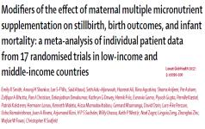

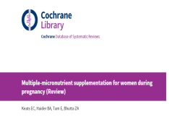
Research
supports MMS
  More than 15 randomly controlled trials have been analyzed. Using different criteria, two different meta-analyses both confirm MMS is effective and safe.
2017
2019
Sources: Keats et al. 2019. Multiple-micronutrient supplementation for women during pregnancy. Cochrane Database Syst.
Smith et al, 2017. Modifiers of the effect of maternal multiple micronutrient supplementation on stillbirth, birth outcomes, and infant mortality: a meta-analysis of individual patient data from 17 randomised trials in low-income and middle-income countries. Lancet Global Health.
Notes:
Speaker Talking Points:
More than 20 years of research—presented in a 2017 meta-analysis of individual patient data and 2019 Cochrane Review—have provided clear evidence that MMS is effective and safe.

Slide 11
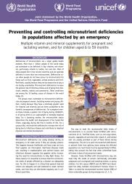

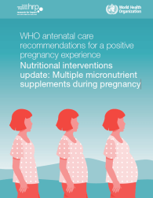
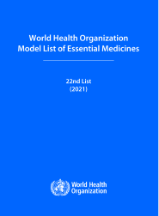
Global guidance supports MMS in various settings
In emergency situations:
For patients with tuberculosis:
In the context of rigorous research:
In the WHO List of Essential Medicines:
Sources: Bloem et al, 2007. Preventing and controlling micronutrient deficiencies in populations affected by an emergency. WHO, WFP, UNICEF.
WHO. 2013. Guideline: Nutritional care and support for patients with tuberculosis. World Health Organization.
WHO. July 2020. Nutritional interventions update: multiple micronutrient supplements during pregnancy. World Health Organization.
WHO. 2021. World Health Organization Model List of Essential Medicines. World Health Organization.
Notes:
Speaker Talking Points:
After decades of research, WHO released a context-specific recommendation for MMS, including in populations affected by an emergency
and/or experiencing an active tuberculosis outbreak,
and in other contexts support by rigorous research as part of antenatal care for pregnant women.
Preventing and controlling micronutrient deficiencies in populations affected by an emergency
https://www.who.int/docs/default-source/nutritionlibrary/preventing-and-controlling-micronutrient-deficiencies-in-populations-affected-by-an-emergency.pdf?sfvrsn=e17f6dff_2
WHO Nutritional care and support for patients with tuberculosis
https://apps.who.int/iris/bitstream/handle/10665/94836/9789241506410_eng.pdf
2020 updated WHO antenatal care recommendations
https://apps.who.int/iris/bitstream/handle/10665/333561/9789240007789-eng.pdf
The newest development is that MMS is now included on the WHO’s Model List of Essential Medicines which is a significant step forward for procurement, supply, implementation research efforts, and ultimately for wider accessibility and use of MMS.
WHO Model List of Essential Medicines
https://www.who.int/publications/i/item/WHO-MHP-HPS-EML-2021.02

Slide 12



Evidence on MMS
MMS is effective
MMS is safe
MMS is affordable & cost-effective
Notes:
Speaker Talking Points:
MMS significantly improves maternal health and birth outcomes compared to IFA.
It is effective, safe, affordable, and cost-effective.
We will discuss each in detail over the next four slides.

Slide 13
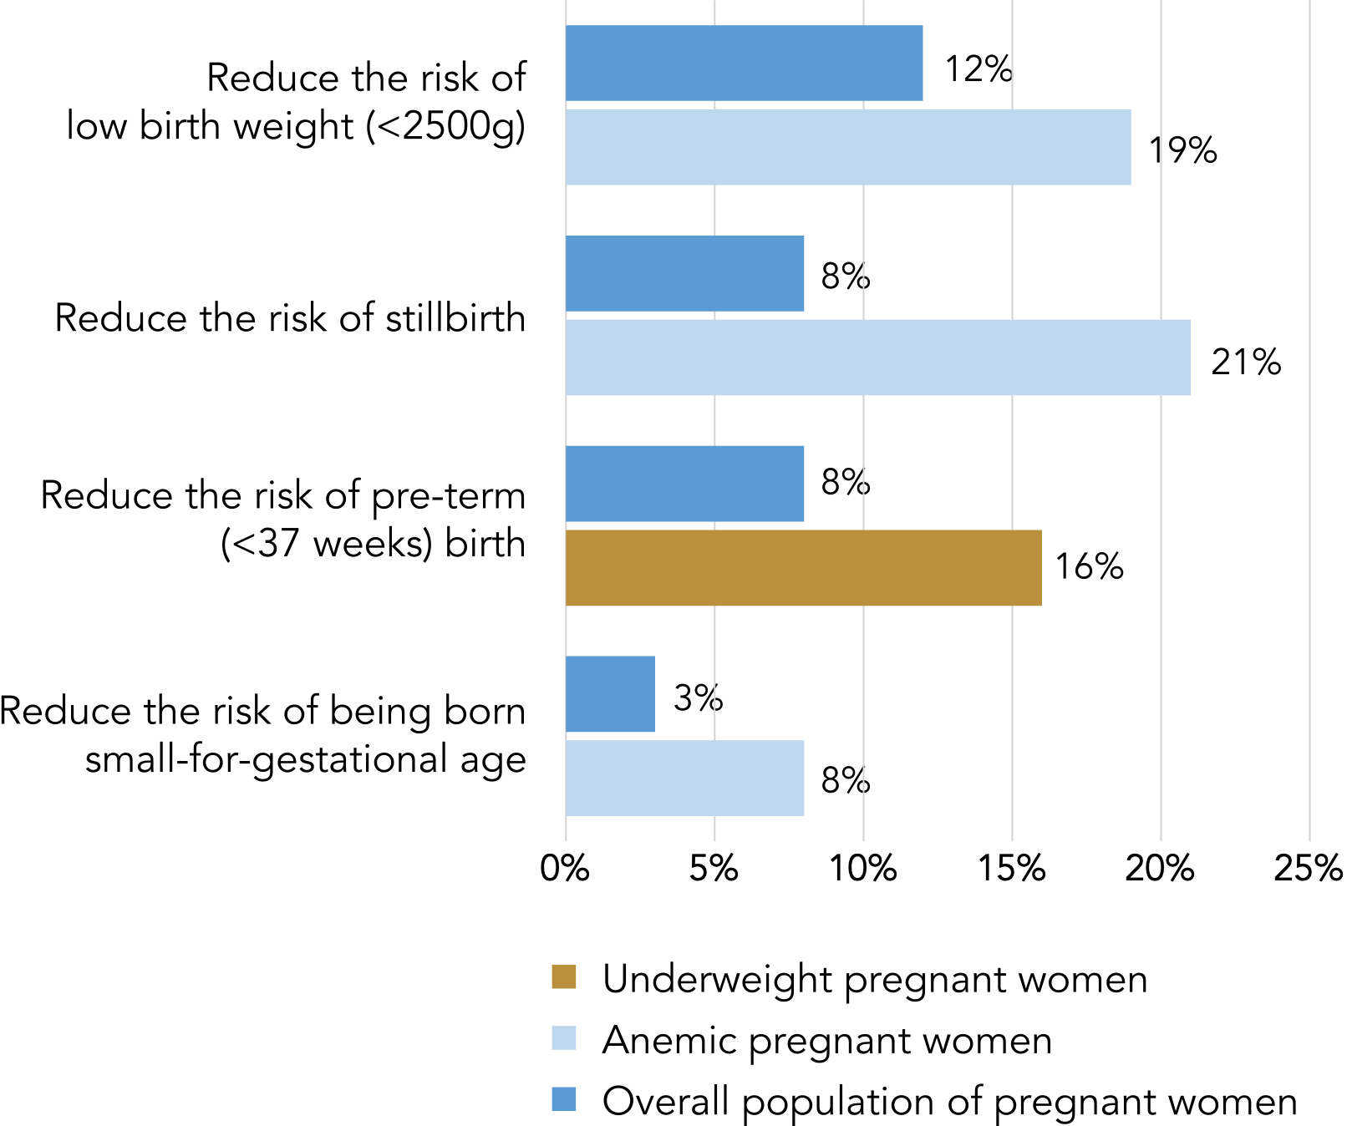
MMS is effective
  Strong evidence shows
  MMS improves maternal nutrition and reduces the risk of adverse birth outcomes.
  In fact, MMS provides even greater benefit for anemic women and underweight women compared
  to IFA.
Additionally, MMS reduces the risk of female infant mortality in the first 6 months by 15%. If the mother is anemic, the reduction in risk is 29%.
Source: Smith et al, 2017. Modifiers of the effect of maternal multiple micronutrient supplementation on stillbirth, birth outcomes, and infant mortality: a meta-analysis of individual patient data from 17 randomised trials in low-income and middle-income countries. Lancet Global Health.
Notes:
Speaker Talking Points:
MMS has been consistently shown to improve maternal nutrition and reduce the risk of adverse birth outcomes including preterm birth, stillbirth, low birth weight, and small for gestational age.
For children born to underweight and anemic mothers the benefits of MMS are even more pronounced.

Slide 14


MMS is safe
  While stomach problems are common for pregnant women, data shows there are no significant difference in reported side effects between IFA or MMS.
  No known evidence of serious adverse effects.
  In trials, there was no difference in adherence to IFA versus MMS.
Sources: Source: Bourassa et al. 2019. Review of the evidence regarding the use of antenatal multiple micronutrient supplementation in low- and middle-income countries. Annals of the New York Academy of Sciences.
WHO antenatal care recommendations for a positive pregnancy experience. July 2020. Nutritional interventions update: multiple micronutrient supplements during pregnancy. WHO.
Notes:
Speaker Talking Points:
MMS is proven to be safe:
It is common for pregnant women to experience stomach problems, such as constipation, heartburn, vomiting, and nausea. However, data shows there are no significant difference in reported side effects between IFA or MMS.
Minor side effects can be avoided by counselling women to take MMS with food.
Daily MMS will not cause women to receive excess micronutrients, even if they have a healthy diet already.

Slide 15


MMS is affordable and cost-effective
  Countries can calculate the value of switching from IFA to MMS using Nutrition International’s cost-benefit tool.
  MMS is a cost-effective antenatal care intervention.
  MMS is affordable. Efforts are underway to improve local manufacturing capacity and increase MMS supply – which could drive the cost down even further.
Source: HMHB Consortium website
Notes:
Speaker Talking Points:
Besides the scientific evidence on the reduction of adverse birth outcomes, MMS is also affordable and cost-effective.
Nutrition International developed a cost-benefit tool to calculate the incremental benefits and costs of transitioning from IFAS to MMS in various countries (Kashi et al., 2018). With this tool, you can construct and test different scenarios and see analytics on different health outcomes, including the impact on disability-adjusted life years (DALYs).
Global costs range from 0.01 US$ to 0.037 US$ per tablet depending on packaging (lowest price equals 180 pills in a bottle / highest price equals 30 pills in a blister pack.)
Efforts are underway to improve local manufacturing and increase MMS supply – which could drive the cost down even further.

Slide 16

Global impact of MMS
Transitioning from IFA to MMS can avert over 250,000 child deaths and nearly 25 million disabilities (DALYs) over 10 years, across 33 LMICs (30% coverage).
Scaling up MMS to 90% coverage is projected to contribute to huge human capital gains for all babies born per year across 132 LMICs:
+ 5 million additional school years
+ 18 billion USD in cumulative lifetime income
Source:
Verney et al. 2023. Multiple micronutrient supplementation cost-benefit tool for informing maternal nutrition policy and investment decisions. Matern Child Nutr. 9(4):e13523.
Perumal et al. 2021. Impact of scaling up prenatal nutrition interventions on human capital outcomes in low-and middle-income countries: a modeling analysis. American Journal of Clinical Nutrition. 114(5):1708-1718
Notes:
Speaker Talking Points:
The global impact of transitioning from IFA to MMS is significant.
Using the NI tool estimated that transitioning from IFA to MMS could potentially avert over 250,000 child deaths and avert nearly 25 million DALYs over 10 years, even with a conservative 30% coverage of pregnant women.
Another study showed that investing in prenatal nutrition interventions — such as providing iron-folic acid, calcium, balanced energy-protein supplementation, or multiple micronutrient supplements — could equate to billions of dollars through gains in school years and lifetime income.
If MMS were to reach 90% of pregnant women across 132 LMICs, then it is estimated that an additional 5.02 million school years and $18.1 billion in cumulative lifetime income would be gained. IFA is another example, for which the gain would respectively be 2.28 million school years and $8.26 billion.

Slide 17
Antenatal Care (ANC) Services
MMS must be included in a package of antenatal maternal nutrition interventions for populations, including:
Supplementation
  Multiple micronutrient supplements
  Maternal calcium supplements
  Balanced-energy protein (BEP) supplements
Nutrition Counseling
  Healthy weight gain
  Increased energy and protein intake
  Diverse diet (including fortified foods)
Source: The Lancet Series on Maternal and Child Undernutrition Progress (2021)
Notes:
Speaker Talking Points:
To fully address maternal malnutrition, we must invest in quality delivery of a package of antenatal care services to enhance health and well-being of the mother, avoid adverse birth outcomes and reduce maternal, infant and child mortality.
MMS is a mighty tablet and needs to be a central part of that package. But it is not a magic bullet.

Slide 18
MMS implementation across the world
 | Information on MMS available - no active implementation
 | Exploration phase to build an MMS enabling environment
 | Initial implementation supported by implementation research
 | Scale-up MMS delivery at the national or sub-national level
Source: https://hmhbconsortium.org/world-map/
Notes:
Speaker Talking Points:
The Healthy Mothers Healthy Babies Consortium keeps track of MMS-related activities on a “World Map on MMS Activities”. This map illustrates where MMS implementation is being explored, where implementation research is ongoing in the initial implementation stage or where MMS is being scaled up to national or subnational level (not currently the case yet).
Clicking on countries takes users to pages with more information on the status of MMS activities in that country.

Slide 19
Next Steps
TEMPLATE to be adapted. Remove this box once updated.
Optional slide to add next step or key takeaways

Slide 20
Keep In Touch
TEMPLATE to be adapted. Remove this box once updated.
Optional slide to add website URL, social handles, and/or email address.

Slide 21
Key publications
Bloem et al, 2007. Preventing and controlling micronutrient deficiencies in populations affected by an emergency. WHO, WFP, UNICEF.
Smith et al, 2017. Modifiers of the effect of maternal multiple micronutrient supplementation on stillbirth, birth outcomes, and infant mortality: a meta-analysis of individual patient data from 17 randomised trials in low-income and middle-income countries. Lancet Global Health.
Prado et al, 2017. Maternal multiple micronutrient supplementation and other biomedical and socio environmental influences on children’s cognition at age 9-12 years in Indonesia: follow up of the SUMMIT randomised trial.
WHO antenatal care recommendations for a positive pregnancy experience. July 2020. Nutritional interventions update: multiple micronutrient supplements during pregnancy. World Health Organization.
Perumal et al. July 2021. Impact of scaling up prenatal nutrition interventions on human capital outcomes in low-and middle-income countries: a modeling analysis. American Journal of Clinical Nutrition.
May 2020. Use of MMS for maternal nutrition and birth outcomes during COVID-19. MMS TAG.
Dalmiya et al. January 2022. Maternal Nutrition: Prevention of malnutrition in women before and during pregnancy and while breastfeeding. UNICEF.
Gomes et al, 2022. Multiple micronutrient supplements vs iron-folic acid supplements and maternal anemia outcomes: an iron dose analysis. Ann. N.Y. Acad. Sci.
Gomes et al, 2022. Effect of multiple micronutrient supplements vs iron and folic acid supplements on neonatal mortality: a reanalysis by iron dose. Public Health Nutr.

Slide 22
Healthy Mothers Healthy Babies resources
HMHB Knowledge Hub
HMHB Knowledge Bytes
HMHB MMS Interactive World Map
HMHB FAQ and Advocacy Brief on the Inclusion of MMS on the Essential Medicine List
HMHB Launch Video
HMHB Commitment-making Guide for Nutrition for Growth
Watch the HMHB Powering Women, Promising Futures Nutrition for Growth side event
Maternal Nutrition in Focus: HMHB at FIGO 2021 World Conference
Join us! Visit www.hmhbconsortium.org to become a member.

Slide 23
Join the Consortium at
HMHBconsortium.org
Contact us
HMHB@micronutrientforum.org
Follow us
@hmhbconsortium
Notes:
This presentation has been prepared by the Healthy Mothers Heathy Babies Consortium. Our goal is to ensure 75 million more pregnant women have access to MMS by 2030 so that mothers and babies can reach their full potential. For more information, visit our website, follow us on social media, and contact us at this email address.

