Slide 1

Advancing Multiple Micronutrient Supplementation
Module B: Global scope of maternal malnutrition

Slide 2



How to use this slide deck
Facilitate dialogue & create consensus
  View these slides as a resource for anyone wanting to communicate the evidence and benefits of MMS for pregnant women and their babies. Our goal is to equip the presenter of these slides with key messages that can be delivered to decision makers or to those considering piloting, scaling, and implementation of MMS.
Customize dialogue
  Speaker notes are provided with each slide, but they are not intended to be read word-for-word. Tailor and add your own speaking notes to make this relevant for your audience.
ADAPT to Your Audience
  Content in red font should be tailored, then updated to black font. Slides labeled ‘National impact and investment case’ should be tailored with data and statistics from your country and made relevant for your audience. Slides or entire sections can be removed or re-ordered. Additional resources can be found at the end of the presentation.
We’d like to hear from you! Contact HMHBConsortium@micronutrientforum.org if you have questions or would like additional support.​
Notes:
Please review the instructions on this slide for how to use/customize this presentation. Then, remove this slide before presenting.

Slide 3




Audiences for this slide deck
Advocates & Public Health Professionals
  Suggested sections include A-E
This presentation provides an overview of maternal nutrition and the evidence on multiple micronutrient supplements (MMS), providing key messages and slides that can be tailored with country-specific data to support the introduction, piloting, and scaling of MMS.
You may wish to include (or omit) specific sections of the presentation. Suggested sections for each audience are included here. See the section descriptions on Slide 5.
National health officials & NGOS
  Suggested sections include A-E
Research & Academia
  Suggested sections include B-D
Local providers & Distributors
  Suggested sections include B
Notes:
Please review the instructions on this slide for how to use/customize this presentation. Then, remove this slide before presenting.

Slide 4
Meeting Objectives
TEMPLATE to be adapted. Remove this box once updated.
Optional slide to add meeting agenda and/or objectives
Notes:
This is a placeholder slide for the speaker’s welcome and introduction. Add in an overview of meeting objectives and/or agenda here.

Slide 5
Sections
A. Pregnancy and nutrition
Slides 6 - 18
B. Global scope of maternal malnutrition
Slides 19 - 24
C. Evidence on multiple micronutrient supplements
Slides 25 - 37
D. National impact and investment case
Slides 38 - 45
E. Introducing and scaling MMS
Slides 46 - 61
Notes:
Speaker may present each section or skip ahead to the relevant section(s) for the audience.

Slide 6
Global scope of maternal malnutrition
Notes:
Section B
Speaker Talking Points:
In this section, we will explain:
The scope of the problem of maternal malnutrition on a global scale – how many women and children are affected
How the consequences impact us all
Why a global commitment to tackle maternal malnutrition is so important

Slide 7




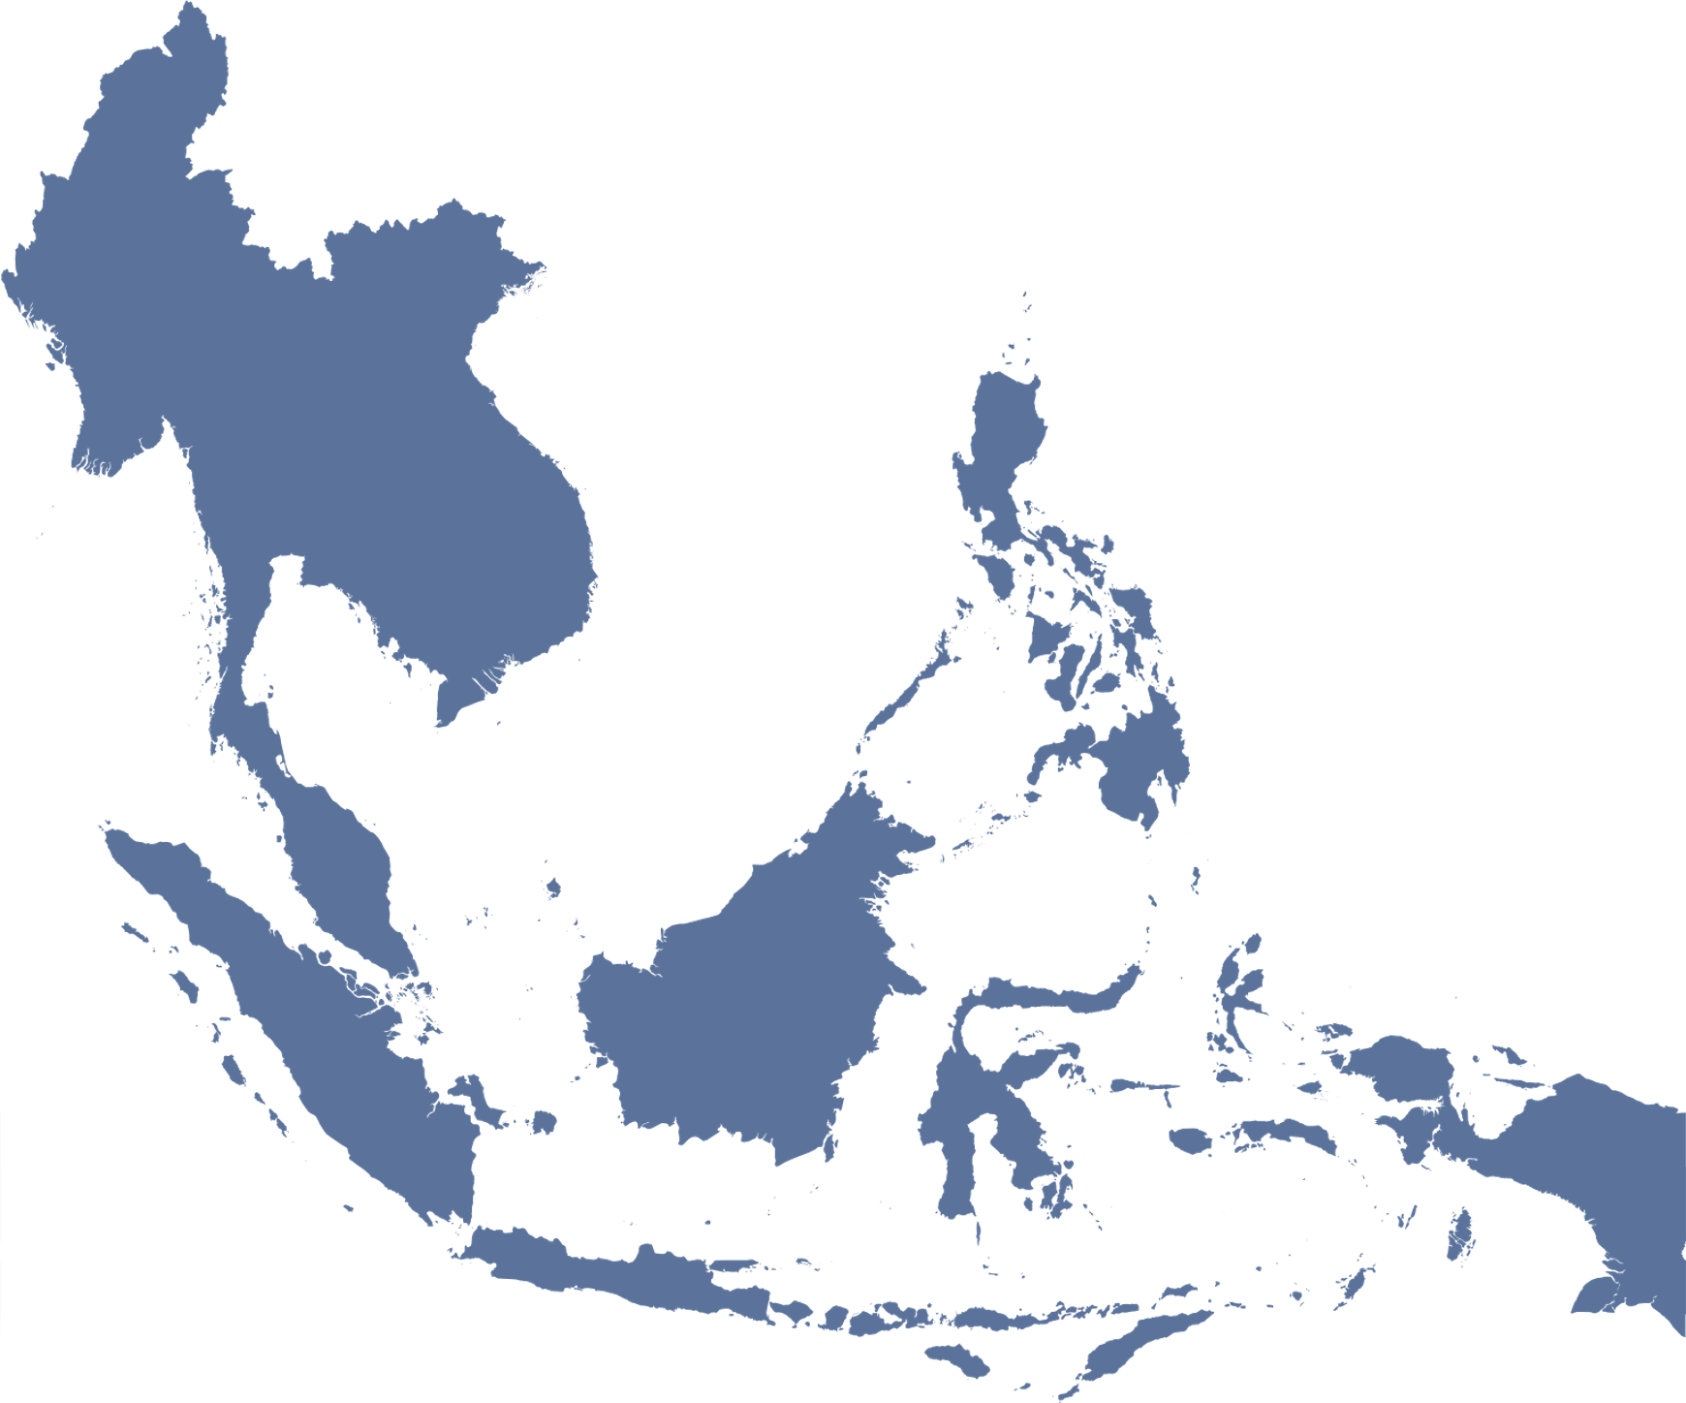
Globally, many women lack access to nutritious diets…
170 million women – 1 in 10 – of
reproductive age are underweight.
570 million women – 1 in 3 – of
reproductive age are anemic.
In South/Southeast Asia,
stunting (short stature)
affects 35% of women.
Sources: WHO Global Health Observatory Indicators website
Dalmiya et al, 2022. UNICEF Programming Guidance. Prevention of malnutrition in women before and during pregnancy and while breastfeeding. United Nations Children’s Fund.
Bourassa et al. 2019. Review of the evidence regarding the use of antenatal multiple micronutrient supplementation in low- and middle-income countries. Annals of the New York Academy of Sciences.
Notes:
Speaker Talking Points:
Maternal malnutrition has three main indicators:
1) Low body mass index (BMI): Underweight pregnant women face a greater risk of preterm delivery.
2) Anemia: Children born to anemic mothers are more likely to be born too early or too small and face an increased risk of death.
3) Stunting (which means short stature) is an indicator of malnutrition, which leads to serious risks for women’s health and increases the risk their child will be born stunted.
Remember that a woman can be obese and still be malnourished.

Slide 8




…and lack access to quality health
& nutrition services
Only 38% of women receive 90+ iron folic acid (IFA) tablets during their pregnancy.
Only 59% of pregnant women attend 4 antenatal care (ANC) visits. Since 2016, WHO recommends 8 ANC contacts, which further increases the gap.
Each year, 20 million babies suffer from low birthweight (LBW), an early marker of poor maternal and fetal nutrition.
Due to COVID-19, access to quality diets and services is decreasing leading to “worst case scenarios”.
Sources: Dalmiya et al, 2022. UNICEF Programming Guidance. Prevention of malnutrition in women before and during pregnancy and while breastfeeding. United Nations Children’s Fund.
Osendarp et al. 2021. The COVID-19 crisis will exacerbate maternal and child undernutrition and child mortality in low- and middle-income countries. Nat Food.
Notes:
Speaker Talking Points:
Globally, many women of reproductive age lack access to quality diets and nutrition services.
The COVID-19 pandemic has already compounded this lack of access. Stand 4 Nutrition Consortium projects that child malnutrition may reach the most ‘pessimistic’ estimated levels, with an additional:
283,000 child deaths over the next 3 years (250 child deaths per day)
13.6 million wasted children with high risks of death
3.6 million children with life-long physical and cognitive impairments due to stunting
4.8 million more women afflicted with anemia.

Slide 9



Poor maternal nutrition has dire consequences for communities and the world
  The economic consequences of poor nutrition can affect an individual for 30+ years and their families for generations.
  Good nutrition is linked to improved school performance and increased productivity. This leads to long-term economic benefits on individual, national, and global scales.
  Investing in nutrition could reach USD $5.7 trillion a year in economic gains to society by 2030.
Source: Halim et al, 2015. The economic consequences of selected maternal and child nutrition interventions in low- and middle- income countries: A systematic review of recent literature, 2000–2013. BMC Women’s Health.
Notes:
Speaker Talking Points:
Poor nutrition in infancy and childhood leads to economic disadvantages for the individual lasting more than 30 years and spanning across generations.
The reverse is true too: good nutrition is linked to better cognition, which translates to improved school performance and increased productivity.
Good nutrition leads to long-term economic benefits on individual, national, and global scales.
Investing in nutrition could reach USD $5.7 trillion a year in economic gains to society by 2030.

Slide 10

Improving maternal malnutrition is possible when we invest in women and deliver a package of evidence-based maternal nutrition interventions.
Notes:
Speaker Talking Points:
There is global consensus that we must tackle malnutrition and hunger urgently. This goal is within reach as long as we invest in and deliver a package of evidence-based maternal nutrition interventions to enhance health and well-being of women and reduce maternal, neonatal and child mortality.
2030 United Nations’ Sustainable Development Goals: A global commitment to tackle undernutrition and hunger by 2030 is part of the United Nations’ Sustainable Development Goals (SDGs)
2025 World Health Assembly (WHA) Targets: WHA endorsed a plan on maternal, infant and young child nutrition, which specified a set of six global nutrition targets that by 2025 aim to:
achieve a 40% reduction in the number of children under 5 who are stunted;
achieve a 50% reduction of anemia in women of reproductive age;
achieve a 30% reduction in low birth weight;
ensure that there is no increase in childhood obesity;
increase the rate of exclusive breastfeeding in the first 6 months up to at least 50%;
reduce and maintain childhood wasting to less than 5%.
https://www.who.int/publications/i/item/WHO-NMH-NHD-14.2

Slide 11
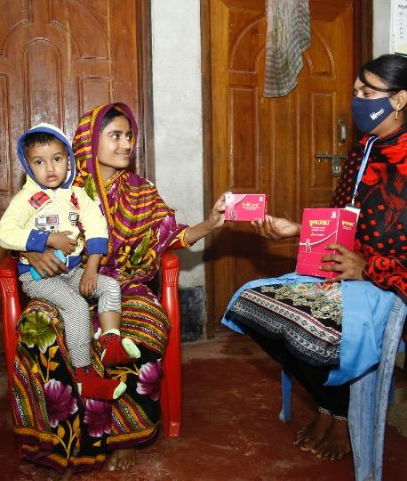
Multiple micronutrient supplements (MMS), commonly referred to as prenatal multivitamins, are one of the most impactful nutrition interventions that significantly improves maternal health and
birth outcomes.
Notes:
Speaker Talking Points:
Multiple Micronutrient Supplements (MMS) need to be a central part of that package as it is an effective, cost-effective, safe, and affordable intervention for malnourished women with poor diets.
In the next section, we will walk through the evidence to explain why MMS is such a critical intervention.

Slide 12
Next Steps
TEMPLATE to be adapted. Remove this box once updated.
Optional slide to add next step or key takeaways

Slide 13
Keep In Touch
TEMPLATE to be adapted. Remove this box once updated.
Optional slide to add website URL, social handles, and/or email address.

Slide 14
Key publications
Bloem et al, 2007. Preventing and controlling micronutrient deficiencies in populations affected by an emergency. WHO, WFP, UNICEF.
Smith et al, 2017. Modifiers of the effect of maternal multiple micronutrient supplementation on stillbirth, birth outcomes, and infant mortality: a meta-analysis of individual patient data from 17 randomised trials in low-income and middle-income countries. Lancet Global Health.
Prado et al, 2017. Maternal multiple micronutrient supplementation and other biomedical and socio environmental influences on children’s cognition at age 9-12 years in Indonesia: follow up of the SUMMIT randomised trial.
WHO antenatal care recommendations for a positive pregnancy experience. July 2020. Nutritional interventions update: multiple micronutrient supplements during pregnancy. World Health Organization.
Perumal et al. July 2021. Impact of scaling up prenatal nutrition interventions on human capital outcomes in low-and middle-income countries: a modeling analysis. American Journal of Clinical Nutrition.
May 2020. Use of MMS for maternal nutrition and birth outcomes during COVID-19. MMS TAG.
Dalmiya et al. January 2022. Maternal Nutrition: Prevention of malnutrition in women before and during pregnancy and while breastfeeding. UNICEF.
Gomes et al, 2022. Multiple micronutrient supplements vs iron-folic acid supplements and maternal anemia outcomes: an iron dose analysis. Ann. N.Y. Acad. Sci.
Gomes et al, 2022. Effect of multiple micronutrient supplements vs iron and folic acid supplements on neonatal mortality: a reanalysis by iron dose. Public Health Nutr.

Slide 15
Healthy Mothers Healthy Babies resources
HMHB Knowledge Hub
HMHB Knowledge Bytes
HMHB MMS Interactive World Map
HMHB FAQ and Advocacy Brief on the Inclusion of MMS on the Essential Medicine List
HMHB Launch Video
HMHB Commitment-making Guide for Nutrition for Growth
Watch the HMHB Powering Women, Promising Futures Nutrition for Growth side event
Maternal Nutrition in Focus: HMHB at FIGO 2021 World Conference
Join us! Visit www.hmhbconsortium.org to become a member.

Slide 16
Join the Consortium at
HMHBconsortium.org
Contact us
HMHB@micronutrientforum.org
Follow us
@hmhbconsortium
Notes:
This presentation has been prepared by the Healthy Mothers Heathy Babies Consortium. Our goal is to ensure 75 million more pregnant women have access to MMS by 2030 so that mothers and babies can reach their full potential. For more information, visit our website, follow us on social media, and contact us at this email address.

